Slide 1
SMART SCALE FY 2026 (Round 6) Results
Brooke Jackson, P.E. – SMART SCALE Program Manager
Office of Intermodal Planning and Investment
January 14, 2025

Slide 2
SMART SCALE FY 2026 Results Agenda
Process Overview
FY 2026 Funding Distribution
FY 2026 Staff Recommended Scenario by District
Next Steps

Slide 3
History and Purpose
PROCESS OVERVIEW
SMART SCALE was created to improve the transparency and accountability of project selection and stabilize the Six-Year Improvement Program
Effective July 1, 2014 (Virginia House Bill 2, defined in § 33.2-214.1), required developing a prioritization process that the CTB was to use for project selection by July 2016.
Needed to remove the political element and select projects that bring the best value
It reformed Virginia’s transportation programming process by requiring the use of a data-driven, outcome-based prioritization process
SMART SCALE has improved the transparency and accountability of project selection
The process scores projects based on an objective and fair analysis that is applied statewide
SMART SCALE is a tool to help CTB select projects that provide the greatest benefits for tax dollars spent

Slide 4
Virginia Code§ 33.2-214.1
PROCESS OVERVIEW
Benefit-Cost Relationship
Six Factor Areas Required (SCALE) – safety, congestion mitigation, accessibility, land use*, economic development, and environmental quality
Multi-Modal Project Evaluation – must consider highway, transit, rail, roadway, technology operational improvements, and transportation demand management strategies
Meet a VTrans Need
Projects must be fully funded when added to the SYIP
*Note: Land Use is required in populations over 200,000 defined in the 6th enactment clause

Slide 5
Virginia Code§ 33.2-214.1, Cont’d
PROCESS OVERVIEW
No later than 150 days prior to a vote to include projects or strategies evaluated in the Six-Year Improvement Program, the Office of Intermodal Planning and Investment shall make public, in an accessible format,
(i) a recommended list of projects and strategies for inclusion in the Six-Year Improvement Program based on the results of such evaluation;
(ii) the results of the screening of candidate projects and strategies, including whether such projects are located on a primary evacuation route;
(iii) whether a project has been designed to be or the project sponsor has committed that the design will be resilient; and
(iv) the results of the evaluation of candidate projects and strategies, including the weighting of factors and the criteria used to determine the value of each factor.

Slide 6
Implemented Improvements from 2023 SMART SCALE Review
PROCESS OVERVIEW
Administrative Improvements
Applications pass readiness gates before submission to improve quality and reduce staff resources
Considering applicant delivery performance in final Board consensus funding decisions
Policy Improvements
Clarified High-Priority Projects Program (HPP) definition to ensure projects are of statewide or regional significance by
refining the definition to include “what” type of projects are eligible
distributing all HPP program funds based on statewide rankings of SMART SCALE scores, rather than districtwide rankings
Reduced the influence of the one-factor majority of the Land Use factor by making it multiplier of all other factor areas and modifying the other factor weightings
Applied a forward-looking congestion benefit for 7 years in the future, to better align with project design requirements that are based on future growth volumes and consider future economic growth
Incorporate key economic priorities of the Commonwealth to reflect best-in-class economic impact assessments used by VEDP

Slide 7
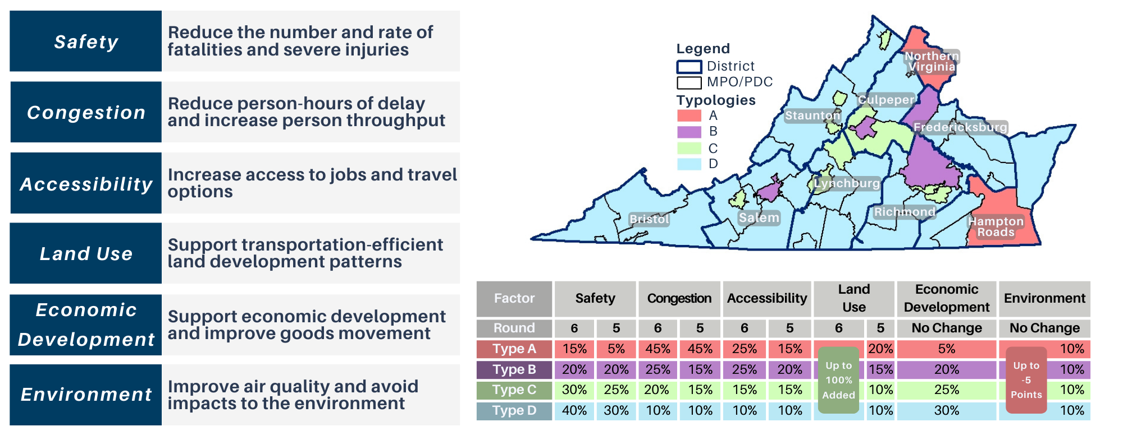
Implemented Improvements from 2023 SMART SCALE Review Evaluation Factors and Weighting
PROCESS OVERVIEW

Slide 8
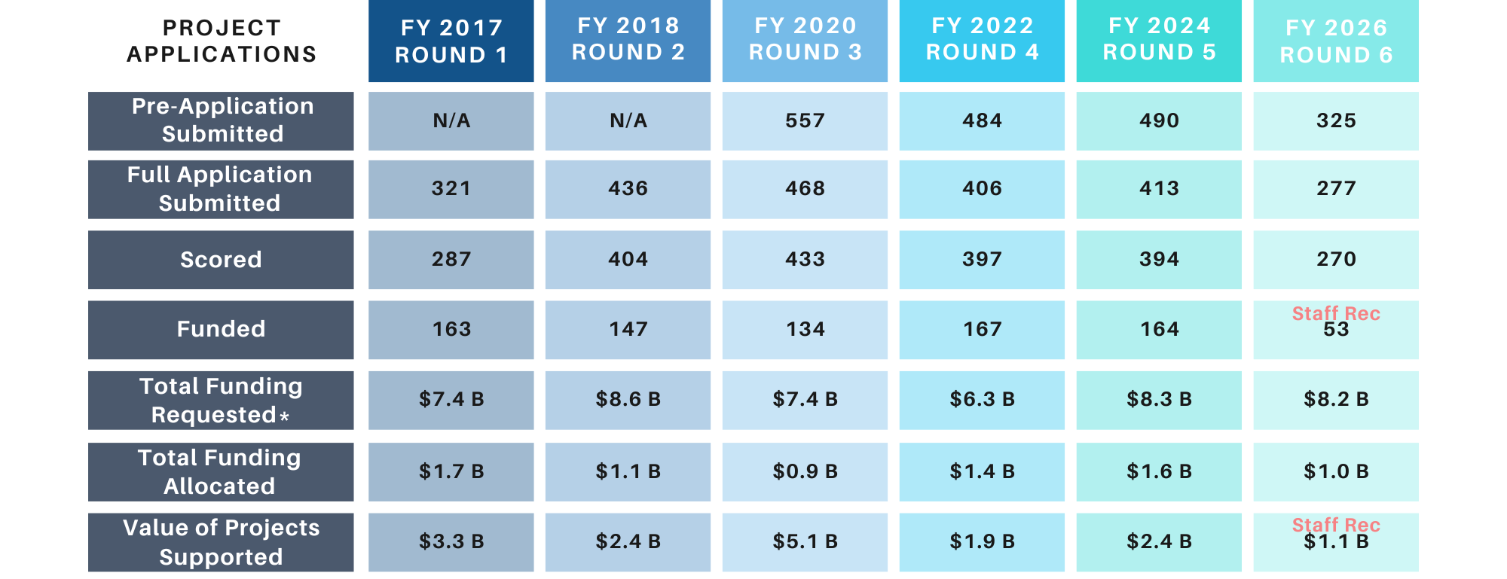
SMART SCALE FY 2026 (Round 6) Summary and Comparison to Prior Rounds
PROCESS OVERVIEW
*Total of scored applications funding requested

Slide 9
Funding Distribution for FY 2026 (Round 6) – $ in millions
FY 2026 FUNDING DISTRIBUTION
Draft allocations for HPP and DGP represent the best-case scenario
Full financial impact of emergency response (Helene and snow) for FY 2025 is uncertain based on activity to date for VDOT
Spending in the coming months will determine if a revision to the current year budget is necessary (By May 2025)
District | DGP Available | Previous DGP Cost Increases | HPP Available
Bristol | $37.0
Culpeper | $68.0 | -$6.6
Fredericksburg | $76.2
Hampton Roads | $121.6
Lynchburg | $85.9
Northern Virginia | $97.4
Richmond | $104.9
Salem | $64.3
Staunton | $39.4 | -$6.0
Statewide HPP |  |  | $384.7
Total | $694.6 |  | $384.7

Slide 10
Project Selection Process
FY 2026 FUNDING DISTRIBUTION
Step 1 – Fund top-scoring projects within each district eligible for Highway Construction District Grant Program (DGP) funds using DGP funds until the remaining funds are insufficient to fund the next highest-scoring project.
DGP eligibility pertains only to localities addressing a VTrans need
Step 2 – Fund remaining top-scoring projects statewide that are eligible for Highway High-Priority Projects Program (HPP) funds using HPP funds until the remaining funds are insufficient to fund the next highest-scoring project.
HPP eligibility pertains to localities, transit agencies, and regional entities addressing a VTrans need on either a Corridor of Statewide Significance (CoSS) or a Regional Network (RN), and refined policy definitions

Slide 11
Staff Recommended Funding Scenario Summary - $ in millions
FY 2026 FUNDING DISTRIBUTION
Step 1
Step 2
District | Number of Applications | DGP Available | Previous DGP Cost Increases | HPP Available | DGP Allocated | DGP Remaining | HPP Allocated | HPP Remaining | Funded in Staff Scenario | Total Allocated
Bristol | 20 | $37.0 |  |  | $27.2 | $9.8 | $0.0 |  | 3 | $27.2
Culpeper | 24 | $68.0 | -$6.6 |  | $57.0 | $4.3 | $36.4 |  | 4 | $93.5
Fredericksburg | 34 | $76.2 |  |  | $73.5 | $2.7 | $16.8 |  | 4 | $90.3
Hampton Roads | 31 | $121.6 |  |  | $111.9 | $9.7 | $27.3 |  | 11 | $139.2
Lynchburg | 12 | $85.9 |  |  | $82.4 | $3.5 | $0.0 |  | 4 | $82.4
Northern Virginia | 23 | $97.4 |  |  | $88.7 | $8.8 | $0.0 |  | 4 | $88.7
Richmond | 65 | $104.9 |  |  | $82.6 | $22.2 | $255.8 |  | 14 | $338.5
Salem | 34 | $64.3 |  |  | $53.9 | $10.3 | $0.0 |  | 3 | $53.9
Staunton | 27 | $39.4 | -$6.0 |  | $25.3 | $8.1 | $44.7 |  | 6 | $69.9
Statewide HPP |  |  |  | $384.7
Total | 270 | $694.6 |  | $384.7 | $602.5 | $79.5 | $381.0 | $3.6 | 53 | $983.6
Starting Total | $1,079.3
Remaining Total | $83.1

Slide 12
Summary of Principal Improvement Type - $ in millions
FY 2026 FUNDING DISTRIBUTION
Principal Improvement Type | Applications Scored | Request | Percent of Request | Funded in Staff Scenario | Funding Allocated | Percent of Funded
Highway | 219 | $7,216.5 | 88.3% | 43 | $855.2 | 87.0%
Bike/Pedestrian | 47 | $805.8 | 9.9% | 8 | $94.3 | 9.6%
Bus Transit | 3 | $133.5 | 1.6% | 2 | $34.0 | 3.5%
TDM | 1 | $13.7 | 0.2% | 0 | $0.0 | 0.0%
Rail Transit | 0 | $0.0 | 0.0% | 0 | $0.0 | 0.0%
Rail Freight | 0 | $0.0 | 0.0% | 0 | $0.0 | 0.0%
Grand Total | 270 | $8,169.6 |  | 53 | $983.6

Slide 13
Staff Recommended Scenario - Bristol
FY 2026 STAFF RECOMMENDED SCENARIO BY DISTRICT
Application ID | Project | Organization | Total Cost | SMART SCALE Request | SMART SCALE Score | Step Funded
11745 | US 23 at Wise-Norton Road (Route 757) Turn Lane Improvement | Wise County | $5,315,212 | $5,315,212 | 12.08 | DGP
11589 | Route 75 at Green Springs Church Road Turn Lane Improvements | Washington County | $11,456,597 | $11,456,597 | 7.54 | DGP
11735 | Cummings St at US 11 and Remsburg Dr Improvements | Abingdon Town | $10,411,602 | $10,411,602 | 4.21 | DGP
 | Total Staff Recommended - 3 | Total | $27,183,411 | $27,183,411

Slide 14
Staff Recommended Scenario - Culpeper
FY 2026 STAFF RECOMMENDED SCENARIO BY DISTRICT
Application ID | Project | Organization | Total Cost | SMART SCALE Request | SMART SCALE Score | Step Funded
11573 | Rt. 229, Rt.694 Double Lane Roundabout | Culpeper County | $22,963,251 | $22,963,251 | 7.47 | DGP
11794 | Ira Hoffman Roundabout | Culpeper Town | $20,941,406 | $20,941,406 | 6.70 | DGP
11487 | US250/Peter Jeff. Pkway and Rolkin Road Pipeline Bundle | Charlottesville-Albemarle MPO | $36,406,798 | $36,406,798 | 6.70 | HPP
11732 | Lee Highway and Branch Avenue Intersection Improvement | Warrenton Town | $13,140,255 | $13,140,255 | 5.60 | DGP
 | Total Staff Recommended - 4 | Total | $93,451,710 | $93,451,710

Slide 15
Staff Recommended Scenario – Fredericksburg
FY 2026 STAFF RECOMMENDED SCENARIO BY DISTRICT
Application ID | Project | Organization | Total Cost | SMART SCALE Request | SMART SCALE Score | Step Funded
11663 | Paige and Marye Route 1 Intersection | Caroline County | $7,085,483 | $7,085,483 | 27.71 | DGP
11661 | Turn Lanes at Lake Caroline | Caroline County | $9,043,110 | $9,043,110 | 10.23 | DGP
11640 | Rt 3 Pipeline Old Plank Road to Salem Church Rd | George Washington RC | $16,803,447 | $16,803,447 | 6.43 | HPP
11624 | US Rte.1 Southpoint Pkwy Intersection Improvements | Spotsylvania County | $68,659,081 | $57,371,621 | 5.65 | DGP
 | Total Staff Recommended - 4 | Total | $101,591,121 | $90,303,661

Slide 16
Staff Recommended Scenario – Hampton Roads
FY 2026 STAFF RECOMMENDED SCENARIO BY DISTRICT
Application ID | Project | Organization | Total Cost | SMART SCALE Request | SMART SCALE Score | Step Funded
11807 | US Rt 17 Widening Phase 1 Lane Extension @ State Rt 669 | Isle of Wight County | $15,913,234 | $13,910,234 | 23.35 | DGP
11560 | STARS - Jefferson Corridor Improvements | Newport News City | $10,882,866 | $10,882,866 | 16.50 | DGP
11561 | Warwick Blvd & Colony Dr Intersection Improvements | Newport News City | $4,762,574 | $4,762,574 | 14.73 | DGP
11743 | Project Pipeline HR-23-06: Monticello Ave Spot Improvements | Norfolk City | $7,567,531 | $7,567,531 | 14.31 | DGP
11699 | Crosswalks on Merrimac Trail at 2nd St. and Penniman Rd. | York County | $1,825,592 | $1,825,592 | 9.20 | DGP
11559 | Jefferson & J. Clyde Morris Blvd Intersection Improvements | Newport News City | $21,403,026 | $21,403,026 | 8.43 | DGP
11791 | Project Pipeline HR04 Military Highway | Norfolk City | $4,506,963 | $4,506,963 | 8.15 | DGP
11683 | Little Creek Road Bicycle Improvements | Norfolk City | $5,419,436 | $5,419,436 | 6.16 | DGP
11812 | Northampton Segment: Eastern Shore of Virginia Rail Trail | Northampton County | $17,814,640 | $17,814,640 | 5.88 | DGP
11671 | Virginia Beach Trail Phase IV | Virginia Beach City | $23,792,343 | $23,792,343 | 4.45 | DGP
11811 | Rt 17 Widening Phase 2 | Isle of Wight County | $27,334,264 | $27,334,264 | 3.96 | HPP
 | Total Staff Recommended - 11 | Total | $141,222,469 | $139,219,469

Slide 17
Staff Recommended Scenario – Lynchburg
FY 2026 STAFF RECOMMENDED SCENARIO BY DISTRICT
Application ID | Project | Organization | Total Cost | SMART SCALE Request | SMART SCALE Score | Step Funded
11691 | Orphanage Road and Franklin Turnpike Traffic Signal | Pittsylvania County | $5,973,029 | $5,973,029 | 18.91 | DGP
11471 | Route 151 at Tanbark Drive Roundabout | Nelson County | $12,693,049 | $12,693,049 | 2.52 | DGP
11493 | Timberlake Road Improvements (Greenview Dr. to Laxton Rd.) | Campbell County | $33,364,620 | $33,364,620 | 1.71 | DGP
11492 | Route 29 Safety Improvements - Southern Section | Campbell County | $30,407,170 | $30,407,170 | 1.51 | DGP
 | Total Staff Recommended - 4 | Total | $82,437,868 | $82,437,868

Slide 18
Staff Recommended Scenario – Northern Virginia
FY 2026 STAFF RECOMMENDED SCENARIO BY DISTRICT
Application ID | Project | Organization | Total Request | SMART SCALE Request | SMART SCALE Score | Step Funded
11496 | Duke St and Route 1 Intersection Improvements | Alexandria City | $6,577,065 | $6,577,065 | 18.90 | DGP
11577 | US 50 at VA 27 Interchange Access Improvements | Arlington County | $32,348,376 | $32,348,376 | 7.56 | DGP
11475 | US 29 (Lee Highway) Corridor Improvements | Prince William County | $40,463,612 | $40,463,612 | 4.60 | DGP
11469 | Cascades Pkwy Bike &Ped (Church Rd. to Victoria Station Dr) | Loudoun County | $13,932,841 | $9,296,841 | 3.94 | DGP
 | Total Staff Recommended - 4 | Total | $93,321,894 | $88,685,894

Slide 19
Staff Recommended Scenario – Richmond
FY 2026 STAFF RECOMMENDED SCENARIO BY DISTRICT
Application ID | Project | Organization | Total Cost | SMART SCALE Request | SMART SCALE Score | Step Funded
11598 | Fairground Rd/Maidens Rd Roundabout | Goochland County | $8,465,347 | $5,175,347 | 22.24 | DGP
11596 | Rte 288 - New SB Auxiliary Lane South of U.S. 250 | Goochland County | $21,937,569 | $14,437,569 | 17.82 | DGP
11656 | W Broad St & Glenside Dr Intersection Improvements | Henrico County | $12,199,788 | $10,199,788 | 16.70 | DGP
11689 | Operational and Bike/Ped Improvements on US Route Corridor | Hanover County | $14,460,668 | $11,960,668 | 13.50 | DGP
11456 | I-95/Route 10 Interchange Improvement, Phase II | Richmond Regional TPO | $49,199,490 | $30,535,523 | 11.07 | HPP
11508 | Mechanicsville Tpke (Rte 360) SUP - Laburnum Ave to City | Henrico County | $27,607,338 | $25,107,338 | 10.64 | DGP
11441 | B Belt Boulevard (SR161) Transit Streetscape | Richmond Regional TPO | $33,373,813 | $31,373,813 | 10.03 | HPP
11740 | I-95@Rives Rd Exit Roundabouts | Petersburg City | $20,995,240 | $15,743,044 | 9.39 | DGP
11595 | Route 250 at Route 288 Interchange Improvements | Goochland County | $29,961,918 | $22,461,918 | 6.24 | HPP
11590 | Busy Street Extended | PlanRVA Richmond Regional PDC | $22,293,031 | $14,762,577 | 5.93 | HPP
11608 | Winston Churchill Drive Corridor Improvements | Tri-Cities Area MPO | $42,654,365 | $42,654,365 | 5.16 | HPP
11605 | I-85/95 Interchange Improvements | Tri-Cities Area MPO | $45,990,644 | $45,990,644 | 5.06 | HPP
11792 | I-95 and Route 54 Interchange | Ashland Town | $45,756,123 | $41,091,948 | 4.98 | HPP
11509 | Route 360/I-64 Interchange Improvements | PlanRVA Richmond Regional PDC | $26,971,616 | $26,971,616 | 4.06 | HPP
 | Total Staff Recommended - 14 | Total | $401,866,950 | $338,466,158

Slide 20
Staff Recommended Scenario – Salem
FY 2026 STAFF RECOMMENDED SCENARIO BY DISTRICT
Application ID | Project | Organization | Total Cost | SMART SCALE Request | SMART SCALE Score | Step Funded
11538 | Carrollton Pike (Rt 58) at Coulson Church Rd (Rt 620) RCUT | Carroll County | $10,531,849 | $10,531,849 | 4.39 | DGP
11728 | Roundabout at Dillons Fork Rd (609) and The Great Rd (683) | Henry County | $17,978,683 | $17,978,683 | 3.04 | DGP
11539 | Intersection Improvements at Route 100 and Route 221 | Carroll County | $25,397,984 | $25,397,984 | 1.88 | DGP
 | Total Staff Recommended - 3 | Total | $53,908,516 | $53,908,516

Slide 21
Staff Recommended Scenario – Staunton
FY 2026 STAFF RECOMMENDED SCENARIO BY DISTRICT
Application ID | Project | Organization | Total Cost | SMART SCALE Request | SMART SCALE Score | Step Funded
11746 | Route 50/17/522 Partial Median U-turn | Win-Fred MPO | $18,452,893 | $14,762,314 | 17.68 | HPP
11736 | Mt. Clinton Pike Corridor Safety | Harrisonburg City | $12,347,319 | $12,347,319 | 9.96 | DGP
11819 | Gateway Drive Ext. and Intersection with Valley Mill Road | Frederick County | $12,861,272 | $10,289,018 | 7.70 | DGP
11614 | Port Republic Road at I-81 Exit 245 | Harrisonburg-Rockingham MPO | $10,507,440 | $10,507,440 | 5.65 | HPP
11604 | Waynesboro Transit Access Project | Waynesboro City | $2,635,351 | $2,635,351 | 5.37 | DGP
11566 | Route 256/I-81 Interchange: Three Lane Bridge | Augusta County | $19,384,059 | $19,384,059 | 4.24 | DGP
 | Total Staff Recommended - 6 | Total | $76,188,334 | $69,925,501

Slide 22
Next Steps
February to April – Board to consider potential revisions to staff recommended funding scenario
April to May – Public hearings (Spring SYIP Meetings) on staff recommended scenario and any potential revisions
May CTB meeting – Consensus funding scenario developed
June CTB meeting – Adoption of Six-Year Improvement Program

Slide 23
Thank you.

