Slide 1
Round 7 SMART SCALE Full Application
Applicant Training
June 3, 2026

Slide 2
Round 7 (FY 2028) Full Application Training Agenda
Training Expectations
Policy Updates
  Pre-Application Screening
    Pre-Screening Decisions
    Common Pre-Application Issues
    Clarifying Resolutions of Support
  Full Application FAQs
    Checklist for Full Application
    Resolutions of Support
  Funding and Cost Estimate Validation Guidance
SMART Portal Demo
Timeline and Key Dates
Final Reminders

Slide 3
Training Expectations
Training Expectations
Pre-Application Training Material will be recorded and posted to the SMART SCALE Website in the “Apply/Resources Section”
  Video
  PDF
  Questions and Answers
Please use the chat functionality if you have a question (you will not be able to unmute)
  Time Permitting – we will respond to questions directly related to the topic being presented (i.e., clarifying questions)
  All other questions will be responded to in a Q&A Document if needed

Slide 4
2026 Policy and Administrative Revisions
Policy Update
  Presentations led by SOT
  In February, Deputy Schewel presentation to the Board (Video, starts @1:49:00):
    Proposed HPP Eligibility to include innovative intersection features
    CTB Members brought up interest in HPP First
  In March, Deputy Schewel presentation to the Board (Video, starts @3:22:43):
    Overview of SMART SCALE
    Requested Scenarios
  April 21, Deputy Schewel presentation to the Board (Video, starts @2:36:00):
    Reiterate HPP Innovative Intersections for Board Action
    CTB FYIs….next slide
  April 22, Board adopted innovative intersections as HPP Eligible
Notes:
I highly encourage you to review the CTB materials, especially watching the videos, which gives insight to what the Board is thinking for the future, but in summary, here are the changes implemented:
On top of an active round this year, we had a Governor change; even if the same party stays in office, there will be new goals for each Administration that they campaigned on, and need to deliver on
SMART SCALE Policy helps to steer programming of major transportation funds, and is a reflection of what the Administration wants to accomplish
Luckily at the helm we have the brainchild/the godfather/the wizard - Sect Nick Donohue (previous deputy for two governors), so hitting the ground running was easy to do for this Administration
It might feel like whiplash for everyone else, when policy is in flux, but within a matter of two months, a revised policy in place for Round 7, so we can quickly move forward

Slide 5
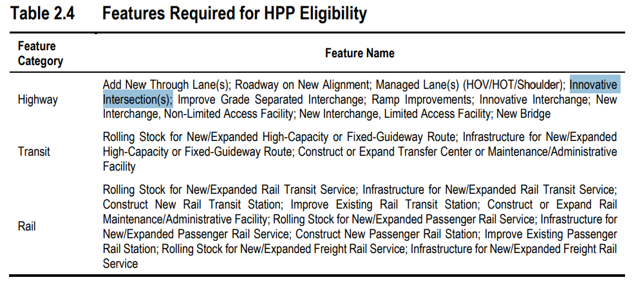
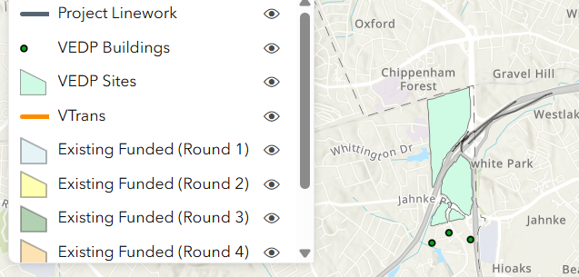
2026 Policy and Administrative Revisions Continued
Policy Update
HPP eligibility added for Innovative Intersections
HPP funded first vs. DGP funded first
    Recommendation to vote on Round 7 results in January (24-Hour turnaround)
FYI Preferred Alternative – Allowing a phasing option if relying on Study for HPP
FYI Fix to VEDP process for Economic Development to include all sites and buildings
Notes:
Reach out to your POC if you think you have a special situation - Restricting or allowing a non-conventional movement
Technical Guide revisions were published 4/30/26
Request/Approval Form for HPP Preferred Alternative Eligibility

Slide 6
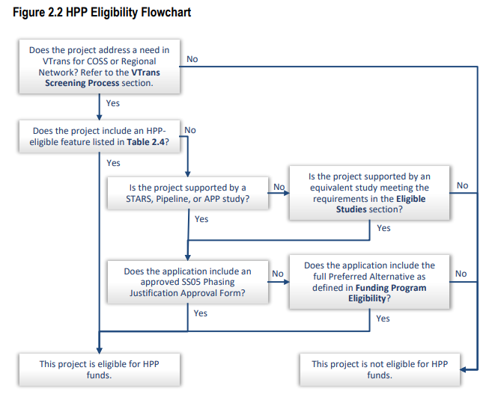
HPP Identification
Policy Update
  Disregard the HPP Eligibility assignment given on the Portal; the data has not been OIPI-Verified
    OIPI will assign based on the flowchart
    VDOT and DRPT Point of Contact (POC) will validate the OIPI assignment
  As of Pre-Application Screening, no regional entities are at risk of not meeting HPP eligibility
Notes:
Hard to revise the portal logic

Slide 7
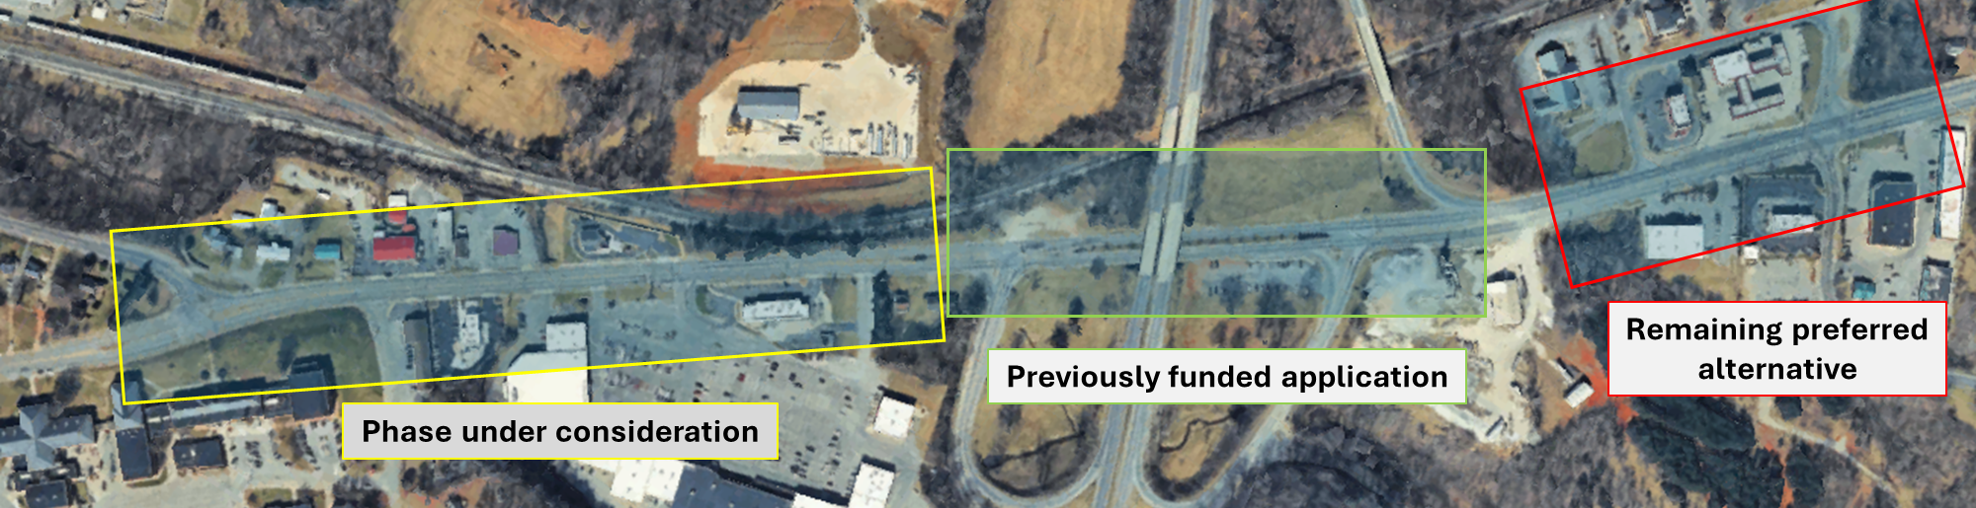
HPP Preferred Alternative Phasing
Policy Update
  Most seeking HPP-eligibility will meet the VTrans Need (CoSS or RN) Plus HPP Feature
  Others will rely on the preferred alternative in a regionally significant study
      Either by providing the full preferred alternative or a phased approach
Phasing Sketch for Example App

Slide 8
HPP Preferred Alternative Phasing Cont’d
Policy Update
  If the application is completing the full alternative, you do NOT need phasing form
  If a project applying for HPP funds includes a component or phase from the Preferred Alternative of an eligible study, without submitting the entire Preferred Alternative
  Must demonstrate:
      Independent Utility – The Preferred Alternative cannot be divided/segmented to the extent that they no longer have logical termini or independent utility.
      Supported by the Study – The scope of the submitted application must be consistent with the selected phase of the Preferred Alternative.
      Geographically Constrained – The Preferred Alternative should be divided geographically rather than by mode or by improvement type, and the phased segment should include all of the elements of the Preferred Alternative.

Slide 9
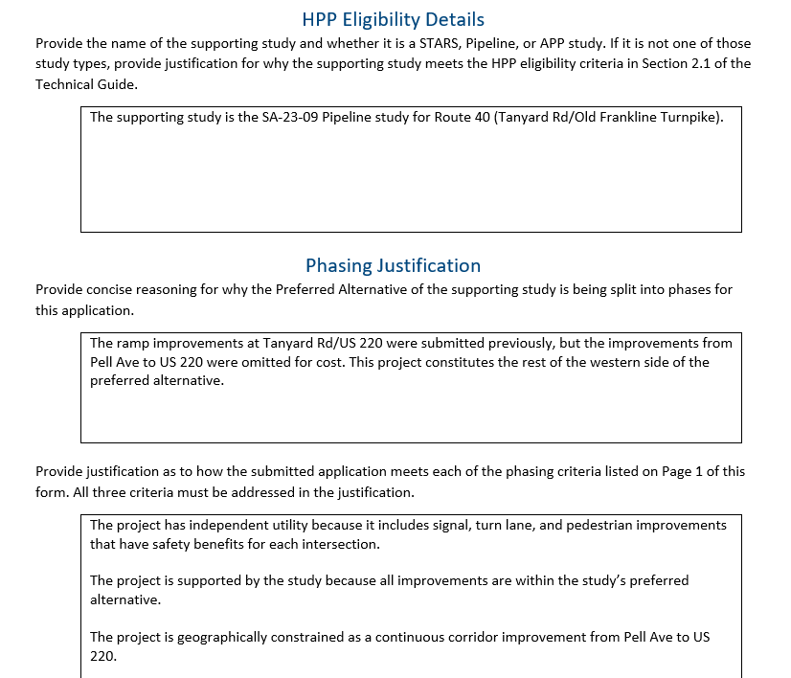
HPP Phasing Justification Approval Form
Policy Update
  SS05 Phasing Justification Approval Form Example
  Provide to Lead POC by June 17th
  POC will review and resolve any issues with the applicant by June 24th
  OIPI review:
      If rejected, OIPI will provide a comment with justification
      If approved, OIPI will upload the form and comment if approved by July 15th

Slide 10
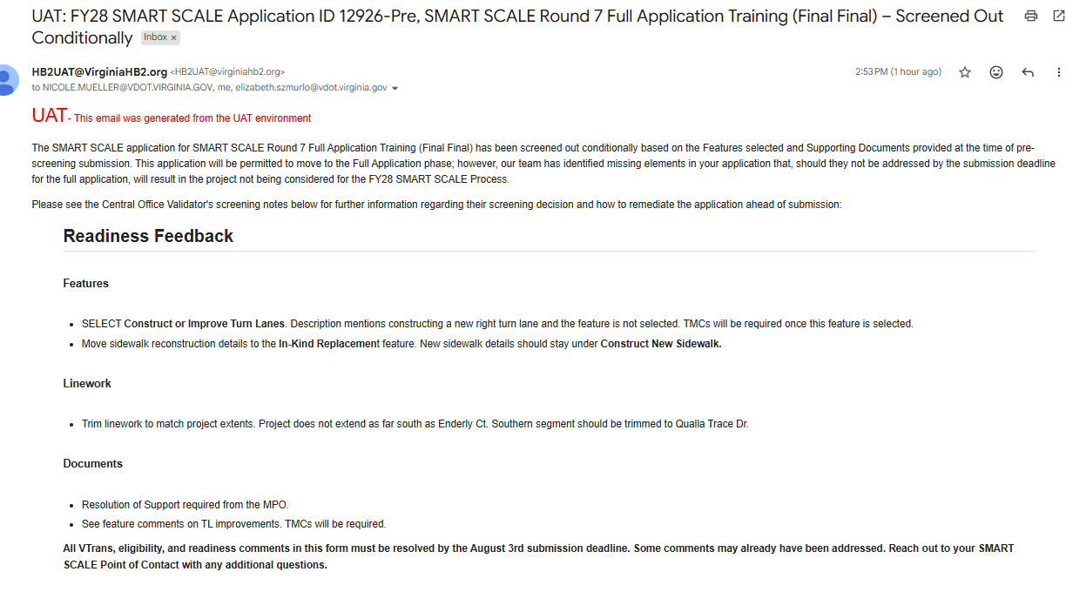
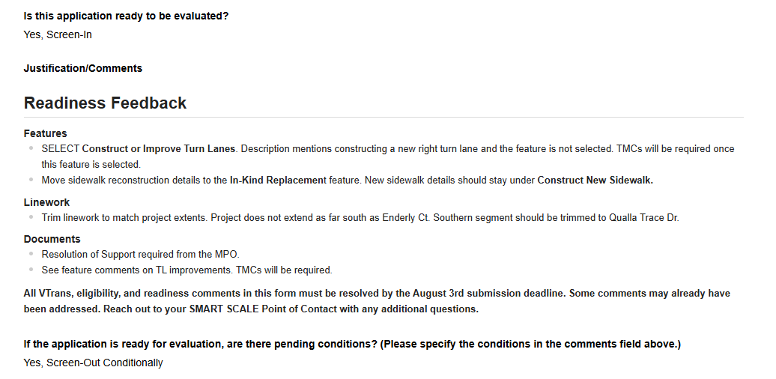
Pre-Screening Decisions
General
Pre-Application Screening
View Pre-Screening Decisions
  Submitter Roles received an auto-generated email
  Submitter and Editor Roles can view Pre-Screening Forms in the Portal
Notes:
The final decision was reflected in the Central Office Screening Form, directions to view District Engineer/DRPT Chief Screening if it was a district or DRPT gate or screening decision
In the CO Screening Form “Is this application ready to be evaluated?” Section the Justification/Comments is what was auto-generated into the

Slide 11
Pre-Screening Decisions Continued
General
Pre-Application Screening
Pre-Screening DID NOT include:
  State’s Understanding of Project Scope
  Review of Cost Estimate
  Review of Leveraged Funding (and Supporting Documents)
As applications evolve, there could be more requirements that pop up
  If app element changes, make it to all - sketch, features, study, linework, cost estimate, SUPS
  Reducing the scope is allowed due to the feedback
  Withdrawal is an option if feedback is too much to overcome by August 3rd
Notes:
Do not change the location (or add major scope items) of your application because of screening feedback

Slide 12
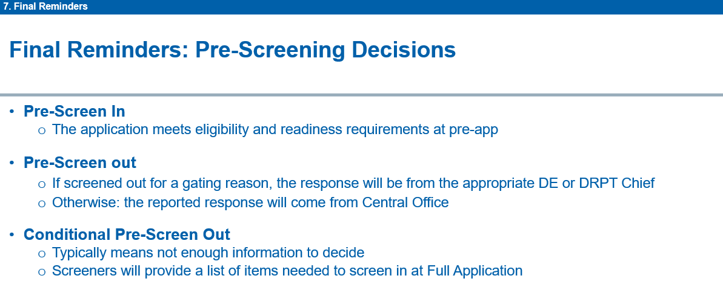
Pre-Screening Decisions Cont’d – Risk analysis
Pre-Application Screening
Excerpt from Pre-Application Training
Round 7 Pre-Screening Decisions | % of Apps
Pre-Screen In | 0%
Pre-Screen Out | 2%
Withdrawn | 3%
Pre-Screen Out Conditionally (Minor) | 78%
Pre-Screen Out Conditionally (Major/Critical) | 17%
Minor - All text-based changes within the portal; all linework issues; sketch modifications; missing Gate 3 documents that are confirmed underway
Major - Apps that cannot be screened due to scope indecision; missing sketches; feature selection issues with Gate 3 requirements; missing Gate 2 documents that have been confirmed to be in progress; Gate 2 or Gate 3 documents with internal issues that require updates, such as a missing alternatives analysis.
Critical - Missing Gate 2 documents that have not been started; most eligibility issues
Notes:
335 Applications and all applications were reviewed as if the scope was finalized
As in Round 6, and reiterated in the Pre-Application Training, methodology from Pre-Screen In Conditionally to Pre-Screen Out Conditionally - A deficiency that needs to be resolved by August 3rd
Don’t panic if it is pre-screened out conditionally – the majority (78%) were minor issues
Completely understand that studies are finishing up, but we needed to flag the issues we will check for right away once August 1st roles around
We are human, push back (through your POC) if you think we flagged something incorrectly, inversely we could have missed something in our first swag that we should have caught.
You are ultimately responsible for your application’s readiness, and should be honest if there is a requirement that should be met.
Note: We did not complete all of the SUPs, our screeners are going to continue to work through June/July importing into the Portal
Major was 28% last round

Slide 13
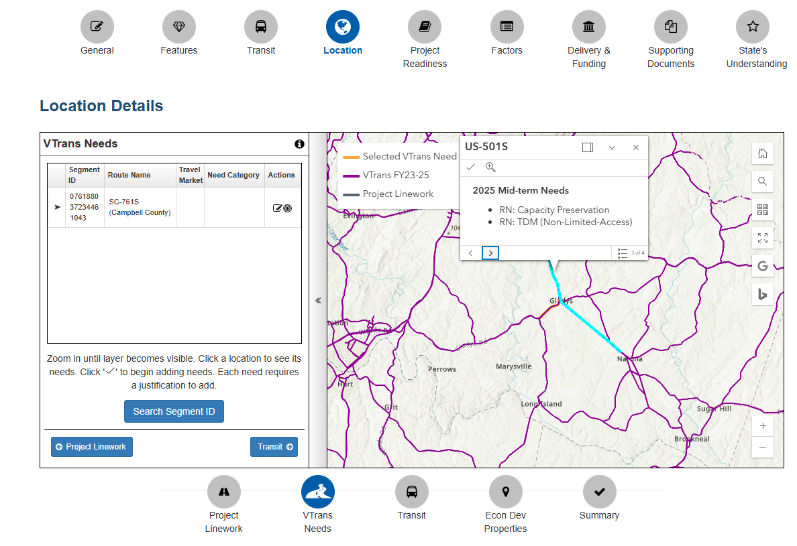
Pre-Screening Decisions Continued
VTrans Needs
Pre-Application Screening
During reviews of Pre-App and Full Applications, screeners have three options:
  Screen In: when a pre- or full app meets a VTrans Need
  Conditional screen out: when information is missing or clarification is needed.
  Screen out: when a pre- or full app does not meet a VTrans Need
    The next few slides highlight key considerations for applicants
Notes:
not been started; most eligibility issues; any other significant screen out risks.

Slide 14
Pre-Screening Decisions Continued
VTrans Needs Flowchart
Pre-Application Screening
VTrans Screening of Pre-App
Screen In
No Change
Change Segments or Selected Needs
Full Re-review
Reconfirm scope has not changed
1. Pre-app VTrans Screening Decision
(Currently Available)
2. Applicant Action
3. Focus of Full App VTrans Screening
Notes:
; most eligibility issues; any other significant screen out risks.

Slide 15
Pre-Screening Decisions Continued
VTrans Needs Flowchart 2
Pre-Application Screening
VTrans Screening of Pre-App
Screen In
No Change
Change Segments or Selected Needs
Full Re-review
Reconfirm scope has not changed
Example: “…….Applicant should revise selected VTrans segments to remove ineligible 2021 segments and replace with the following Segment IDs: 0694846232989948.“
Example: “…. This pre-application is conditionally screened out due to an unfinalized scope. If the applicant finalizes the scope prior to the deadline, the pre-application could be screened in for meeting the following VTrans needs: Safety: Roadway Safety.”
1. Pre-app VTrans Screening Decision
(Currently Available)
2. Applicant Action
3. Focus of Full App VTrans Screening

Slide 16
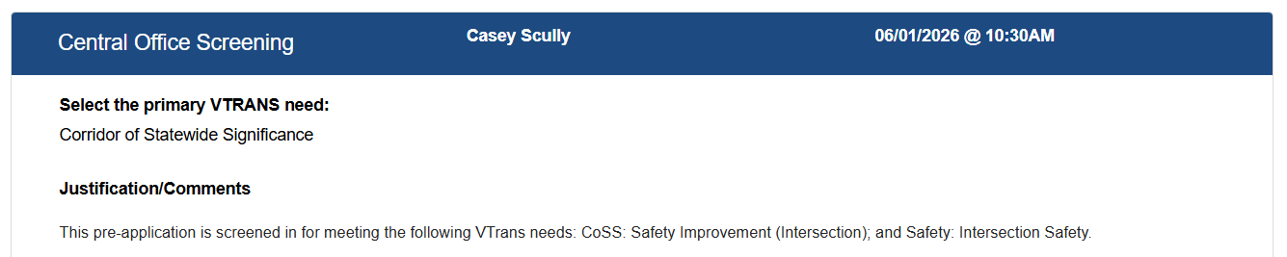
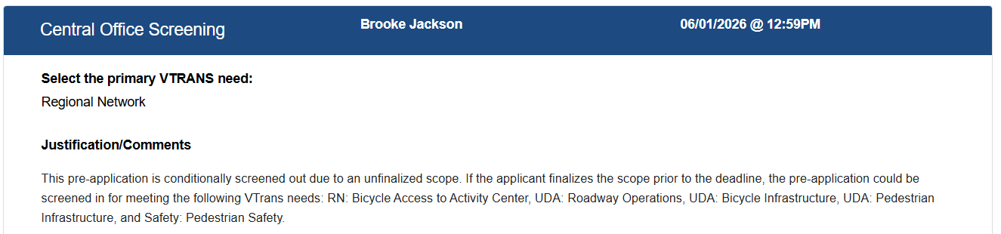
VTrans Needs Pre-Screening
How to View
Pre-Application Screening
Visible in Portal Only – did not get reflected in the auto-generated email

Slide 17
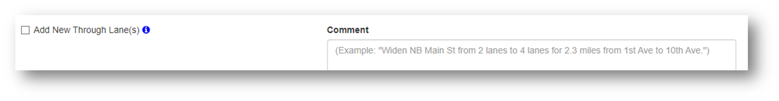
Common Pre-Application Issues
Pre-Application Screening
Resubmission (40%) of a Previous Application
  One element had been removed or added, but only removed from one place
Features
  Not selecting a feature that has a Gate 2 or Gate 3 requirement, needs immediate remediation, but no later than June 15th
  Feature Descriptions Missing Dimensions
  Providing lengths in the feature descriptions, but did not match the sketch
  Feature descriptions not written in a concise and factual manner, with no extraneous information. Refer to Feature Descriptions and Example Text or portal pre-loaded examples
Notes:
Do not change the location (or add major scope items) of your application because of screening feedback

Slide 18
Common Pre-Application Issues Continued
Pre-Application Screening
Features Continued
  In-Kind Elements were not in the In-Kind Replacement Feature, basically if it replaces something that already exists
  Selecting the wrong feature for turn lanes should be "Construct or Improve Turn Lane(s)“, not "Intersection Improvement(s)
  Improvements associated with an innovative intersection do not need to be listed in features other than the Innovative Intersection feature
    Example median extension and a rebuilt turn lane for an RCUT
  Documents - Outdated or Incomplete Planning Study
  Must be post-August 2016 AND
  must identify a preferred alternative that matches the application scope
Notes:
Do not change the location (or add major scope items) of your application because of screening feedback
The most common example is existing sidewalk that is being replaced due to widening. This also often occurs for pedestrian crossings that are being rebuilt and restriped but not improved.
Bus stop benches, same-width sidewalks, and guardrails — all flagged constantly.

Slide 19
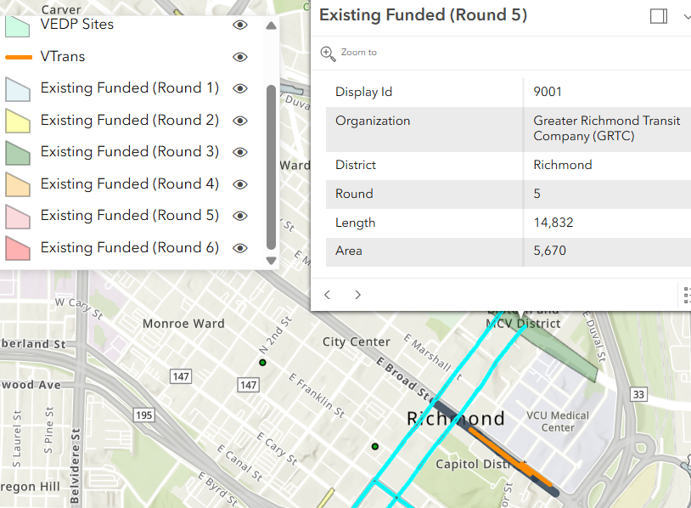
Common Pre-Application Issues
Overlapping Scope with Previously Funded Components
Pre-Application Screening
An application scope overlaps with an active (funded) SMART SCALE project in the SYIP
127 scope overlaps identified in Pre-screening on active projects
21 require clarification or action
Currently tracking two for CPC review
Option 1
District/OIPI/DRPT teams may request a revision of the application scope. Impacts and ties-ins must be referenced in the application and shown and noted in the project sketch.
Option 2
The existing funded project can be reviewed for either a scope change.
Scope changes for existing projects are permissible only if the active project has not closed scoping.
Option 3
Active project cancellation through the CTB.
Notes:
Approximately 30 projects fit in this category
Some are transit or signal projects that are not in conflict
Once a project is selected for funding, an entity may not resubmit the project with a revised scope in a subsequent round unless the previously selected project has been canceled
Once a project is selected for funding, an entity must wait for two rounds of SMART SCALE following the end date of construction before submitting a new project application for the same location that meets the same need as the project that was selected for funding.

Slide 20
Common Pre-Application Issues
Overlapping Scope - Previously Funded Components
Pre-Application Screening
How is overlapping scope reviewed?
1. GIS Assessment
2. Scope Reviews
Application linework is compared to active projects to determine impacts.
Application scope and sketch are reviewed and compared to active projects to determine impacts.
3. Previous Project Changes
4. Assessment Complete
Existing project comparisons are assessed against prior changes to ensure scope accuracy.
Reviews are completed and provided to District/OIPI/DRPT.
Most overlaps are resolved with application clarifications.
Notes:
Verbalize
Once a project is selected for funding, an entity may not resubmit the project with a revised scope in a subsequent round unless the previously selected project has been canceled
Once a project is selected for funding, an entity must wait for two rounds of SMART SCALE following the end date of construction before submitting a new project application for the same location that meets the same need as the project that was selected for funding.

Slide 21
Common Pre-Application Issues
Next Steps
Pre-Application Screening
Next Steps
Option 1 - Application Modification
  Work with POC to modify the application by August 3rd
Option 2 - Scope Change
  Work with POC to request a Project Change if the active project has not closed scoping, must be reviewed by the Committee on Project Change (CPC )by June 30th
Option 3 - Active Project Cancellation
  Work with POC to request a Cancellation, must be reviewed by CPC by July 15th
  CTB Action will be required
  CPC is lead by Sarah Rhodes, Infrastructure Investment Division, sarah.rhodes@vdot.virginia.gov
Notes:
The VDOT POCs and DRPT POCs have the summary of the review in hand, they will continue to reach out to Sarah

Slide 22
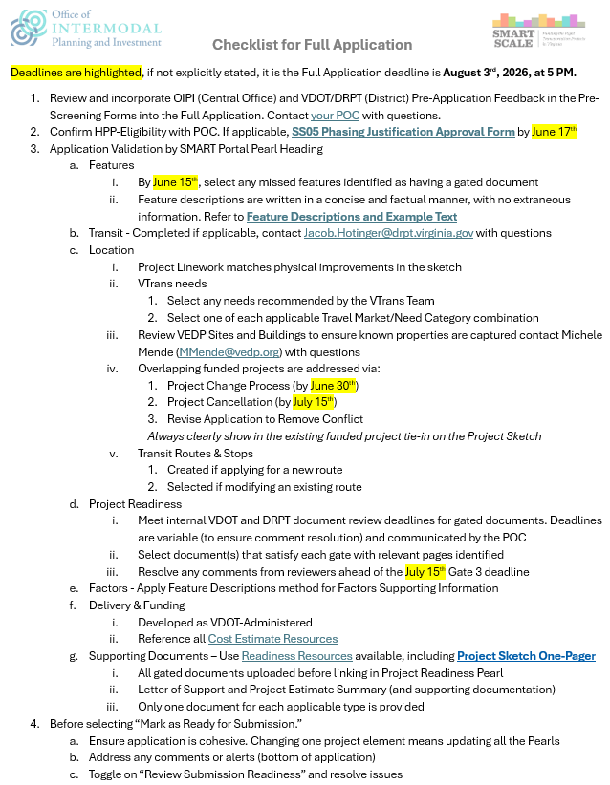

Checklist for Full Application
Full Application FAQs
Full Application Checklist
  FAQs
  Deadlines
  Common Issues

Slide 23
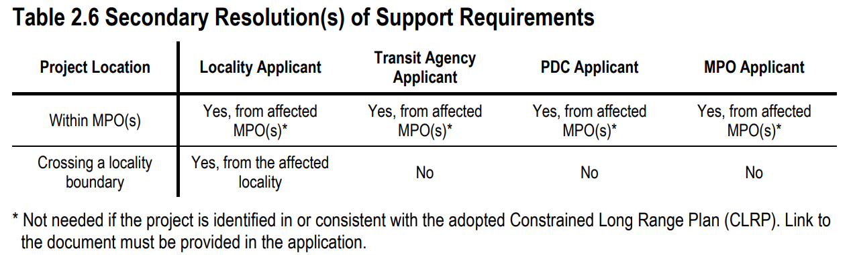
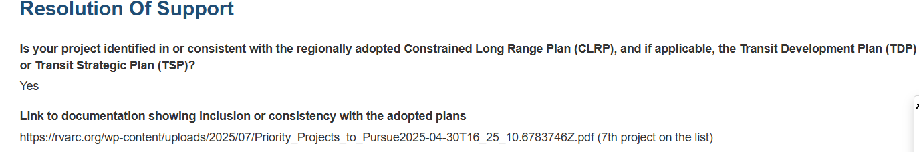
Resolutions of Support
Full Application FAQs
All are due August 3rd
Every applicant needs to provide their own resolution of support, no exceptions
Might need a secondary resolution
Notes:
This is where we made mistakes, as I was inputting screening decisions I caught that many screeners recommended Regional entities getting locality resolutions and that is not needed

Slide 24



Presentation Overview
Funding and Cost Estimate Validation Guidance
Application Development
Screening and Validation
Estimates
Schedules
“Fun”ding

Slide 25
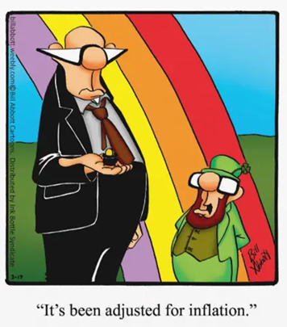
Application Development – Estimates
Funding and Cost Estimate Validation Guidance
Inflation
VDOT Executive Memorandum – June 2026 (forthcoming)
  FY2028-2033 Inflation / Escalation set to 3% per year on all phase types (i.e. PE, RW, CN)
  FY34 and beyond maintains 3% per year
Based on project/application key milestone dates (i.e. PE, RW, CN).

Slide 26
Application Development – Estimates Cont’d
Funding and Cost Estimate Validation Guidance
Inflation… Now What?
Example
Base Cost (sum of defined costs and allowances):
  $1M PE, $2M RW, $3M CN
Schedule (based on VDOT admin templates):
  PE start August 2029, RW start 2031, CN start 2033
Contingency: 20% risk/contingency for PE/RW/CN; 20% CEI for CN
Results
Estimate Year FY26 = ~$9.54 million
Estimate Year FY27 = ~$9.26 million
If same base cost is used on Pre-App and Full App, Full App estimate will be lower than Pre-App; ensure most current base cost possible is entered into Portal on Full App
Estimate should be based on current year and/or current unit costs
  Do not submit an old estimate with inflation applied
  Follow Executive Memorandum
SMART Portal will calculate based on schedule and Fiscal Year
  Estimates entered into Pre-App will have first year of inflation in FY27
  Estimates entered into Full-App will have first year of inflation in FY28 after July 1

Slide 27
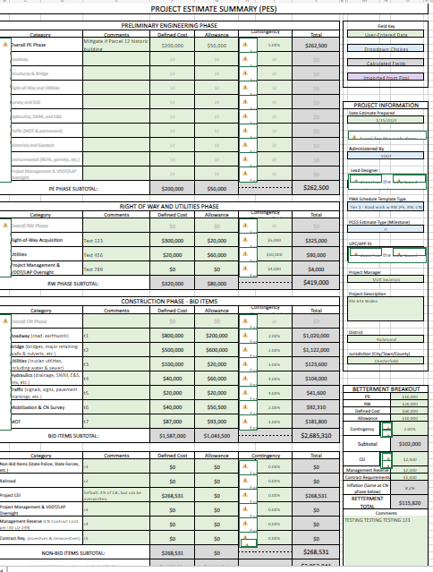
Application Development – Required Documentation
Funding and Cost Estimate Validation Guidance
Required Documentation
Project Estimate Summary (PES) will be required for application to proceed past validation
Applicant OR VDOT can upload PES
  VDOT, if not filling out PES, should review PES submitted by applicant for correctness in addition to estimate validity
  Include detailed, supporting documentation for PES in Smart Portal upload

Slide 28
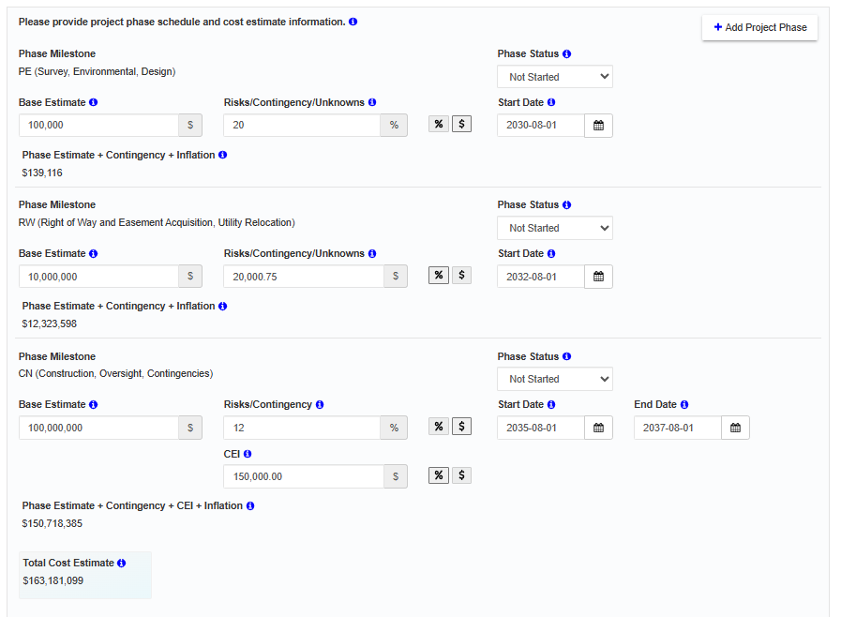
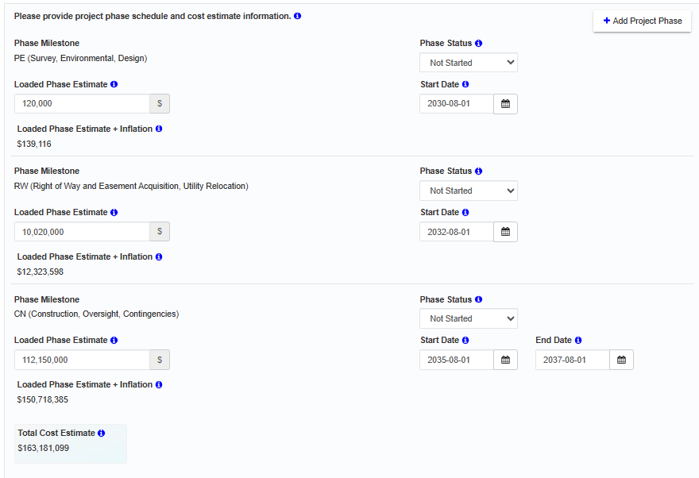
Application Development – Pre-App vs Full App
Funding and Cost Estimate Validation Guidance
Pre-App
Full App

Slide 29
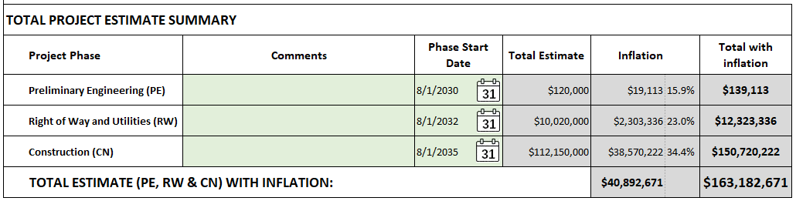
Application Development – Full App vs PES
Funding and Cost Estimate Validation Guidance
Full App
PES
Loaded Phase Estimate
Base estimate + risk/contingency/mgt reserve + CEI (CN Phase)

Slide 30

Application Development – Project Administration
Funding and Cost Estimate Validation Guidance
Project Administration
VDOT administration!… …unless application is already approved LAP in SYIP
If strong likelihood of LAP in future, recommend to include oversight in estimate
Document that oversight is included

Slide 31
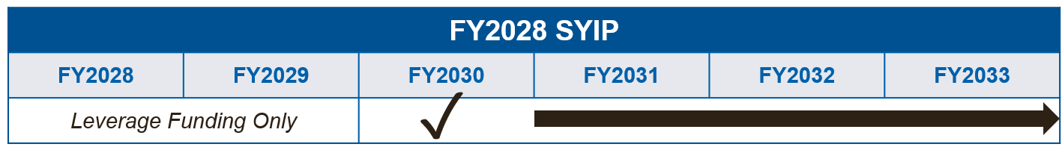
Application Development – Schedules
Funding and Cost Estimate Validation Guidance
First-Year Available
PWA Templates
First year of available funding, for application purposes, will be FY2030
August 2029 start date recommended
Use VDOT Administered PWA templates to set durations unless already approved LAP in the SYIP

Slide 32
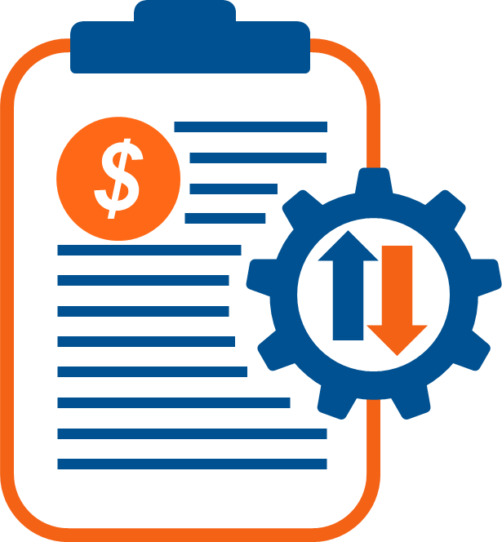
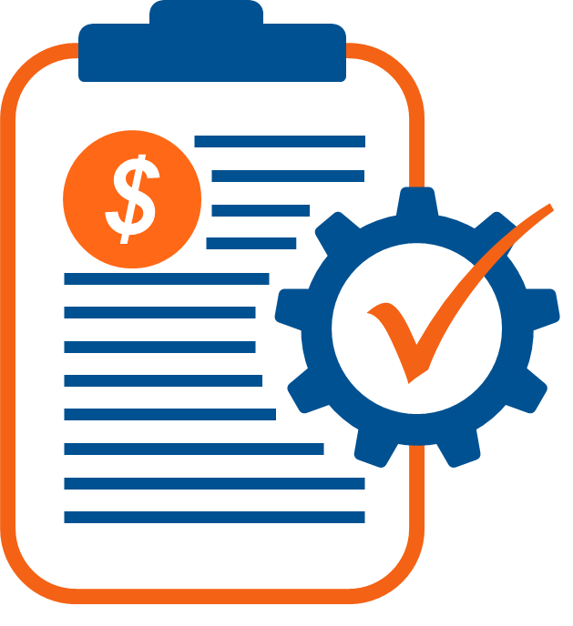
Application Development – “Fun”ding
Funding and Cost Estimate Validation Guidance
Leveraged Funds
Prior to submission deadline, leverage funding must be…
Full Application – SYIP allocations on applications should reflect FINAL SYIP adopted in June 2026
Applied For…
…Or Approved
NOTE: If there is no leveraged funding, THEN be sure the estimate start date is FY30 or later.
All leverage MUST be represented within the six-year window of the program.

Slide 33
Application Development – Schedules/“Fun”ding
Funding and Cost Estimate Validation Guidance
Leveraged Funds
Infrastructure Investment Division will validate leverage funding in District Validation.
Projects with confirmed leveraged funding to cover reasonable cash flow between funded phase and non-funded phase start date MAY have advanced schedules confirmed on case-by-case basis.
Leverage Approach
Example
BAD | $50k of leveraged funding on $1 million PE phase and wants to start in FY28
GOOD | $400k of leveraged funding on $1 million PE start and wants to start in FY29

Slide 34
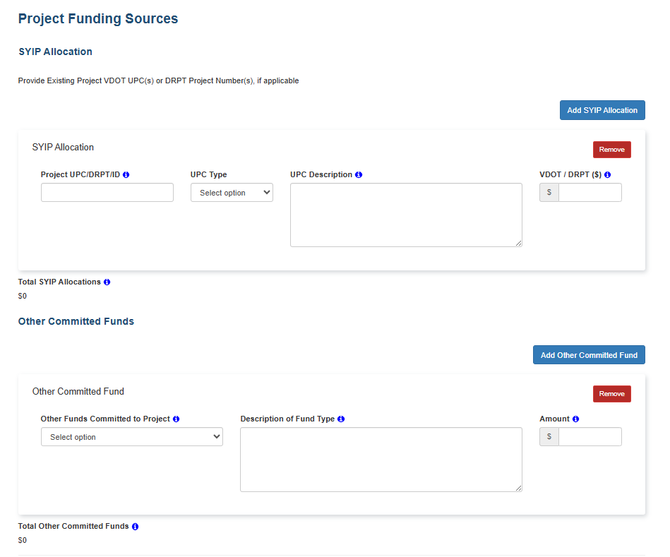
Application Development – Leveraged Funds
Funding and Cost Estimate Validation Guidance
Leveraged Funds
Funding is represented in the SYIP
Funding is NOT represented in the SYIP

Slide 35
District and Central Office Estimate Validation
Funding and Cost Estimate Validation Guidance
Who is validating each application cost estimate?
Districts will be reviewing and validating all estimates
Central Office will be reviewing and validating all Tier 2 projects (over $15M in construction cost)
  Central Office validation will occur in random order and multiple teams will be used to ensure an independent perspective
If specific consultants were involved in developing estimates, please communicate to avoid conflict
If there are known issues with a submitted estimate, please notify VDOT immediately

Slide 36
Validation - Central Office (CO) Thresholds
Funding and Cost Estimate Validation Guidance
Validation Tiers
CO provides a detailed, independent estimate review
Requires CO comment resolution and acceptance from the State L&D Engineer
$50M in CN
CO provides a detailed, independent estimate review
Requires comment resolution and acceptance from the Assistant State L&D Engineer
$15M in CN

Slide 37
Cost Estimate Validation Success
Funding and Cost Estimate Validation Guidance
Keys to successful validation: make sure you have……
CONSISTENCY!
✓
✓
Application Features
SUPS
✓
✓
Project Sketch
Estimate

Slide 38
Cost Estimate Validation Success Cont’d
Funding and Cost Estimate Validation Guidance
For successful District and CO Validation, you will need to ask…
  Are there inconsistencies that prevent independent estimate validation?
  Are there differences in the features shown and described that would substantially affect the estimate?
  Are there features shown and/or described that aren’t included in the estimate?
  Does the sketch or description provide adequate information for independent estimate validation?

Slide 39
Validation – Estimate Package
Funding and Cost Estimate Validation Guidance
Project Estimate Summary (PES)
The Project Estimate Summary (PES) is Required
The PES must be uploaded into the Smart Portal with the full application.
The PES is available on the external VDOT website
For an application to move on to scoring, it's critical to ensure the PES matches the supporting detailed estimate documentation

Slide 40
Validation – Detailed Documentation
Funding and Cost Estimate Validation Guidance
Detailed Estimate Documentation
The PES is only an estimate SUMMARY!
Detailed estimate supporting documentation is required and should be uploaded to the SMART Portal
Documentation format and clarity needs to be appropriate for independent review
Major items estimate must be provided at a minimum
Ensure current unit prices
Use tools endorsed by VDOT Cost Estimate Office, where appropriate

Slide 41
Project Sketch Recommendations
Funding and Cost Estimate Validation Guidance
  Examples

Slide 42
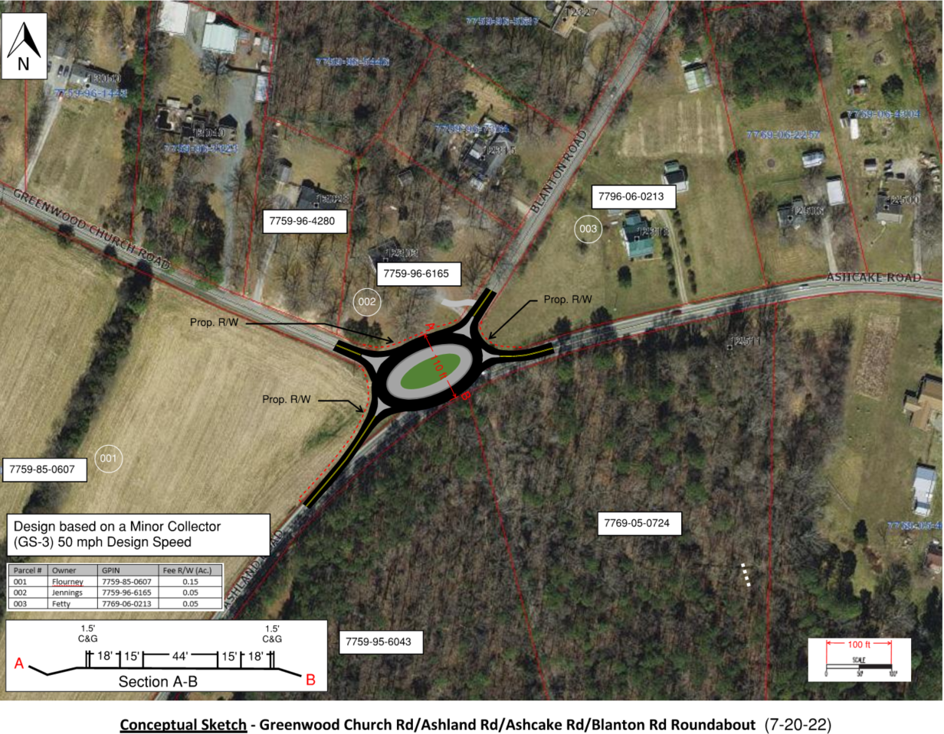
Project Sketch Quality – Needs Improvement
Funding and Cost Estimate Validation Guidance
Positives:
RW area summary, design speed, classification, typical section, some labels
Negatives:
Plot scale, no SWM assumptions, difficult to even tell lane configuration or widths, no approximate construction limits, drainage features, would require a significant contingency with so many unknowns.

Slide 43
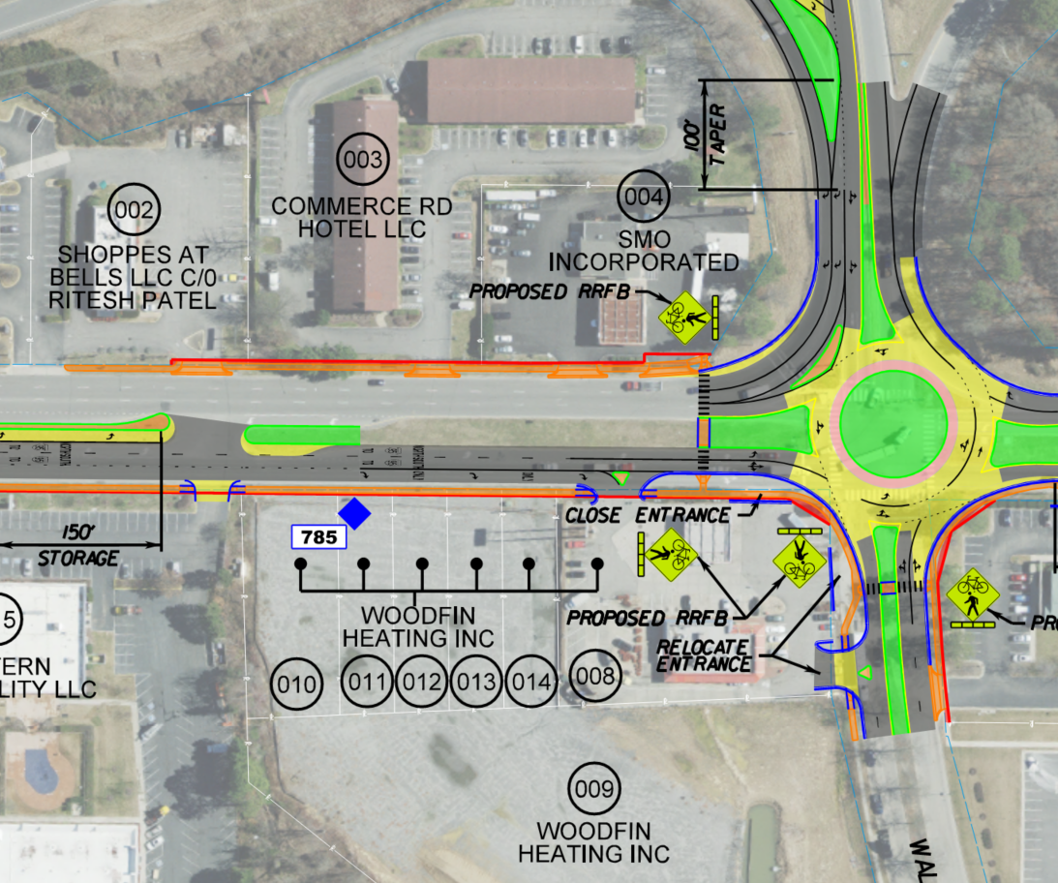
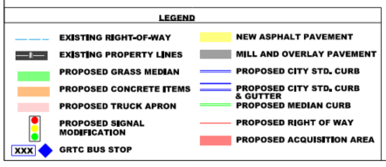
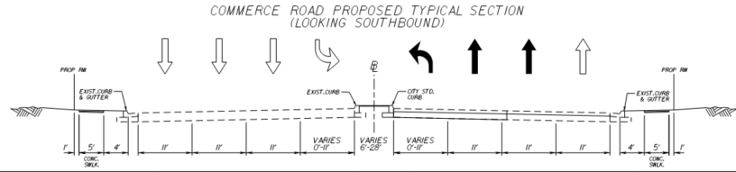
Project Sketch Quality – Significantly Better
Funding and Cost Estimate Validation Guidance
Positives: roundabout lanes clearly depicted, shows full depth and mill/overlay pavement, proposed right of way impacts shown, extensive legend, typical section is clear, modified entrances shown
Negatives: unclear SWM

Slide 44
Validation – Best Practices
Funding and Cost Estimate Validation Guidance
Scope and Project Features
Clearly define major features: Includes lanes, shoulders, pedestrian facilities, traffic signals, PROWAG requirements, stormwater management, structures
Clearly define locations of new and mill/overlay pavement
Establish clear project limits that consider MOT needs and profile changes
Obtain VDOT concurrence on intent to use Design Exceptions or Waivers
Don't upload more than one version of the project sketch or estimate

Slide 45
Validation – Estimate Documentation
Funding and Cost Estimate Validation Guidance
Estimate Documentation Checklist
Upload the PES into the Smart Portal
Include detailed, supporting documentation for PES in Smart Portal upload
Supporting documentation to include major items estimate at a minimum
Ensure that supporting documentation is consistent with the PES
Ensure the project sketch is clear and consistent with the application
A SMART Portal upload similar to a Cost Estimate Package is optimal

Slide 46
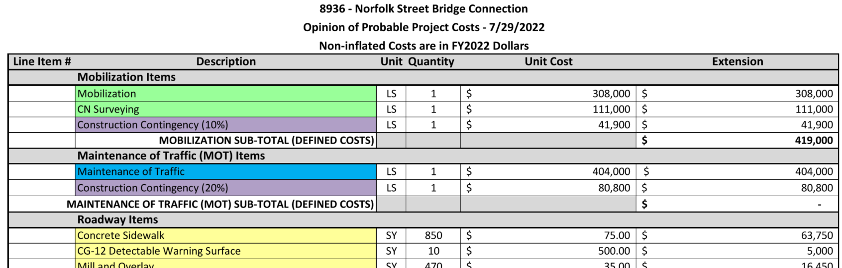
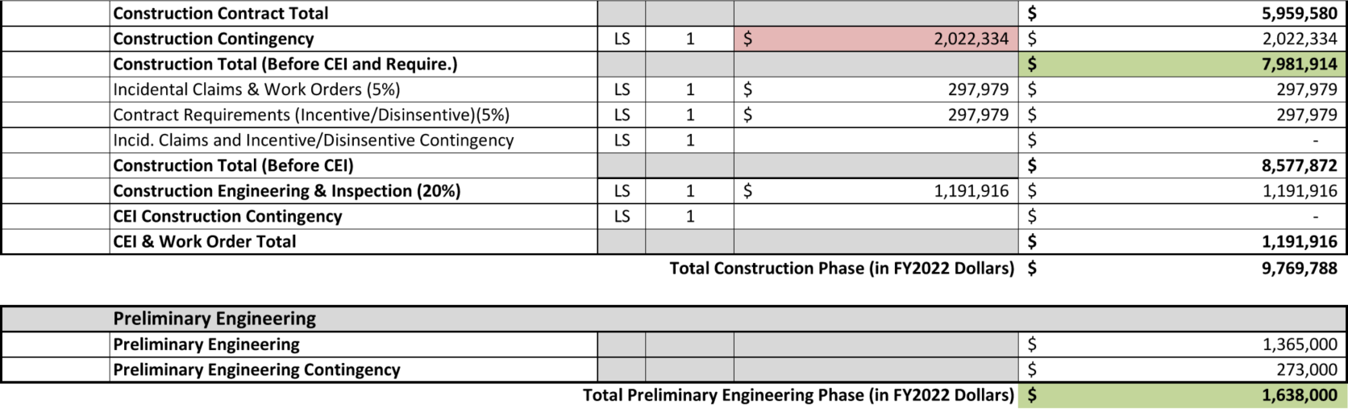
Validation – Estimate Documentation Cont’d
Funding and Cost Estimate Validation Guidance
Combination of major item quantities and lump sums
User-friendly format for independent review
Major Items Estimate can be easily matched up with the PES

Slide 47
Cost Estimate Best Practices
Funding and Cost Estimate Validation Guidance
Cost Estimates
Focus on accuracy of major items: pavement, pedestrian facilities, earthwork, bridge, retaining walls, stormwater management, large culverts
Ensure major MOT items are included: concrete barrier, temporary pavement
Include contingencies based on project specific risks and unknowns – document those risks and assumptions
Ensure recent bid data is used for unit prices to reflect the current market
Adjust noise wall and bridge unit prices for site specific constraints

Slide 48
Cost Estimate Best Practices Cont’d
Funding and Cost Estimate Validation Guidance
Cost Estimates
Document what is assumed in lump sum costs – no "miscellaneous" items
Contingency and inflation should never be included in the base cost
Ensure the project features, sketch and estimate match supporting readiness gate documentation (IAJR, OSAR, SJR, etc.)
Include environmental and railroad costs
Ensure Stormwater Management cost and assumptions are clear, especially those impacting right of way

Slide 49
Validation – Lessons Learned
Funding and Cost Estimate Validation Guidance
Cost Estimates
Documented assumptions should describe what is included or excluded
Be careful using percentages to determine Maintenance of Traffic costs – ensure the cost is consistent with project complexity
Consider high-risk property owners, stakeholders, and environmental constraints in project concept development and contingencies
Documentation should be prepared keeping in mind that it will be used for an independent validation

Slide 50
Recap
Funding and Cost Estimate Validation Guidance
Key Takeaways
Earliest funding start year is FY 2030 (August 2029)
Estimate must be created based on current year
  Do not submit an old estimate with inflation applied
SMART Portal will apply additional inflation (statewide) based on the phase dates entered

Slide 51
Contact Information
Funding and Cost Estimate Validation Guidance
Sarah Rhodes, Infrastructure Investment Division, sarah.rhodes@vdot.virginia.gov
Butch Heishman, Location and Design Division, vernon.heishman@vdot.virginia.gov

Slide 52
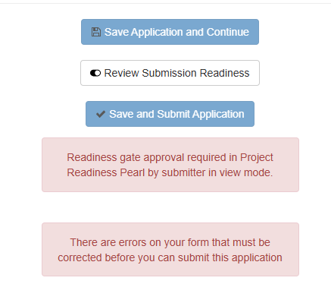
SMART Portal
Demo Highlights
SMART Portal Demo
SMART SCALE POC Contact Information
Reminders
Ctrl + F5
Application consistency is key
  Updates to one (Project Description, Features, Cost Estimate, Sketch, Linework, Sketch) means updates to all!
Review Submission Readiness
  When slider is on, Highlights in red which items need to be addressed
  Slider must be off to Save Application and Continue

Slide 53
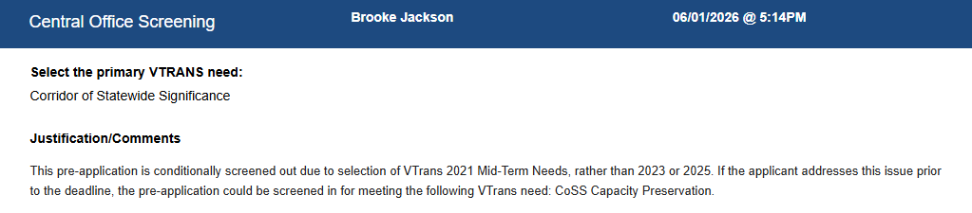
SMART Portal
Demo Highlights Cont’d
SMART Portal Demo
Pre-Screening feedback is available
  Both District and Central Office Screening forms in the Portal
  Email went out with CO Screening feedback
    Includes Readiness and Eligibility feedback
    See form in Portal for VTrans

Slide 54
SMART Portal Demo Highlights: General & Features
SMART Portal Demo
General Pearl
  Has Scope been finalized? If NO in Pre-App, should be YES by Full App submission
Features Pearl
  CO pre-screening feedback will indicate whether features need to be modified
  Any feature feedback not included in screening feedback will need to be coordinated with state staff
    Gate 2 features disabled for all applicants
    Gate 3 able to be selected

Slide 55
SMART Portal Demo Highlights: Transit
SMART Portal Demo
Transit Pearl
  Transit Environmental Review built into Pearl (previously SS03 form)
  Feature to Pearl automatic connection
  Supplemental questions on Pearl are feature dependent

Slide 56
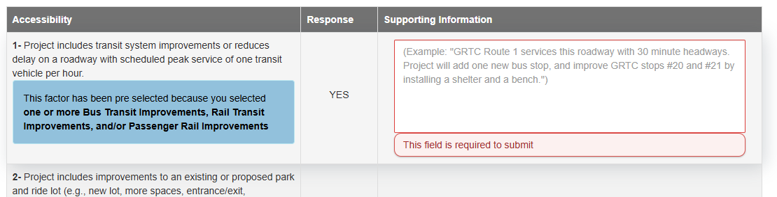
SMART Portal Demo Highlights: Location & Factors
SMART Portal Demo
Location Pearl
  Editing linework, as directed
  VTrans Needs selection
    Hotfix coming, Portal bug on the Location Pearl
  Transit subpearl, selecting routes and/or stops
    Hotfix coming, legend
Factors Pearl
  Supporting Info required for full app submission
  Some answers may have been pre-selected based on feature selection. If pre-selected “YES”, supporting info is required

Slide 57
SMART Portal Demo Highlights: Delivery & Funding
SMART Portal Demo
Delivery & Funding
  Covered by Sarah in the Delivery and Funding Guidance section!

Slide 58
SMART Portal Demo Highlights: Supporting Documents
SMART Portal Demo
Supporting Documents
  All documents should be in final form
  All applications will require PES, which is a new document type
  All applications will get triggered for a Letter of Support, even if uploaded under another “Attachment Type”
    Can be quickly updated, if applicable

Slide 59
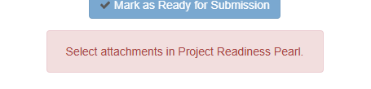
SMART Portal Demo Highlights: Project Readiness
SMART Portal Demo
Project Readiness
  Document selection required for each gated feature
  Document must already be uploaded under the Supporting Documents Pearl

Slide 60
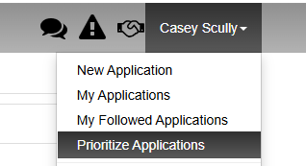
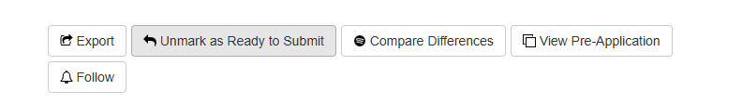
SMART Portal Demo Highlights: App Prioritization
SMART Portal Demo
Prioritize Applications
Mark as Ready to Submit
  Application will automatically submit once app has been marked ready to submit and all applicable gates have been approved by state staff
  Can “Unmark” if necessary

Slide 61
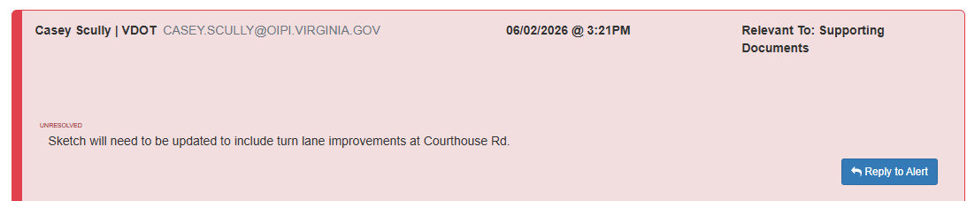

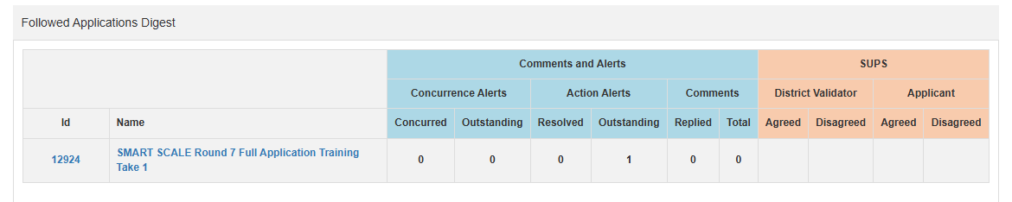
SMART Portal Demo Highlights: Communication
SMART Portal Demo
Portal Communication
  Comments
  Followed Application functionality
Notes:
Follow feature, check the box to opt out of the daily digest
Using the district validation tool will generate action alerts
State can also communicate through portal comments

Slide 62
SMART Portal Demo Highlights: SUPS
SMART Portal Demo
State’s Understanding of Project Scope

Slide 63
Timeline and Key Dates for Applicants
Timeline Full Application
Date | Activity
June 1st | Full Applications Open
June 15th | Gated features included in application
June 30th | Deadline to finalize a project change to an active SS project
July 15th | Finalized Documents with Gate Requirement Due (attached in the SMART Portal) Note: there may be earlier dates required internally by districts to accommodate reviews
July 15th | Request cancellation of the existing project
August 3rd – 5PM | Full Applications Close – Final Sketches, Estimates, Leveraged Funding Supporting Documentation, Resolutions of Support
September 16th | Applicants approve all State’s Understanding of Project Scope
Notes:
October 22nd – Presentation to the CTB
Is there flexibility in the timeline? No, All documents to be submitted by July 15th (hard deadline), if they are ready before upload please upload them earlier.

Slide 64
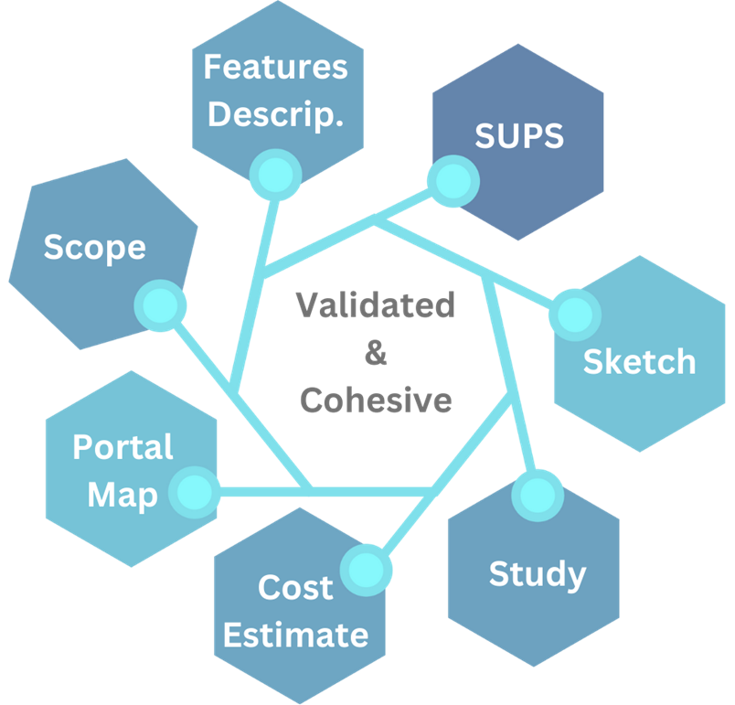
Thank YOU!
Final Reminders
SMART SCALE Team Contacts
Application Readiness Goal
  Clearly defines scope
  Matching & cohesive
  Meets document & data requirements
ONE sketch, ONE study, ONE estimate
Having Portal Issues? CTRL + F5
Be responsive to requests for information – Timeline is not flexible
Do not wait until August 3rd to Mark as Ready for Submission
Notes:
Changes to one means changes to all

