Slide 1
SMART SCALE Process and Round 6 Update
Brooke Jackson, P.E.

Slide 2
Today’s Goal: 1. Confidence in the transparent process 2. Understand and utilize resources 3. Quality projects are identified through performance-based planning, and scoring details are secondary
Agenda/Contents
SMART SCALE FY 2026 Round 6 Overview
Process Overview and Support
Performance-Based Planning
Example Project – ID 11556 (Garrisonville Rd Widening Phase 1)
Initial High-level Considerations or Project Characteristics that identify a benefit/high-scoring project
Detailed Computations of Project Benefit and SS Score
Appendix
C.1 Throughput (BPR) Highway calculations
C.2 Delay (BPR) Highway calculations
Accessibility Lookup Table

Slide 3
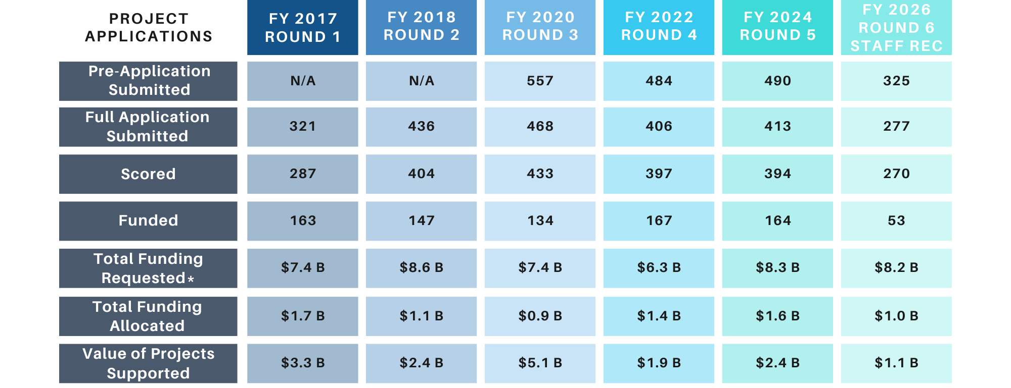
SMART SCALE FY 2026 (Round 6) Summary and Comparison to Prior Rounds
SMART SCALE FY 2026 (Round 6) Overview
*Total of scored applications funding requested

Slide 4
Funding Available in millions for FY 2026 (Round 6)
SMART SCALE FY 2026 (Round 6) Overview
District | DGP Available | Previous DGP Cost Increases | HPP Available
Bristol | $37.0
Culpeper | $68.0 | -$6.6
Fredericksburg | $76.2
Hampton Roads | $121.6
Lynchburg | $85.9
Northern Virginia* | $97.4
Richmond | $104.9
Salem | $64.3
Staunton | $39.4 | -$6.0
Statewide HPP |  |  | $384.7
Total | $694.6 |  | $384.7
A total of $1.08 billion is available for Round 6
Background information for the FY2026 – 2031 planning period
VDOT CFO Presentation (pdf)
VDOT CFO Presentation (YouTube)
Budget is still in flux depending on remaining needs through May
*Note: Supplemental DGP from additional gas tax in localities is not captured in NOVA District

Slide 5
Staff Recommended Funding Scenario Summary - $ in millions
SMART SCALE FY 2026 (Round 6) Overview
District | Number of Applications | DGP Available | Previous DGP Cost Increases | HPP Available | DGP Allocated | DGP Remaining | HPP Allocated | HPP Remaining | Funded in Staff Scenario | Total Allocated
Bristol | 20 | $37.0 |  |  | $27.2 | $9.8 | $0.0 |  | 3 | $27.2
Culpeper | 24 | $68.0 | -$6.6 |  | $57.0 | $4.3 | $36.4 |  | 4 | $93.5
Fredericksburg | 34 | $76.2 |  |  | $73.5 | $2.7 | $16.8 |  | 4 | $90.3
Hampton Roads | 31 | $121.6 |  |  | $111.9 | $9.7 | $27.3 |  | 11 | $139.2
Lynchburg | 12 | $85.9 |  |  | $82.4 | $3.5 | $0.0 |  | 4 | $82.4
Northern Virginia | 23 | $97.4 |  |  | $88.7 | $8.8 | $0.0 |  | 4 | $88.7
Richmond | 65 | $104.9 |  |  | $82.6 | $22.2 | $255.8 |  | 14 | $338.5
Salem | 34 | $64.3 |  |  | $53.9 | $10.3 | $0.0 |  | 3 | $53.9
Staunton | 27 | $39.4 | -$6.0 |  | $25.3 | $8.1 | $44.7 |  | 6 | $69.9
Statewide HPP |  |  |  | $384.7
Total | 270 | $694.6 |  | $384.7 | $602.5 | $79.5 | $381.0 | $3.6 | 53 | $983.6
Starting Total | $1,079.3
Remaining Total | $83.1

Slide 6
Staff Recommended Scenario – Fredericksburg
SMART SCALE FY 2026 (Round 6) Overview
Display ID | Organization | Name | Area Type | Benefit | Total Cost | SMART SCALE Request | SS Score | Fund Eligibile | (1) DGP | (2) HPP
11663 | Caroline County | Paige and Marye Route 1 Intersection | D | 19.63 | $ 7,085,483 | $ 7,085,483 | 27.71 | DGP | $ 7,085,483
11661 | Caroline County | Turn Lanes at Lake Caroline | D | 9.25 | $ 9,043,110 | $ 9,043,110 | 10.23 | DGP | $ 9,043,110
11640 | GWRC | Rt 3 Pipeline Old Plank Road to Salem Church Rd | B | 10.81 | $ 16,803,447 | $ 16,803,447 | 6.43 | HPP |  | $ 16,803,447
11624 | Spotsylvania County | US Rte.1 Southpoint Pkwy Intersection Improvements | B | 32.41 | $ 68,659,081 | $ 57,371,621 | 5.65 | BOTH | $ 57,371,621
11664 | Caroline County | Rte 207 Sidewalk improvements at Rte 1 and Welcome Way | D | 6.95 | $ 12,689,428 | $ 12,689,428 | 5.48 | DGP
11806 | Mathews County | Rte. 3 and Rte. 198 Intersection and Road Segment | D | 1.15 | $ 2,902,789 | $ 2,902,789 | 3.95 | DGP
11769 | Gloucester County | Rte. 17 and Belroi Road Intersection | D | 2.12 | $ 6,370,284 | $ 6,370,284 | 3.33 | DGP
11627 | Spotsylvania County | Route 639 STARS Study Improvements | B | 4.58 | $ 15,682,894 | $ 15,682,894 | 2.92 | DGP
11552 | Stafford County | Route 1 and Foreston Woods Dr / Coal Landing Rd Improvements | B | 4.81 | $ 21,901,719 | $ 18,901,719 | 2.55 | DGP
11662 | Caroline County | Route 1 Ladysmith Road | D | 4.14 | $ 17,564,099 | $ 17,564,099 | 2.36 | DGP
11641 | GWRC | Warrenton Road Widening | B | 7.01 | $ 32,526,091 | $ 32,526,091 | 2.16 | HPP
11756 | Middlesex County | Rt 17-Rt 616 Town Bridge Road Int. and Segment Improvements | D | 1.55 | $ 7,524,673 | $ 7,524,673 | 2.07 | DGP
11625 | Spotsylvania County | Route 3 (Plank Road) Widening Improvements | B | 5.40 | $ 40,685,514 | $ 26,685,514 | 2.02 | BOTH
11817 | King William County | Venter Road-Rt. 30 Intersection | D | 0.84 | $ 4,844,570 | $ 4,844,570 | 1.74 | DGP
11780 | Gloucester County | Rte 17 Widening - Tidemill to Guinea | D | 11.13 | $ 64,804,111 | $ 64,804,111 | 1.72 | BOTH
11620 | FAMPO | Rt 208 Pipeline Study Corridor Improvements: Leavells Rd | B | 5.43 | $ 35,750,817 | $ 31,650,817 | 1.71 | HPP
11556 | Stafford County | Garrisonville Road Widening Phase 1 | B | 11.54 | $ 100,013,733 | $ 67,780,327 | 1.70 | BOTH
11692 | Essex County | Brays Fork Continuous Green-T | D | 3.54 | $ 23,688,008 | $ 23,688,008 | 1.49 | DGP
11626 | FAMPO | Rte 208 Pipeline Study Corridor Improvements - Smith Station | B | 4.88 | $ 45,180,736 | $ 41,180,736 | 1.19 | HPP
11554 | Stafford County | Route 1 and I-95 / Coachman Circle Safety Improvements | B | 3.93 | $ 40,869,875 | $ 37,378,274 | 1.05 | DGP
11637 | GWRC | Enon Road/Centreport Parkway Connector | B | 5.36 | $ 57,472,613 | $ 51,472,613 | 1.04 | HPP
11730 | Fredericksburg City | Lafayette Blvd Sidewalks | B | 1.25 | $ 13,541,373 | $ 13,541,373 | 0.92 | DGP
11553 | Stafford County | Route 1 and Potomac Hills LTL and Route 1 Corridor Safety | B | 1.45 | $ 16,201,266 | $ 16,201,266 | 0.90 | DGP
11804 | Westmoreland County | Route 205 at Longfield Road Intersection – North | D | 0.68 | $ 7,721,431 | $ 7,721,431 | 0.89 | DGP
11633 | FAMPO | Butler Rd Widening from Castle Rock Dr to Carter St | B | 9.22 | $ 104,752,018 | $ 104,752,018 | 0.88 | HPP
11623 | Spotsylvania County | Harrison Road / Lafayette Blvd Intersection Improvements | B | 1.23 | $ 22,063,205 | $ 14,762,492 | 0.83 | DGP
11634 | FAMPO | I-95 four-Lane Widening SB B/T Exit 130 and Exit 126 | B | 10.31 | $ 147,449,966 | $ 146,368,600 | 0.70 | HPP
11821 | King William County | Rt. 30 Bicycle/Pedestrian Improvements | D | 1.75 | $ 25,222,042 | $ 25,222,042 | 0.69 | DGP
11639 | GWRC | I-95/ Exit 136 Interchange/Centreport Parkway to Rt 1 | B | 4.45 | $ 71,639,895 | $ 71,639,895 | 0.62 | HPP
11753 | Middlesex County | Town Bridge Rd Roadway Improvements (RRR) | D | 0.65 | $ 12,802,569 | $ 12,802,569 | 0.51 | DGP
11767 | Gloucester County | Providence Rd-Rte 17 (Turn Lane) and Multimodal Improvements | D | 0.24 | $ 5,481,489 | $ 5,481,489 | 0.43 | DGP
11820 | Lancaster County | Rt 3 and Rt 794 Intersection Improvement | D | 0.09 | $ 2,230,220 | $ 2,230,220 | 0.39 | DGP
11711 | Fredericksburg City | Route 3 Intersection Improvements and VCR Trail Bridge | B | 0.50 | $ 16,229,302 | $ 15,656,249 | 0.32 | DGP
11693 | Essex County | White Oak Dr. to Teakwood Dr. Sidewalk and Crosswalks | D | 0.46 | $ 14,314,278 | $ 14,314,278 | 0.32 | DGP

Slide 7
SMART SCALE FY 2026 (Round 6) Overview
Statewide Comparison Benefit and Cost
Round 6 Applications
Round 6 Funded Applications
District | # | Ave Req | Ave Cost | Cong | Saf | Acc | Env | EcD | LUM | Ave Benefit
Bristol | 20 | $ 14.5 | $ 14.5 | 0.01 | 1.33 | 0.04 | 0.18 | 0.70 | 1.16 | 2.70
Culpeper | 24 | $ 33.0 | $ 33.0 | 0.20 | 4.40 | 1.17 | 1.17 | 0.51 | 1.35 | 10.55
Fredericksburg | 34 | $ 29.5 | $ 32.1 | 0.82 | 2.33 | 0.87 | 0.18 | 0.87 | 1.10 | 5.55
Hampton Roads | 31 | $ 20.9 | $ 23.3 | 1.24 | 2.09 | 1.48 | 0.37 | 0.34 | 1.21 | 6.55
Lynchburg | 12 | $ 24.6 | $ 24.6 | 0.21 | 2.11 | 0.11 | 0.23 | 1.19 | 1.09 | 4.08
Northern Virginia | 23 | $ 57.8 | $ 81.1 | 1.86 | 1.30 | 2.62 | 1.24 | 0.05 | 1.36 | 9.68
Richmond | 65 | $ 33.7 | $ 39.6 | 1.17 | 3.10 | 2.34 | 0.86 | 1.67 | 1.27 | 11.66
Salem | 34 | $ 36.5 | $ 37.2 | 0.08 | 2.17 | 0.36 | 0.25 | 0.33 | 1.20 | 3.69
Staunton | 27 | $ 14.0 | $ 15.3 | 0.21 | 1.33 | 0.31 | 0.46 | 1.09 | 1.33 | 4.60
Grand Total | 270 | $ 30.3 | $ 34.5 | 0.75 | 2.38 | 1.25 | 0.58 | 0.85 | 1.24 | 7.33
District | # | Ave Req | Ave Cost | Cong | Saf | Acc | Env | EcD | LUM | Ave Benefit
Bristol | 3 | $ 9.1 | $ 9.1 | 0.02 | 3.68 | 0.04 | 0.25 | 1.79 | 1.19 | 6.48
Culpeper | 4 | $ 23.4 | $ 23.4 | 0.23 | 5.39 | 0.64 | 2.68 | 1.13 | 1.53 | 15.74
Fredericksburg | 4 | $ 22.6 | $ 25.4 | 3.56 | 7.63 | 2.61 | 0.72 | 2.45 | 1.06 | 18.02
Hampton Roads | 11 | $ 12.7 | $ 12.8 | 2.81 | 3.13 | 2.92 | 0.58 | 0.25 | 1.25 | 11.53
Lynchburg | 4 | $ 20.6 | $ 20.6 | 0.17 | 4.93 | 0.30 | 0.34 | 0.04 | 1.06 | 6.20
Northern Virginia | 4 | $ 22.2 | $ 23.3 | 2.59 | 0.84 | 3.05 | 3.15 | 0.07 | 1.55 | 14.79
Richmond | 14 | $ 24.2 | $ 28.7 | 1.44 | 4.63 | 4.59 | 1.15 | 3.74 | 1.31 | 19.76
Salem | 3 | $ 18.0 | $ 18.0 | 0.00 | 4.55 | 0.00 | 0.00 | 0.00 | 1.10 | 4.95
Staunton | 6 | $ 11.7 | $ 12.7 | 0.70 | 1.29 | 1.00 | 1.30 | 2.88 | 1.43 | 10.31
Grand Total | 53 | $ 18.6 | $ 20.2 | 1.54 | 3.90 | 2.43 | 1.11 | 1.75 | 1.29 | 13.56

Slide 8
Virginia Code§ 33.2-214.1
Process Overview and Support
Benefit-Cost Relationship
Six Factor Areas Required (SCALE) – safety, congestion mitigation, accessibility, land use*, economic development, and environmental quality
Multi-Modal Project Evaluation – must consider highway, transit, rail, roadway, technology operational improvements, and transportation demand management strategies
Meet a VTrans Need
Projects must be fully funded when added to the SYIP
*Note: Land Use is required in populations over 200,000 defined in the 6th enactment clause

Slide 9
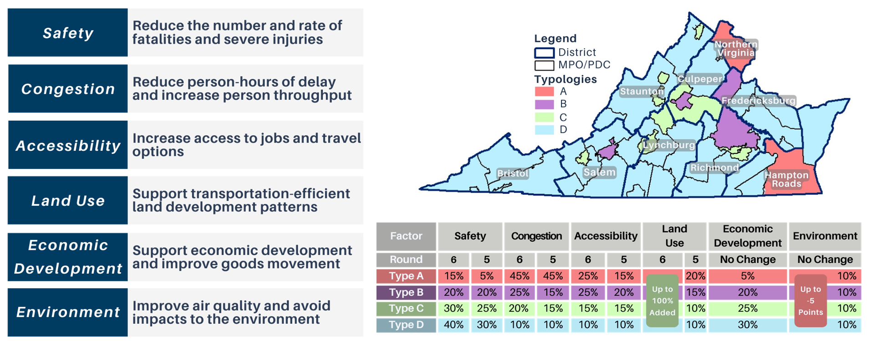
Process Overview and Support
Benefit Consider Area Type Weighting

Slide 10
Project Selection Process
Process Overview and Support
Step 1 – Fund top-scoring projects within each district eligible for Highway Construction District Grant Program (DGP) funds using DGP funds until the remaining funds are insufficient to fund the next highest-scoring project.
DGP eligibility pertains only to localities addressing a VTrans need
Step 2 – Fund remaining top-scoring projects statewide that are eligible for Highway High-Priority Projects Program (HPP) funds using HPP funds until the remaining funds are insufficient to fund the next highest-scoring project.
HPP eligibility pertains to localities, transit agencies, and regional entities addressing a VTrans need on either a Corridor of Statewide Significance (CoSS) or a Regional Network (RN), and refined policy definitions

Slide 11
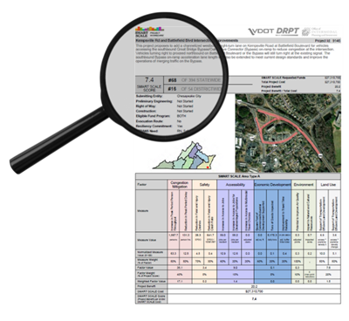
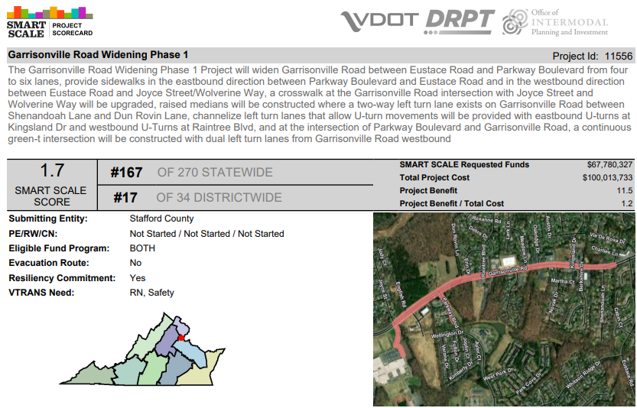
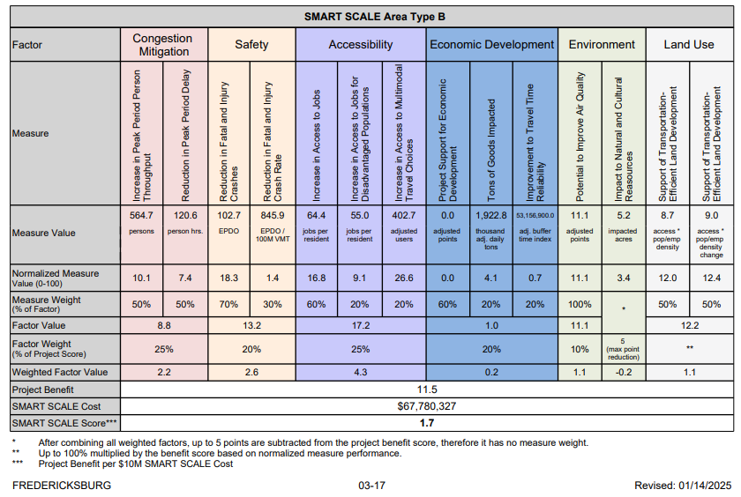
Scorecard Example
Process Overview and Support

Slide 12
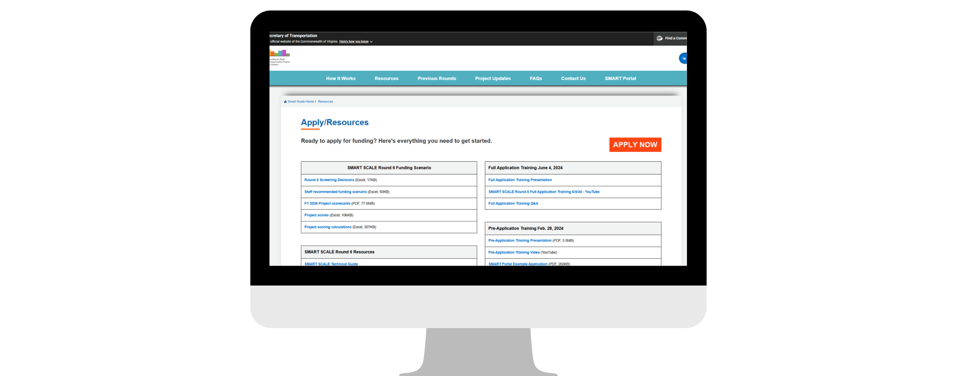
Support Available
Process Overview and Support
https://smartscale.virginia.gov/resources/
VDOT District Staff
Previous Staff, Scorers, Consultants
SMART SCALE Website
Resources
Previous Round Data
Technical Guide
SMARTPortal – Public Visibility
Scorecards
Town Halls, CTB Meetings
Trainings at Round Open
Quarterly MPO Meetings

Slide 13
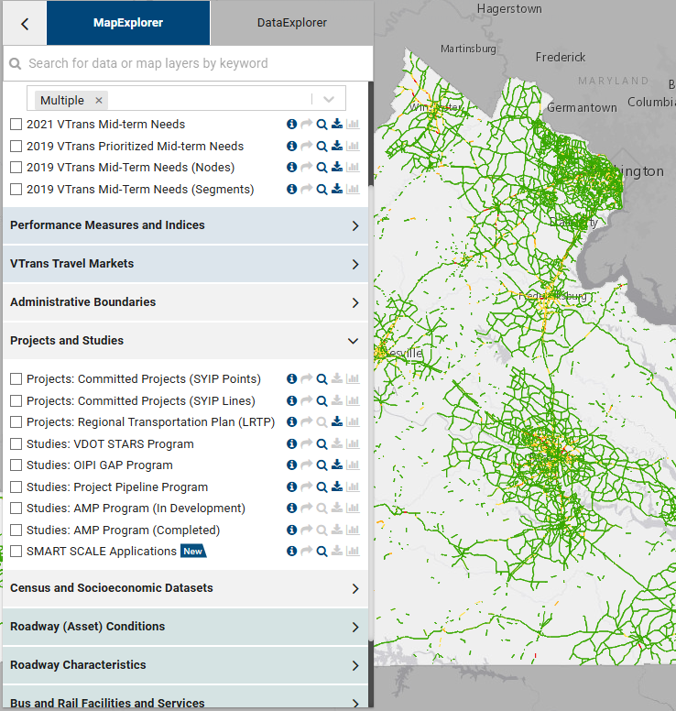
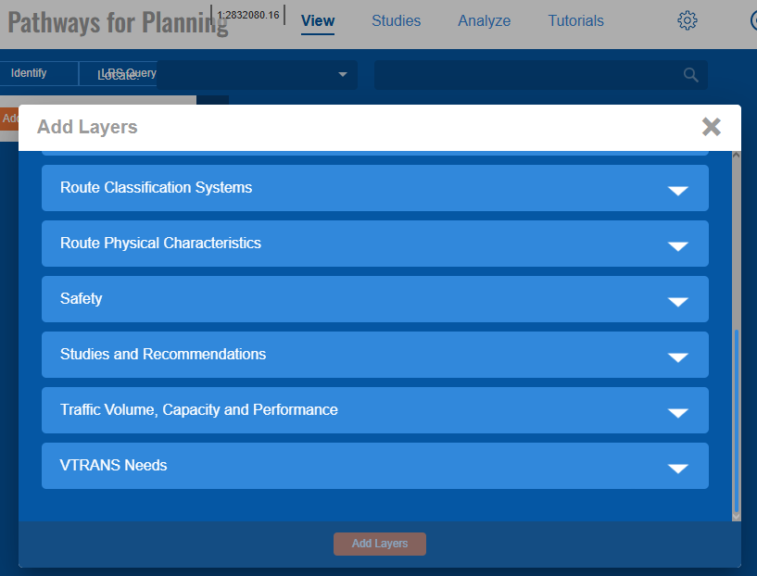
Process Overview and Support
Publicly Available Data Sources
Interact VTrans - vtrans.virginia.gov/
P4P - vdotp4p.com
VDOT TMPD-Managed Data repository site
Virginia Roads for Crash Data - virginiaroads.org
U.S. Census On the Map
Population Density, Points of Interest (HERE)
ArcGIS Online Map Population Density
Open Street Map Data
Economic Development – VEDP Sites
VDOT Tools Homepage - vdot.virginia.gov/doing-business/tools/
VDOT Junction Screening Tool – VJuST
VDOT Online Forms
Virginia Open Data Portal - https://data.virginia.gov/
Applicant-Provided Data - Regional Travel Demand Models, Traffic and Planning Studies – Volumes and Growth

Slide 14
Process Overview and Support
Regional Organizations Adopting SMART SCALE Like Processes
Central Virginia Transportation Authority (CVTA) - Regional Project Selection and Allocation Framework Page 9/PDF Page 11
Staunton-Augusta-Waynesboro Metropolitan Planning Organization (SAWMPO) - Chapter 6: Performance-Based Programming and Project Evaluation
In Round 6, Staunton and Richmond District captured 11 of 14 HPP Projects.

Slide 15
Performance-Based Planning
Performance-Based Planning
VTrans Prioritized Needs - Benefit score is project's impact to needs/problems
Identify the Right Solutions to Needs – Value Engineering
Cost Effectiveness

Slide 16
VTrans Prioritized Needs
Performance-Based Planning
ANY Mid-Term Need is acceptable for SMART SCALE
Locations with the greatest needs are VTrans Prioritized Needs
Priority 1 and 2 locations established in VTrans become eligible for study funding under the Project Pipeline program
Priority Needs are ranked 1 - worst 1%, 2 – worst 5%, 3 – worst 15%, 4 - remaining

Slide 17
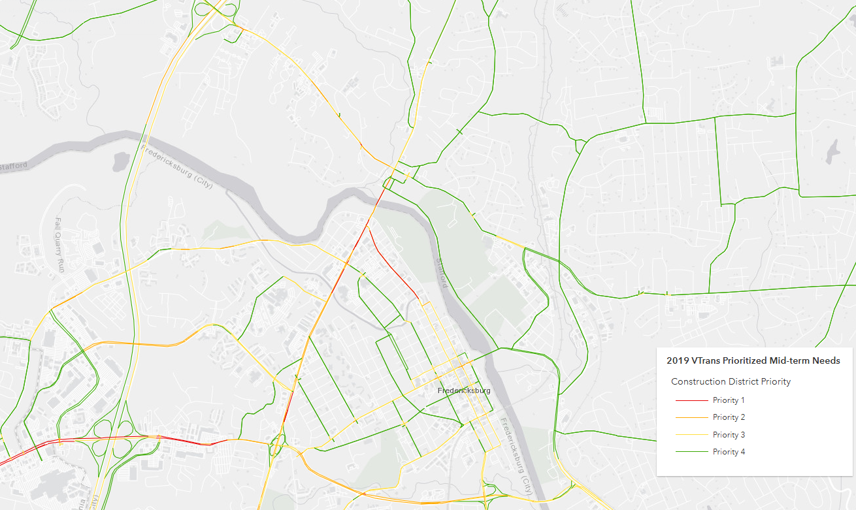
VTrans Prioritized Needs Construction District Priority
Performance-Based Planning
Priority 1 is highest need (red)
43 out of 53 (80%) of all Funded Statewide were located on a Priority 1 or 2 Construction District Priority Need
14 out of 14 (100%) of HPP Projects Funded Statewide were located on a Priority 1 or 2 Construction District Priority Need
https://vtrans.virginia.gov/interactvtrans/map-explorer

Slide 18
VTrans Prioritized Needs Construction District Priority
Performance-Based Planning
Funding Comparison by District
 |  | Priority 1 |  |  | Priority 2 |  |  | All Other Locations
District | Total Apps | Total | Funded | Not Funded | Total | Funded | Not Funded | Total | Funded | Not Funded
Bristol | 9 | 3 | 1 | 2 | 4 | 0 | 4 | 2 | 0 | 11
Culpeper | 18 | 6 | 2 | 4 | 12 | 2 | 10 | 0 | 2 | 6
Fredericksburg | 21 | 6 | 2 | 4 | 14 | 1 | 13 | 1 | 1 | 13
Hampton Roads | 21 | 11 | 6 | 5 | 8 | 3 | 5 | 2 | 3 | 10
Lynchburg | 6 | 1 | 1 | 0 | 4 | 2 | 2 | 1 | 2 | 6
Northern Virginia | 14 | 8 | 3 | 5 | 6 | 1 | 5 | 0 | 1 | 9
Richmond | 42 | 18 | 6 | 12 | 22 | 6 | 16 | 2 | 6 | 23
Salem | 22 | 5 | 0 | 5 | 15 | 1 | 14 | 2 | 1 | 12
Staunton | 20 | 12 | 4 | 8 | 8 | 2 | 6 | 0 | 2 | 7
 |  | 70 | 25 | 45 | 93 | 18 | 75 | 10 | 18 | 97
35% Success Rate
19% Success Rate
10% Success Rate

Slide 19
Performance-Based Planning
Identify the Right Solutions to Needs – Value Engineering
Right size the application scope (corridor size) to the worst performance locations
Planning Studies to determine Preferred Alternative
Incorporate STARS (https://www.vdot.virginia.gov/projects/project-planning/stars-projects/) and Pipeline (https://vaprojectpipeline.virginia.gov) program methodologies
Consider most cost-effective solution in preferred alternative selection
Frequently, the solution has already been determined, value engineering not considered

Slide 20
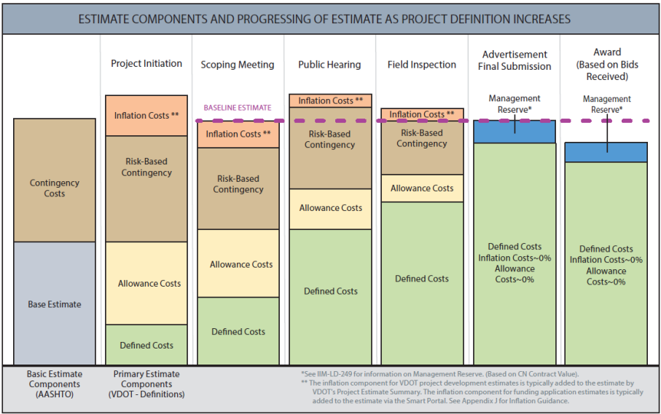
Performance-Based Planning
Cost Effectiveness
Cost Estimates
Work with VDOT District early and often
Reduce risk and contingency
If possible, apply when ready for last dollars

Slide 21
Performance-Based Planning
Cost Effectiveness
Applicants are not “buying down” the requested amount with leverage
Average Funded Project Request Round 6 – $18.6M (all) and $27.2M HPP

Slide 22
Key Takeaways
Performance-Based Planning
Focus on Priority 1 & 2 locations
Value Engineer Solutions
Partnership in cost estimate preparation
Not what percent you leverage; it is what amount is requested
Acknowledge reasons why performance-based planning is overlooked
Local board members expect an application in their district
Pressure to apply for maximum application limit cap
Complaints received in an area that is perceived issue, but doesn’t have supporting historical data
Solution has already been determined; value engineering not considered

Slide 23
Project Example
Example Project – ID 11556 (Garrisonville Rd Widening Phase 1)
Example Project – ID 11556 (Garrisonville Rd Widening Phase 1) used to illustrate how the SS Application is reviewed and scored
Initial High-level Considerations or Project Characteristics that identify a benefit/high scoring project – key information for applicant to consider
Detailed Computations of Project Benefit and SS Score

Slide 24
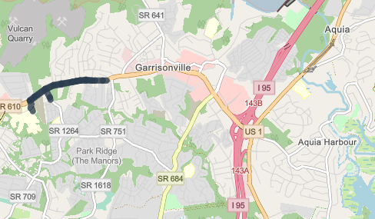

General Information
Example Project – ID 11556 (Garrisonville Rd Widening Phase 1)
Scope: Widen approx. 0.8 miles WB/1.05 miles EB of Garrisonville Rd between Parkway Blvd and Eustace Rd (from 2 lanes to 3 lanes) and convert Garrisonville Rd/Parkway Blvd to a signalized Continuous-Green T. Includes medians, turn lanes, new sidewalks, new crosswalks, and bus stop improvements.
Cost: $100M total, $68M requested, $32M leveraged
Eligibility: Both DGP and HPP funding
Project is in Area Type B
Stafford County
Factor | Safety | Congestion | Accessibility | Land Use | Econ Dev | Environmental
Value for Area Type B | 20% | 25% | 25% | N/A* | 20% | 10%
Reminder: Land Use score is based on a multiplier and does not have a set value. The multiplier is normalized statewide between 0 and 1.

Slide 25
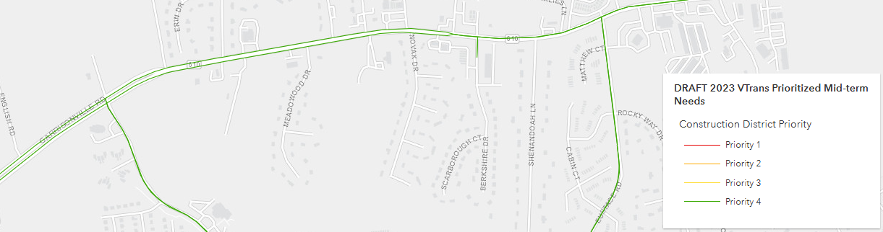
Example Project – ID 11556 (Garrisonville Rd Widening Phase 1)
Performance – VTrans Priority
Garrisonville Road Project - Entire study area is Construction District Priority 4
Based on this priority rating, it is a below-average need location

Slide 26
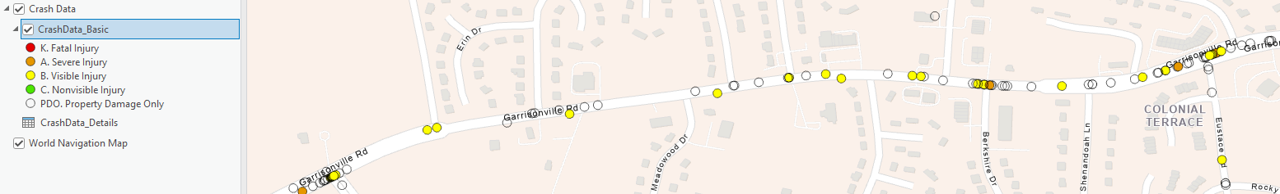
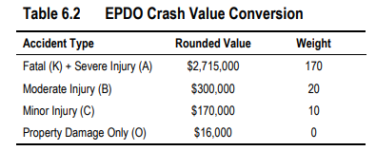
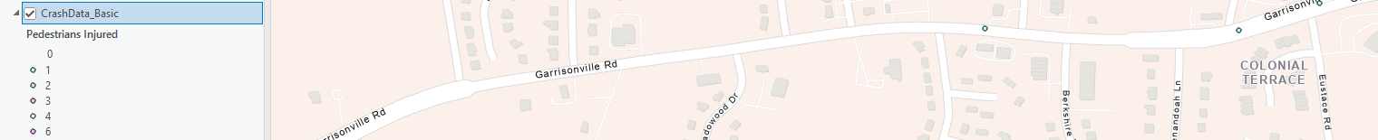
Example Project – ID 11556 (Garrisonville Rd Widening Phase 1)
EPDO of Fatal and Injury Crashes S.1
Initial High-level Considerations
Area Type B
Possible Benefit Points = 14
Refer to Virginia Roads, filter to 2019-2023 and remove PDO
Many (24) B injury crashes, a few (3) A injury crashes, a few pedestrian ~4
Consider most impactful Crash Modification Factors in high-level – CGT, Widening at Int, Median, Sidewalk
CMF range (0.6 – 0.85), so let’s assume 0.7 generally
[(24 B * 20 EPDO * 0.7 CMF = 336) + (3A * 170 EPDO * 0.7 CMF = 357)] / Divide by 5 Years = 140 EPDO Crashes/Year. This means less than 1 K or A crash or about 7 B crashes per year will be avoided.

Slide 27
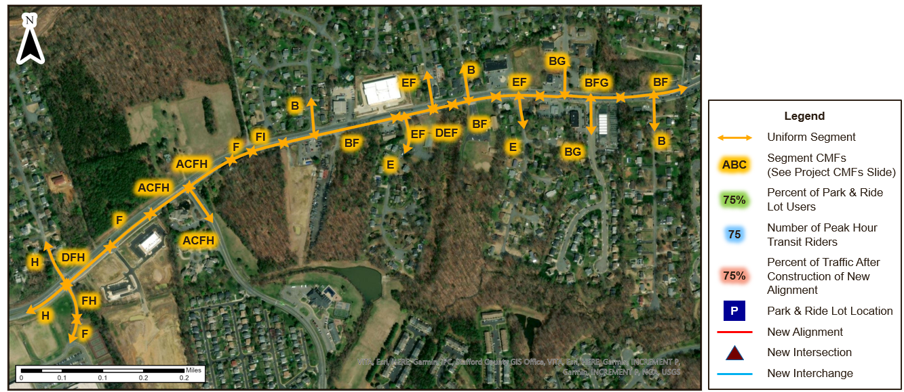
Example Project – ID 11556 (Garrisonville Rd Widening Phase 1)
EPDO of Fatal and Injury Crashes S.1
Detailed Computations
Area Type B
Possible Benefit Points = 14
Segment roadway by uniform improvement type to use for Crash Modification Factors CMF identification

Slide 28
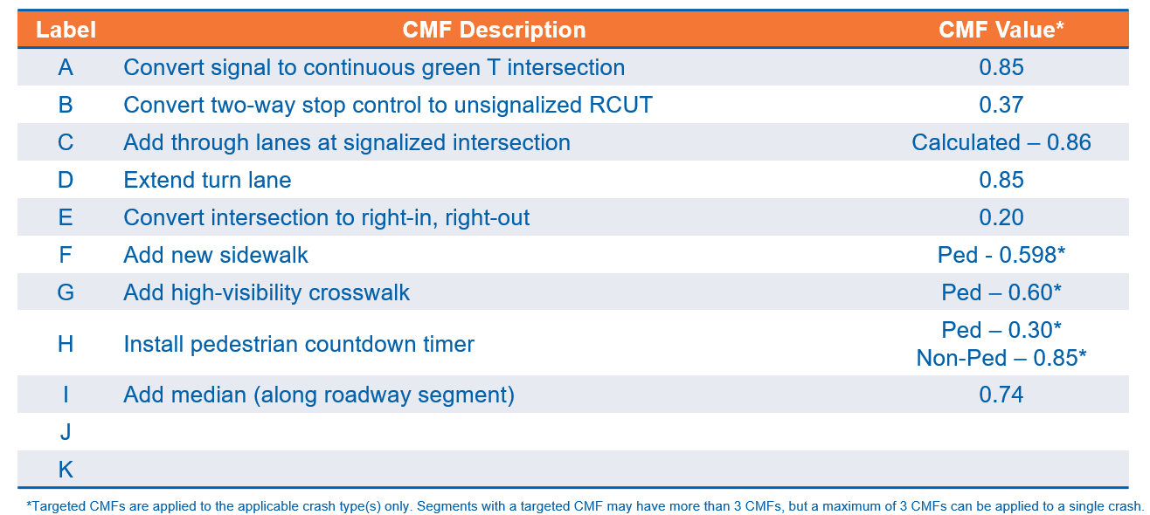
Example Project – ID 11556 (Garrisonville Rd Widening Phase 1)
EPDO of Fatal and Injury Crashes S.1
Detailed Computations
Area Type B
Possible Benefit Points = 14
Identify Crash Modification Factors

Slide 29
Example Project – ID 11556 (Garrisonville Rd Widening Phase 1)
EPDO of Fatal and Injury Crashes S.1
Detailed Computations
Area Type B
Possible Benefit Points = 14
Apply Crash Modification Factors (maximum of three per segment)

Slide 30
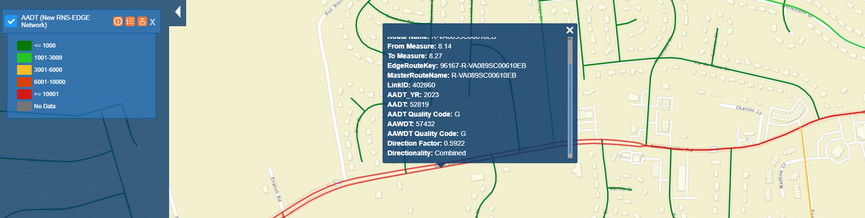
Example Project – ID 11556 (Garrisonville Rd Widening Phase 1)
EPDO Rate of Fatal and Injury Crashes S.2
High-level Concept
Area Type B
Possible Benefit Points = 6
Combine in AADT, consider the lower the AADT the higher the rate per crash
5-year crashes - (24 B * 20 EPDO * 0.7 CMF = 336) + (3A * 170 EPDO * 0.7 CMF = 357) = 693
AADT to VMT = 57, 432 * 0.8 miles * 365 days * 5 years = 83,850,720
Crash Rate = (Number of Crashes) / (Total Vehicle Miles Traveled) * 100,000,000
Crash Rate per 100,000,000 miles = (693 / 83,850,720) * 100,000,000 = 826

Slide 31
Example Project – ID 11556 (Garrisonville Rd Widening Phase 1)
EPDO Rate of Fatal and Injury Crashes S.2
Detailed Computations
Area Type B
Possible Benefit Points = 6

Slide 32
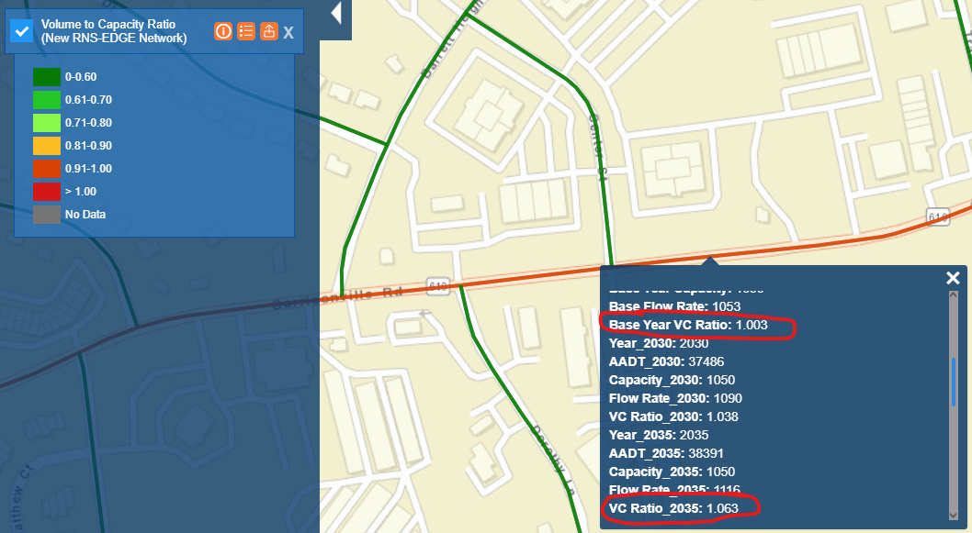
Example Project – ID 11556 (Garrisonville Rd Widening Phase 1)
Congestion Throughput C.1 – Highway
Initial High-level Considerations
Area Type B
Possible Benefit Points = 12.5
Use the attribute information to gather the 2030 V/C, slightly over capacity, would expect the bottom 10% for throughput
Are we moving a bottleneck? Existing there are three lanes East of Eustace and two lanes west of Parkway Boulevard

Slide 33
Example Project – ID 11556 (Garrisonville Rd Widening Phase 1)
Congestion Scoring General
Initial High-level Considerations – No Impact Projects
Area Type B
Possible Benefit Points = 12.5
No Congestion Impact Projects
Turn lane extensions ⮽
Traffic signal retiming or traffic signal coordination projects ⮽
Installation of dynamic flashers, rumble strips, or improved signage ⮽
Widening shoulders
the inside (left) of a freeway or divided multi-lane highway (lateral clearance always assumed to be 6 feet) ⮽
outside (right) shoulder of a freeway or multi-lane highway if the existing lateral clearance is 6 feet or greater ⮽
Vertical or horizontal curve realignment without widening the lane or shoulder widths ⮽

Slide 34
Example Project – ID 11556 (Garrisonville Rd Widening Phase 1)
Area Type B
Possible Benefit Points = 12.5
Congestion Person Throughput C.1 – Highway
Detailed Computations
Change in corridor total (multimodal) person throughput attributed to the project, seven years in the future.
The Highway calculations are semi-automated through the use of 3 tools
Volumes and growth are provided via applicant studies, if not, we use P4P
Segment and intersection analysis, methodologies are outlined in the technical guide Chapter 7 referencing Highway Capacity Manual 6 methodologies, which is the basis for our in-house developed tools
For Segment analysis - Bureau of Public Roads (BPR) equations. Nationally, the BPR equation is the mostly widely used volume-delay function for road segments.
You can hand-calculate these measures, and this BPR example is provided in the Appendix
For Intersection analysis – use FHWA Cap-X evaluation tool that uses critical lane volumes (CLV) to evaluate the efficiency of intersections and interchanges
Applicant-Provided Travel Demand Model – for new alignments, widenings greater than 1 mile

Slide 35
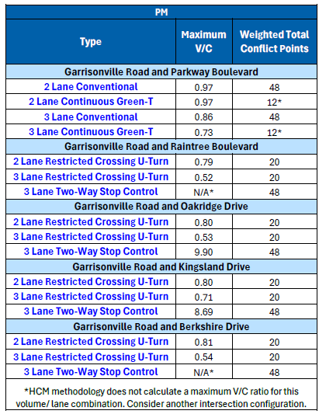
Example Project – ID 11556 (Garrisonville Rd Widening Phase 1)
Congestion Throughput C.1 – Highway
Initial High-level Considerations
Area Type B
Possible Benefit Points = 12.5
Intersection level, applicant can reference the VDOT provided VJust Tool
Pulled from applicant-provided study
From this, selected 3-lane CGT
Pay attention to existing V/C, less than 1

Slide 36
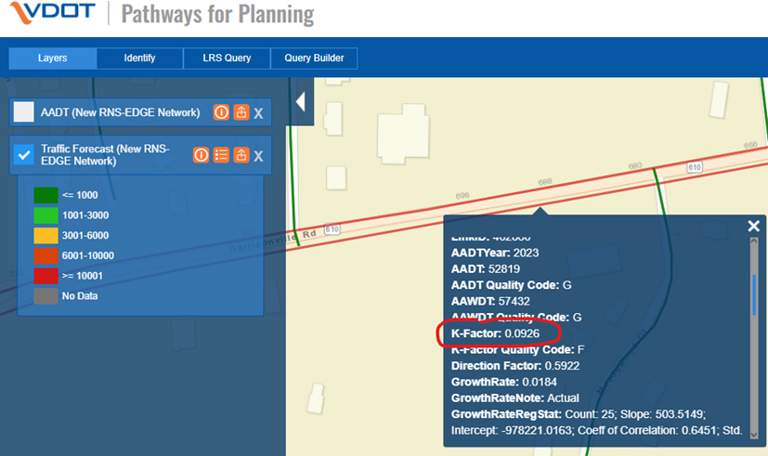
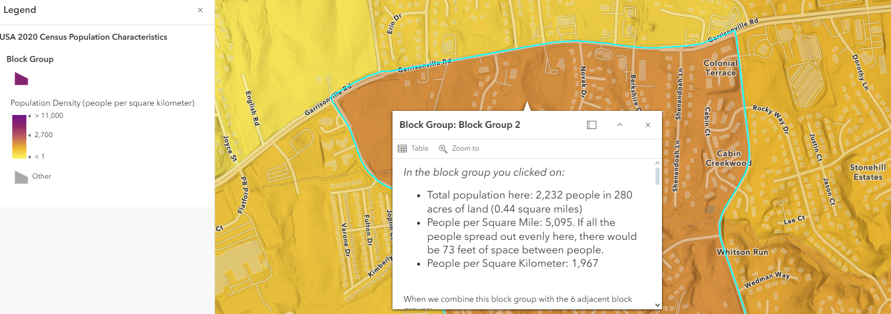
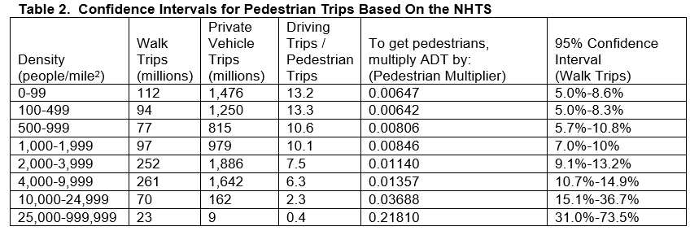
Example Project – ID 11556 (Garrisonville Rd Widening Phase 1)
Congestion Person Throughput C.1 – Non-SOV
Detailed Computations for Ped Volumes
Area Type B
Possible Benefit Points = 12.5
Pedestrian - (AADT*k-factor) on the roadway directly adjacent and multiplying the result by a pedestrian multiplier
ArcGIS Online Map Population Density
Pedestrian Multiplier Table 5,095 people per square mile = Ped Multiplier of 0.01357
Traffic Forecast P4P
New Ped Users = 57,500*0.0926 *0.0137 = 73 person

Slide 37
Example Project – ID 11556 (Garrisonville Rd Widening Phase 1)
Congestion Person Throughput C.1 – Non-SOV
Detailed Computations for Transit
Area Type B
Possible Benefit Points = 12.5
Stop-level improvements without added service are simplified to ~ 2 new users
Therefore, the total Non-SOV users added (peak period) = 78 + 2 = 80 New Users
Summary Transit Scoring if project warrants segmentation scoring (new high-capacity service, increased headway)
What is the highest volume on this roadway?
What is the highest volume of transit ridership either on the roadway route or parallel?
Reduce the roadway volume by the increase in transit ridership from the project

Slide 38
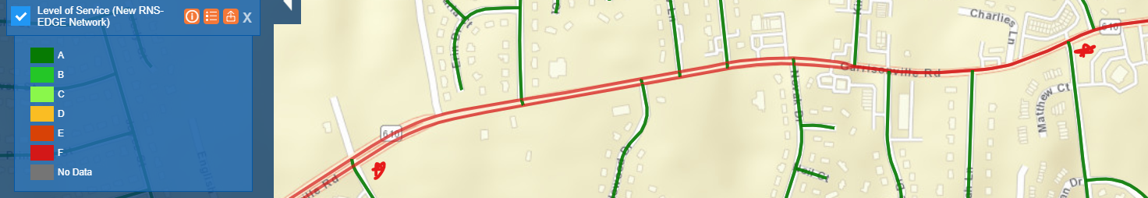
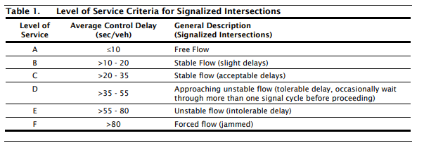
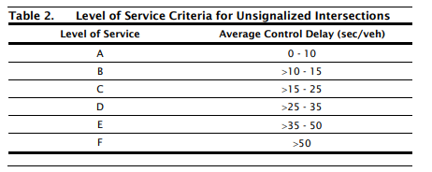
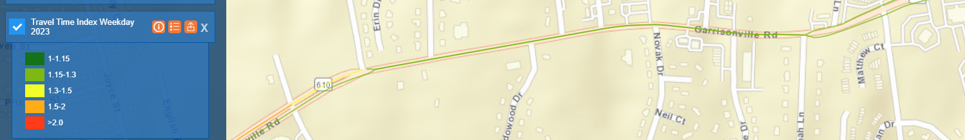
Example Project – ID 11556 (Garrisonville Rd Widening Phase 1)
Congestion Person-Hours of Delay C.2 – Highway
Initial High-level Considerations
Area Type B
Possible Benefit Points = 12.5
LOS E, but travel time index is good
Look at the provided study for Operational Analysis

Slide 39
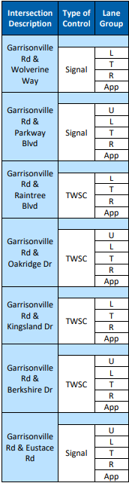


Example Project – ID 11556 (Garrisonville Rd Widening Phase 1)
Congestion Person-Hours of Delay C.2 – Highway
Initial High-level Considerations
Area Type B
Possible Benefit Points = 12.5
Interim
No-Build
Interim
Build
Synchro (microsimulation) is not related to BPR/CAP-X, but if you are not seeing big improvements in Synchro analysis, there won’t be in CAP-X
Provided Study has interim year at 2031
Look at Synchro Results PM Peak
Parkway – 10s delay improvement – New CGT
Raintree – 20s delay improvement
Oakridge – 65s delay improvement
Kingsland – 5s delay improvement
Berkshire – 5s delay improvement
Eustace – 15s delay improvement
Note this is an intersection level only
Most (if not all) of the score for this project will come from the segment (BPR) calculations

Slide 40
Example Project – ID 11556 (Garrisonville Rd Widening Phase 1)
Congestion Person-Hours of Delay C.2 – Highway*
Detailed Computations
Area Type B
Possible Benefit Points = 12.5
The decrease in person hours of delay (C.2) is calculated as the difference in person hours of delay between the No-Improvement and Improvement scenarios
As mentioned earlier, the congestion calculation is semi-automated through the use of 3 tools BPR, CAP-X, and Travel Demand Model, fed by volumes in applicant-provided studies looking 7 years in the future
BPR calculations are in the appendix
* No delay score is given for Bike and Pedestrian components

Slide 41
Example Project – ID 11556 (Garrisonville Rd Widening Phase 1)
Access to Jobs (and for Disadvantaged) A.1 and A.2
Initial High-level Considerations
Area Type B
Possible Benefit Points = 15
Change in average job accessibility per person (A.1)/disadvantaged populations (A.2) within 45 minutes by driving (within 60 minutes for transit, bicycle, and pedestrian projects)
Auto/Highway Mode - Requires a change improvement speed (derived from C.2 calculation), more specifically segment (BPR).The greater the change in speed, the greater the score.
Pedestrian – highest scores for new facilities; upgrades have a small impact
Not eligible – 1. Replacing the existing as-is 2. Crosswalks (new or existing), except combining a NEW refuge island, pedestrian signal, push button, or HAWK/PHB/RRFB
Transit – scores for new routes, change in headway, new/relocated stops
Not eligible – 1. Upgrading bus stop amenities 2. Increasing capacity without changing travel time or schedule
Receives a score for each mode with a direct improvement, example project:
Auto/Highway ☑ Change in speed >20 mph (refer to appendix congestion ex for speed change calc)
Pedestrian ☑New Sidewalk
Bicycle ⮽
Transit ⮽ - No score for amenity improvements

Slide 42
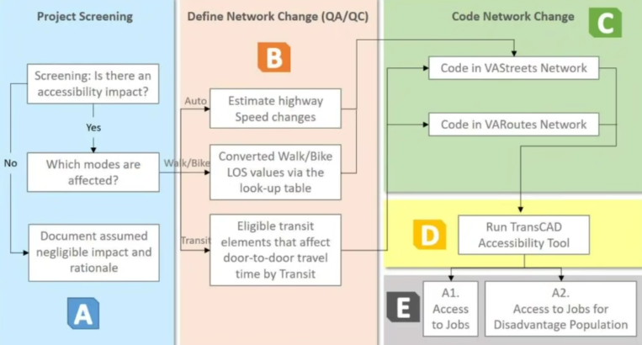
Example Project – ID 11556 (Garrisonville Rd Widening Phase 1)
Access to Jobs A.1/A.2
Detailed Computations

Slide 43
Example Project – ID 11556 (Garrisonville Rd Widening Phase 1)
Access to Jobs A.1/A.2
Detailed Computations
Area Type B
Possible Benefit Points = 15
Determine project limits and the type of improvement
Auto, Park and Ride - change in travel speed
Bike/Walk
Identify adjacent roadway facility - functional class, number of lanes, and speed limit
Check the Level of Service (LOS) value via the lookup table*, which considers the changes in speed from the congestion score and other characteristics mentioned in step 2
Code the LOS value for base/project conditions on selected project links in the scoring tool
Define Influence/Buffer Area 45 miles around project (Auto/Transit), 10 miles Bike, 3 miles for walk
Run the tool (TransCAD) to obtain Accessibility scores by each mode type (there has to be a direct improvement to the mode to begin calculation) –
*Please refer to Slide 74 for lookup tables.

Slide 44
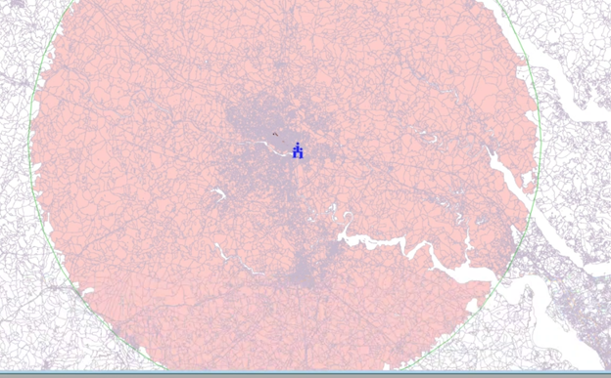
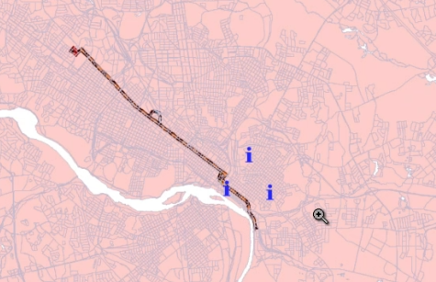

Example Project – ID 11556 (Garrisonville Rd Widening Phase 1)
Access to Jobs A.1/A.2
Detailed Computations Example
Area Type B
Possible Benefit Points = 15
The overall accessibility score for a defined catchment area is calculated using a population-weighted average of the cumulative decayed job access scores for each block group. Each block group contributes to the final score proportionally to its population.
𝐶_𝑗𝑜𝑏_𝑛 be the cumulative decayed* job score for block group n, using the decay-weighted sum of reachable jobs,
Pop n is the population of block group n,
N is the total number of block groups within the catchment area.
$Accessibility_Score=\frac{{Pop}_{1}×{C_job}_{1}+{Pop}_{2}×{C_job}_{2}+…+{Pop}_{N}×{C_job}_{N}}{{Pop}_{1}+{Pop}_{2}+…+{Pop}_{N}}$
Weight by disadvantaged populations for A.2
Note: Accessibility tool calculates these numbers based on a travel time decay function, where jobs within a shorter travel time are weighted more than jobs farther away. For more information on decay functions SSTI Reference-
A Guide For Transportation And Land Use Practitioners
Example has 44,000 census blocks

Slide 45
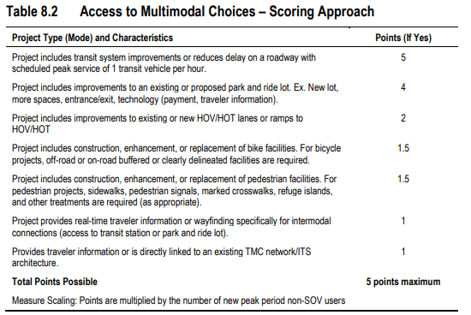
Example Project – ID 11556 (Garrisonville Rd Widening Phase 1)
Access to Multimodal Choices A.3
Initial High-level Considerations / Detailed Calcuation
Area Type B
Possible Benefit Points = 5
5 Points *Non-SOV 80 = 400

Slide 46
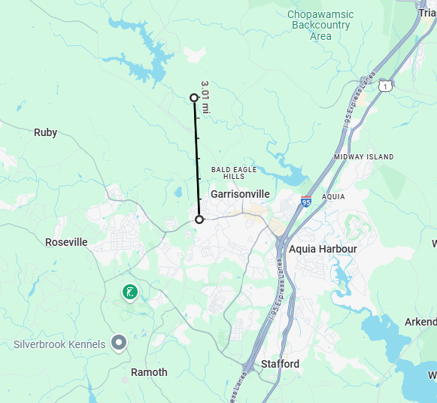
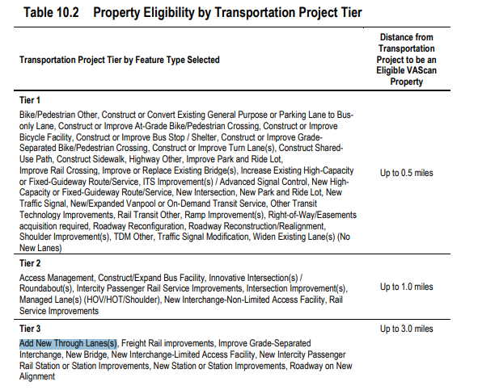
Example Project – ID 11556 (Garrisonville Rd Widening Phase 1)
Project Support for Economic Development ED.1
Initial High-level Considerations
Area Type B
Possible Benefit Points = 12
Define Search Area Distance Table 10.2
Use Google Maps to Define Search Area

Slide 47
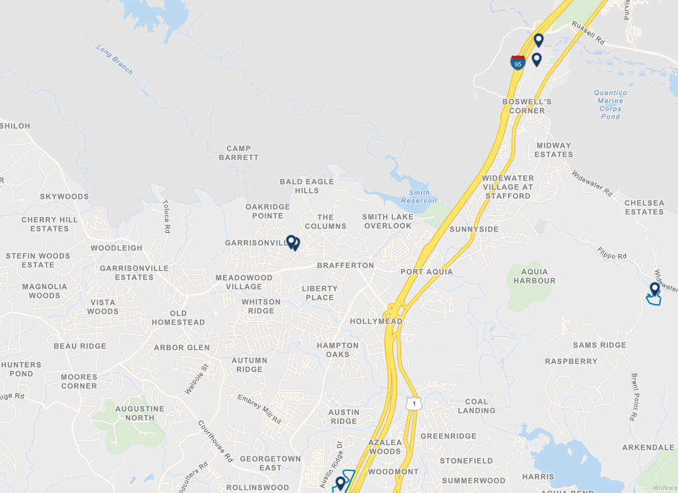
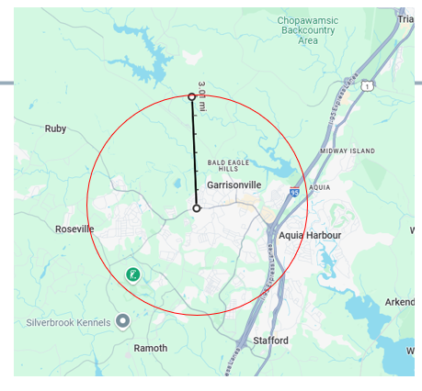
Example Project – ID 11556 (Garrisonville Rd Widening Phase 1)
Project Support for Economic Development ED.1
Initial High-level Considerations
Area Type B
Possible Benefit Points = 12
VEDP Site Search - https://sites.vedp.org
There are two properties, but no VEDP sites
Sites are the polygons
Score will be zero
Generalizations
Typically, the larger the site, the higher the score
ED.1 Round 6 results to estimate
VEDP Sites are incorporated with Portal App
Work with VEDP ahead of Aug 1 submission if you believe there are missing sites
Site
Site

Slide 48
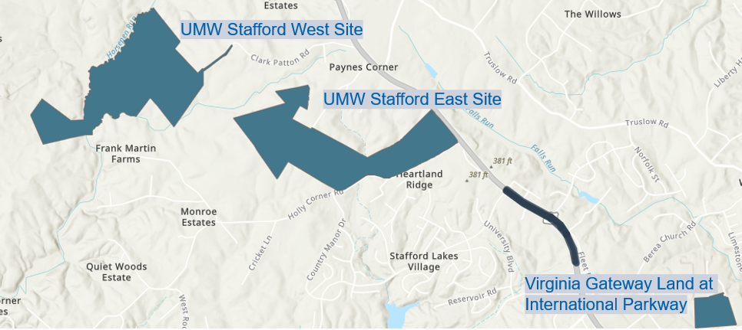
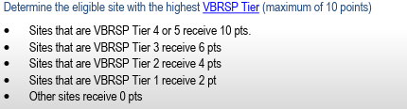
Example Project – ID 11556 (Garrisonville Rd Widening Phase 1)
Project Support for Economic Development ED.1
Detailed Computations Ex. Warrenton Road Widening (11641)
Area Type B
Possible Benefit Points = 12
Add New Through Lanes – 3 mile search
Calculate Economic Impact Points using Historical Model
Jobs Creation – 380 – normalize this to 40 pts
CapEx – 490 – normalize this this to 25 pts
Funding Points (Y/N) – 15 pts Go VA, Tobacco Com, VBRSP ⮽
Project Site Visit Points – normalized to 10pts by # of visits ⮽
Highest VBRSP Tier Site –10pt ☑ Virginia Gateway Land at International Parkway is Tier 2 – 4pts
Calculate Final Measure
DISPLAY_ID | Jobs | Capex | Funding Received | Site Visits | Highest VBRSP Tier Site | Normalized_Jobs | Normalized_CapEx | Funding_Points | Normalized_Visits | Tier_Points | Measure_Value | Normalized_Score
11641 | 380 | 490.93 | No | 0 | 2 | 3.45 | 1.72 | 0 | 0 | 4 | 9.17 | 10.27
$$ED1Measure Value=3.45+1.72+0+0+4=9.17$$

Slide 49
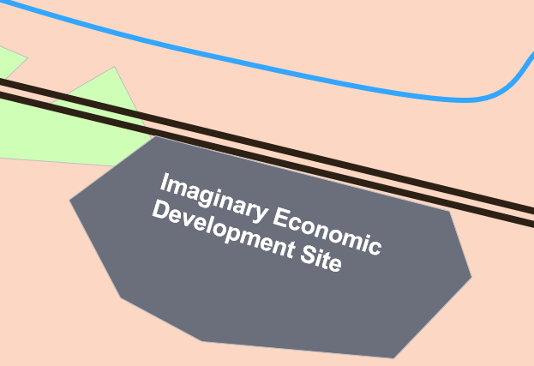
Example Project – ID 11556 (Garrisonville Rd Widening Phase 1)
Project Support for Economic Development ED.1
Historical Model Background – Linear Regression Model
Area Type B
Possible Benefit Points = 12
The Historical Projects Model (HPM) is a tool to provide bulk estimates for the announced jobs and capital expenditure (CapEx) a property could generate if it were to receive an economic development project. These estimations are created by a linear regression model, which considers the size of the property and its geographic location. These figures represent the jobs and CapEx that have typically been associated with similar properties in the past.
Property Size (~ 60% of score)
Geographic Location (~40% of score)
~15% surrounding terrain - Developed/Forest/Swamp/)
Remaining ~20-25%
Industry Sector (Knowledge Work/Logistics/Manufacturing)
Wages for each industry sector w/in 45-minute drive
Potential Employees (workforce w/ in a 45-minute drive)
Educational pipeline – Student population and Research Universities within 20 miles
Metropolitan Statistical Areas (MSA) Classification
Access to Infrastructure – ports/airports within 30 miles
Utilize - https://onthemap.ces.census.gov

Slide 50
Example Project – ID 11556 (Garrisonville Rd Widening Phase 1)
Intermodal Access and Efficiency ED.2
Initial High-level Considerations
Area Type B
Possible Benefit Points = 4
Key Components
Does the project improve freight access? ☑ Widening
Delay Score > 0 ☑ Yes
Freight Volume – <2% HV ~1000
Low Freight Volume is the major indicator of score
Points range from 0-6
Range of score is 0 – 6,000
Round 6 high score 47,000

Slide 51
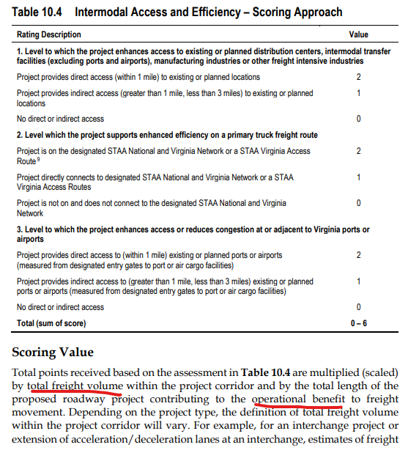
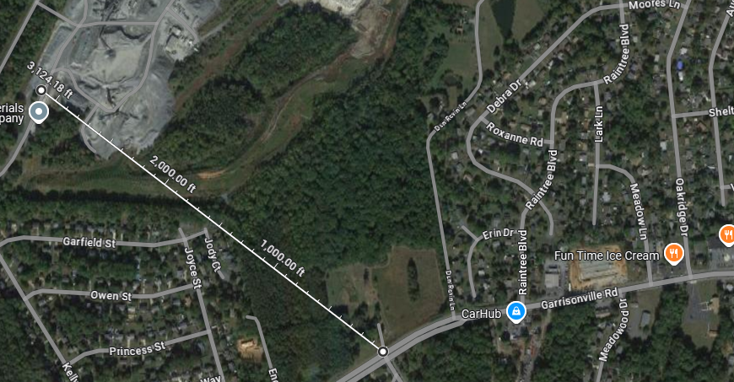
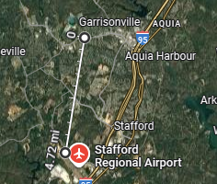
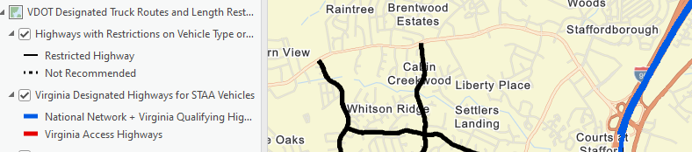
Example Project – ID 11556 (Garrisonville Rd Widening Phase 1)
Intermodal Access and Efficiency ED.2
Detailed Computations
Area Type B
Possible Benefit Points = 4
Add in Point Calculation
Google Imagery Search – Distribution Facilities - Quarry ☑
ArcGIS Online STAA Routes - None = 0 ⮽
ArcGIS Online Ports and Airports – None 0 ⮽
Delay Score > 0 ☑
Freight Volume –< 2% HV ~1,200
Project length 0.8
Measure = (2+0+0) * 1,200 *0.8 = 1,920 (1,922 official score)

Slide 52
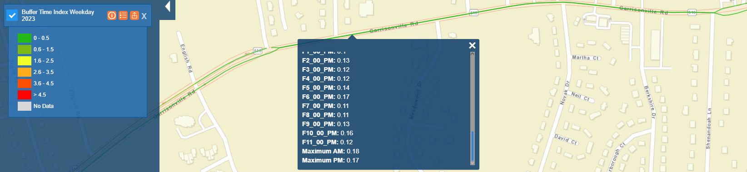
Example Project – ID 11556 (Garrisonville Rd Widening Phase 1)
Travel Time Reliability ED.3
Initial High-level Considerations
Area Type B
Possible Benefit Points = 4
Point-based system, scaled by :
P4P – Buffer Time Index Weekday = round up 0.2
Note: SMART SCALE official score uses Buffer index (BI) from University of Maryland Regional Integrated Transportation Information System (RITIS)
Corridor VMT – refer to S.2- AADT to VMT = 57, 432 * 0.8 miles * 365 days = 16,700,000
BTI * VMT * [(Incident Freq, range 0-2 * EPDO Score, range 0-5) + (Weather Impact, range 0-2 * Frequency, range 0-2)]
Range of Score 0 to 50,000,000 >> max RD 6 score was over 1 Billion, so assume small impact

Slide 53
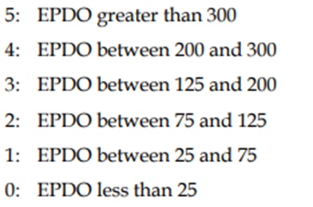
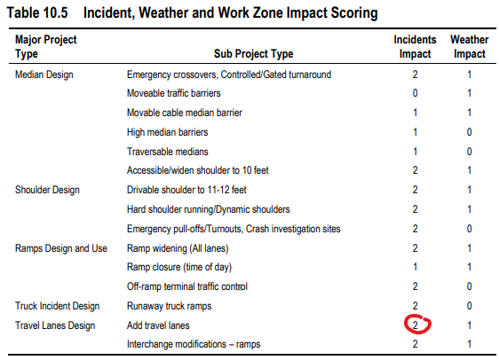
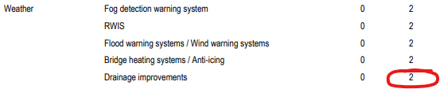
Example Project – ID 11556 (Garrisonville Rd Widening Phase 1)
Travel Time Reliability ED.3
Detailed Computations
Area Type B
Possible Benefit Points = 4
Point based system, scaled by:
RTIS gave higher BTI at 0.24
PDOs boosted to above 300 - 5 Points
Max Points were given
BTI x VMT x [(Incident Freq, range 0-2 x EPDO Score, range 0-5) + (Weather Impact, range 0-2 x Frequency, range 0-2)]
= 0.24 x 16,700,000 VMT x [(2x5) + (2x2)] = 56,112,000
Official Score = 53,156,903, official difference is exact VMT

Slide 54
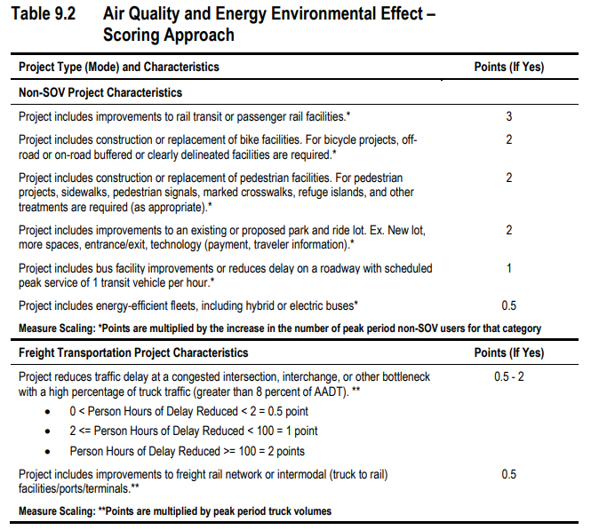


Example Project – ID 11556 (Garrisonville Rd Widening Phase 1)
Air Quality and Energy Environmental Effect E.1
Initial High-level Considerations
Area Type B
Possible Benefit Points = 10
Part 1 (50% of Score)
Point-based system Scaled by:
New Non-SOV Users Normalized to 50 ☑ 80 New Non-SOV Users (Ped and Transit) = 3pts * 80 = 240
Peak period truck volumes IF tuck volume > 8% Normalized to 50 ⮽ ED.2 slide < 2% truck volume
Part 2 (50% of Score)
50% CO₂ Offset Due to:
Increased Non-SOV VMT
+
Due to Reduced Heavy Vehicle Hours of Delay (HVHD)
Score is going to primarily come from new ped users

Slide 55

Example Project – ID 11556 (Garrisonville Rd Widening Phase 1)
Air Quality and Energy Environmental Effect E.1
Detailed Computations
Area Type B
Possible Benefit Points = 10
Part 1 (50% of Score)
Point-based system Scaled by:
New Non-SOV Users, Normalized to 50 = (3 points x 80 users = 160) normalized to 22 +
Peak period truck volumes IF tuck volume > 8%, Normalized to 50 = (0) normalized to 0
Part 1 = 22 -> this is normalized to 17.7 x 50% of Score = 8.9
Part 2 (50% of Score)
50% CO₂ Offset Due to:
Increased Non-SOV VMT = [80 users x0.67 miles average trip length] x (1 gal/24miles ) x (8.9 kgCO₂/1 gal gas) = 20 kgCO₂ gets normalized to
Due to Reduced Heavy Vehicle Hours of Delay (HVHD) = [2% Trucks x120.6 Delay red/(1.2 Persons/Vehicle)]x 0.44 x 8.9 = 8 kgCO₂ gets
Part 2 = 28 total kgCO₂ ,Normalized to 4.5 x 50% of Score = 2.25
Part 1 and Part 2 Combined Score = 11
Refer to Oct 2021 CTB Presentation, Dec 2021 CTB Presentation for a more examples and information

Slide 56
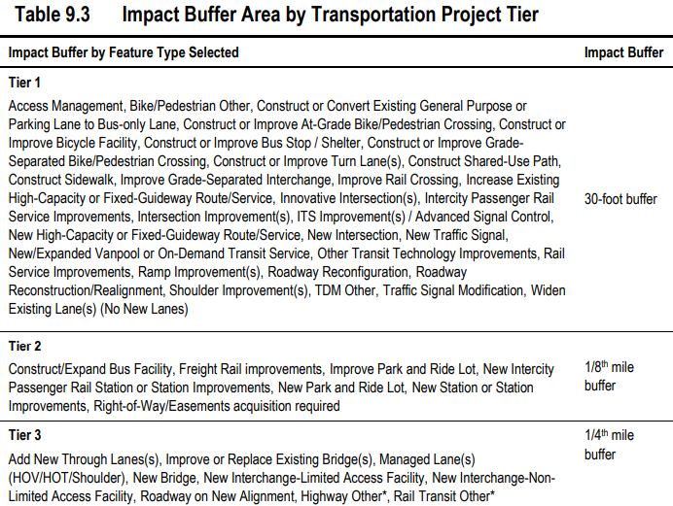


Example Project – ID 11556 (Garrisonville Rd Widening Phase 1)
Impact to Natural and Cultural Resources - E.2
High-level Concept
Area Type B
Possible Benefit Points = -5
Identify if project is low impact:
Project length/size 0.8 miles
Type of Project (Table 9.3) buffer area – Tier 3, ¼ mile
Type of Document (Chapter 12.0 of Tech Guide) – CE = 10%
Maximum Possible Impact Area = (0.8 mile * 0.25 mile) * 640 ac/sq mile * 10% = 12.8 acres
“Top” Score was 117, so maximum subtraction 0.5pts, but will most likely be less
Impact Area is overlaid with Natural/Cultural Resources layers (Next Slide)

Slide 57
Example Project – ID 11556 (Garrisonville Rd Widening Phase 1)
Impact to Natural and Cultural Resources - E.2
Background Information
Area Type B
Possible Benefit Points = -5
This data is protected by individual data-sharing agreements directly with each agency and can be engaged on an agency level. Publicly Available
Conservation Lands
Appalachian Trail Conference Appalachian Trail
Virginia Outdoor Foundation Protected Easements
Virginia Department of Conservation and Recreation Conservation Land
Virginia Department of Conservation and Recreation 6F properties
Virginia Department of Conservation and Recreation Natural Heritage Screening Sites
Virginia Department of Forestry Agricultural/Forest Districts
Species/Habitat
Virginia Department of Wildlife Resources Threatened and Endangered Species
Virginia Department of Wildlife Resources – Bats and Roost Trees
Cultural Resources
National Park Service, American Battlefield Protection Program Potential National Register (POTNR) Areas
Virginia Department of Historic Resources Architecture layer: properties listed in or determined eligible for listing in the National Register of Historic Places (“NRE Eligibility Status”)
Virginia Department of Historic Resources Archeology layer: sites listed in or determined eligible for listing in the National Register of Historic Places (“NRE Eligibility Status”)
Virginia Department of Conservation and Recreation Conservation Lands (Managing Agency= Virginia Department of Historic Resources)
Wetlands
U.S. Fish and Wildlife Service National Wetlands Inventory

Slide 58



Example Project – ID 11556 (Garrisonville Rd Widening Phase 1)
Future Transportation Efficient Land Use - L.1/L.2 (Horizon)
Initial High-level Considerations
Area Type B
1 – 2 Multiplier
Geographic Scope is the number one influence for score:
ArcGIS Online Map Population Density within one-mile
Non-Work Destinations within one-mile walk (HERE official)
New walk connections made by project
Map with Census density data and Open Street point-of-interest data

Slide 59


Example Project – ID 11556 (Garrisonville Rd Widening Phase 1)
Future Transportation Efficient Land Use - L.1/L.2 (Horizon)
Detailed Computations
Area Type B
1 – 2 Multiplier
Uses Accessibility Tool in TransCAD
Runs the walk module with 1-mile buffer
Non-work destinations, scaled by type
Assign LOS Change – same method as Accessibility Team (Slide 74)

Slide 60

Scorecard
Example Project – ID 11556 (Garrisonville Rd Widening Phase 1)
12.5%
12.5%
14%
6%
15%
5%
5%
12%
4%
4%
10%

Slide 61
Next Steps
February to May – Board to consider potential revisions to staff-recommended funding scenario
May 6 – Fredericksburg FY2026-2031 Six-Year Improvement Program Spring Meetings
May CTB meeting – Consensus funding scenario developed
June CTB meeting – Adoption of Six-Year Improvement Program and SS Round 6 projects

Slide 62
Contact Us
Brooke Jackson, P.E. – SMART SCALE Program Manager
Brooke.Jackson@oipi.virginia.gov
Email - SmartPortal@CTB.Virginia.gov
Contact Form

Slide 63


Demand Flow Rate ($v_{p}$): Variables
Appendix - C.1 Throughput (BPR) Highway calculations
$$v_{p}=\frac{V∗d}{PHF∗f_{HV}∗f_{pop}∗N}$$
$V$: peak hour volume—interim year peak hour volumes from provided study, scaled down to SMART SCALE Round 6 analysis year of 2030
$d$: direction distribution factor (d-factor)—from P4P “AADT” or “Traffic Forecast” layer
$PHF$: peak hour factor—not available on P4P, assumed value of 1.0
$f_{HV}$: adjustment factor for presence of heavy vehicles—from Highway Capacity Manual
$f_{pop}$: adjustment factor for atypical driver populations—default value of 1.0
$N$: number of travel lanes

Slide 64

Pathways for Planning (P4P) Layer Screenshot *Study volumes were used for the official score. AADT volumes were used in this BPR example to demonstrate the exploratory calculations that can be done using P4P data.
Appendix - C.1 Throughput (BPR) Highway calculations

Slide 65


Demand Flow Rate ($v_{p}$): Garrisonville Rd Inputs Peak Direction, Wolverine Wy to Dun Rovin Ln
Appendix a) C.1 Calculation Example
$$v_{p}=\frac{V∗d}{PHF∗f_{HV}∗f_{pop}∗N}$$
$V=3,495$
$d=0.5922$
$PHF=1.0$
$f_{pop}=1.0$
$N=$ 2 in No Improvement condition, 3 in Improvement condition
$f_{HV}=\frac{1}{1+P_{T}(E_{T}−1)}=\frac{1}{1+0.02(2−1)}=0.98$
$P_{T}$: Proportion of heavy vehicles—not available on P4P, assumed value of 2%
$E_{T}$: Passenger car equivalent of one heavy vehicle—2.0 (from SMART SCALE Congestion Scoring User Manual)

Slide 66


Demand Flow Rate ($v_{p}$): Calculation
Appendix - C.1 Throughput (BPR) Highway calculations
No Improvement
$$v_{p}=\frac{V∗d}{PHF∗f_{HV}∗f_{pop}∗N}=\frac{3,495∗0.5922}{1.0∗0.98∗1.0∗2}=1,056$$
Improvement
$$v_{p}=\frac{V∗d}{PHF∗f_{HV}∗f_{pop}∗N}=\frac{3,495∗0.5922}{1.0∗0.98∗1.0∗3}=704$$

Slide 67


Person Throughput ($T$)
Appendix - C.1 Throughput (BPR) Highway calculations
$$T=\min\left(v_{p},C\right)∗N∗PHF∗f_{HV}∗f_{pop}∗p$$
$p$: number of persons per trip—default value of 1.20
$C$: roadway segment capacity, based on facility type—from SMART SCALE Congestion Scoring User Manual; value of 900 based on functional classification of Major Collector
No Improvement
$$T=\min\left(1056, 900\right)∗2∗1.0∗0.98∗1.0∗1.20=2,117 persons$$
Improvement
$$T=\min\left(704,900\right)∗3∗1.0∗0.98∗1.0∗1.20=2,484 persons$$

Slide 68


Free-Flow Speed ($FFS$): Variables
Appendix - C.2 Delay (BPR) Highway calculations
$$FFS=BFFS−f_{LW}−f_{TLC}−f_{M}−f_{A}$$
$BFFS$: base free-flow segment speed—from SMART SCALE Congestion Scoring User Manual; value of posted speed limit plus 7 mph
$f_{LW}$: adjustment factor for lane width—from Highway Capacity Manual
$f_{TLC}$: adjustment factor for total lateral clearance—from Highway Capacity Manual
$f_{M}$: adjustment factor for median type—from Highway Capacity Manual
$f_{A}$: adjustment factor for access point density—from Highway Capacity Manual

Slide 69


Free-Flow Speed ($FFS$): Garrisonville Rd Inputs Peak Direction, Wolverine Wy to Dun Rovin Ln
Appendix - C.2 Delay (BPR) Highway calculations
$$FFS=BFFS−f_{LW}−f_{TLC}−f_{M}−f_{A}$$
$BFFS=47 mph$
$f_{LW}=1.9$ (11-foot lanes)
$f_{TLC}=0.0$ (12-foot total lateral clearance)
$f_{M}=0.0$ (segment has a divided median)
$f_{A}=0.75$ (segment has an average of 3 access points per mile)
$$FFS=47−1.9−0.0−0.0−0.75=44.35 mph$$

Slide 70


Average Segment Speed ($S$)
Appendix a) C.1 Calculation Example
$$S=\frac{FFS}{1+{α({v_{p}}/C)}^{β}}$$
$FFS$: free-flow segment speed—calculated from methods in Highway Capacity Manual
$α$: parameter—default value of 0.2
$β$: parameter—default value of 10
No Improvement
$$S=\frac{44.35}{1+{0.2({1,056}/{900})}^{10}}=22.30 mph$$
Improvement
$$S=\frac{44.35}{1+{0.2({704}/{900})}^{10}}=43.60 mph$$

Slide 71


Person Hours of Delay ($D$)
Appendix - C.2 Delay (BPR) Highway calculations
$$D=\left(\frac{L}{S}−\frac{L}{FFS}\right)∗V∗d∗p$$
$L$: roadway segment length—measured from Google Maps (0.34 miles)
No Improvement
$$D=\left(\frac{0.34}{22.30}−\frac{0.34}{{40}^{∗}}\right)∗3,495∗0.5922∗1.20=16.76 person–hours$$
Improvement
$$D=0 person–hours^{∗∗}$$
*if FFS > speed limit, set FFS equal to speed limit
**if S > speed limit, D=0

Slide 72
BPR C.1 and C.2 Measure
Appendix - (BPR) Highway calculations
BPR C.1 Measure
$$C.1=T_{Imp}−T_{No−Imp}=2,484−2,117=+367 persons$$
BPR C.2 Measure
$$C.2=D_{Imp}−D_{No−Imp}=0−16.76=−16.76 person–hours$$

Slide 73



Appendix – Accessibility Lookup Table
Access to Jobs A.1/A.2
Detailed Computations
Area Type B
Possible Benefit Points = 15
Lookup Table for Bike and Ped
*
*Speed limit

