Slide 1
SMART SCALE FY 2026 (Round 6) Results
NVTA Meeting
Brooke Jackson, P.E. – SMART SCALE Program Manager
Office of Intermodal Planning and Investment
February 13, 2025

Slide 2
SMART SCALE FY 2026 Results – NVTA Meeting Agenda
  Process Overview
  FY 2026 Requests and Funding Distribution
  Results Observations
  Next Steps

Slide 3
History and Purpose
PROCESS OVERVIEW
SMART SCALE was created to improve the transparency and accountability of project selection and stabilize the Six-Year Improvement Program
Effective July 1, 2014 (Virginia House Bill 2, defined in § 33.2-214.1), required developing a prioritization process that the CTB was to use for project selection by July 2016.
  Needed to remove the political element and select projects that bring the best value
It reformed Virginia’s transportation programming process by requiring the use of a data-driven, outcome-based prioritization process
  SMART SCALE has improved the transparency and accountability of project selection
  The process scores projects based on an objective and fair analysis that is applied statewide
SMART SCALE is a tool to help CTB select projects that provide the greatest benefits for tax dollars spent

Slide 4
Virginia Code§ 33.2-214.1
PROCESS OVERVIEW
Benefit-Cost Relationship
Six Factor Areas Required (SCALE) – safety, congestion mitigation, accessibility, land use*, economic development, and environmental quality
Multi-Modal Project Evaluation – must consider highway, transit, rail, roadway, technology operational improvements, and transportation demand management strategies
Meet a VTrans Need
Projects must be fully funded when added to the SYIP
*Note: Land Use is required in populations over 200,000 defined in the 6th enactment clause

Slide 5
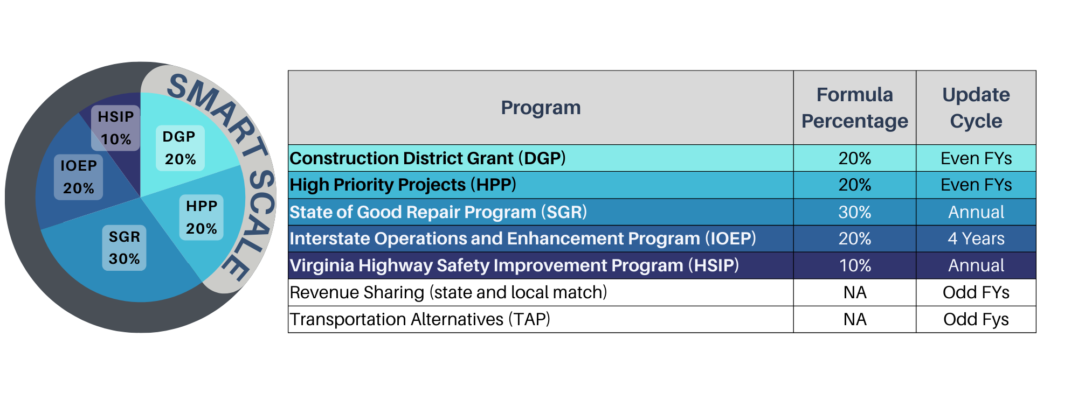
PROCESS OVERVIEW
Virginia HB 1414 Defines Funding to Construction Programs

Slide 6
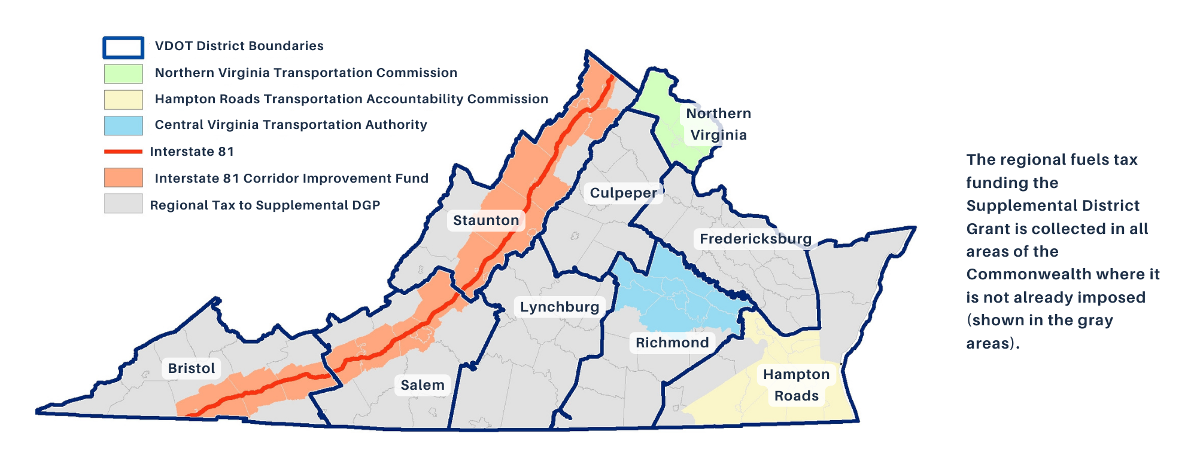
PROCESS OVERVIEW
Supplemental DGP Funding

Slide 7
Implemented Improvements from 2023 SMART SCALE Review
PROCESS OVERVIEW
Administrative Improvements
  Applications pass readiness gates before submission to improve quality and reduce staff resources
  Considering applicant delivery performance in final Board consensus funding decisions
Policy Improvements
  Clarified High-Priority Projects Program (HPP) definition to ensure projects are of statewide or regional significance by
      refining the definition to include “what” type of projects are eligible
      distributing all HPP program funds based on statewide rankings of SMART SCALE scores, rather than districtwide rankings
  Reduced the influence of the one-factor majority of the Land Use factor by making it a multiplier of all other factor areas and modifying the other factor weightings
  Applied a forward-looking congestion benefit for 7 years in the future, to better align with project design requirements that are based on future growth volumes and consider future economic growth
  Incorporate key economic priorities of the Commonwealth to reflect best-in-class economic impact assessments used by VEDP

Slide 8
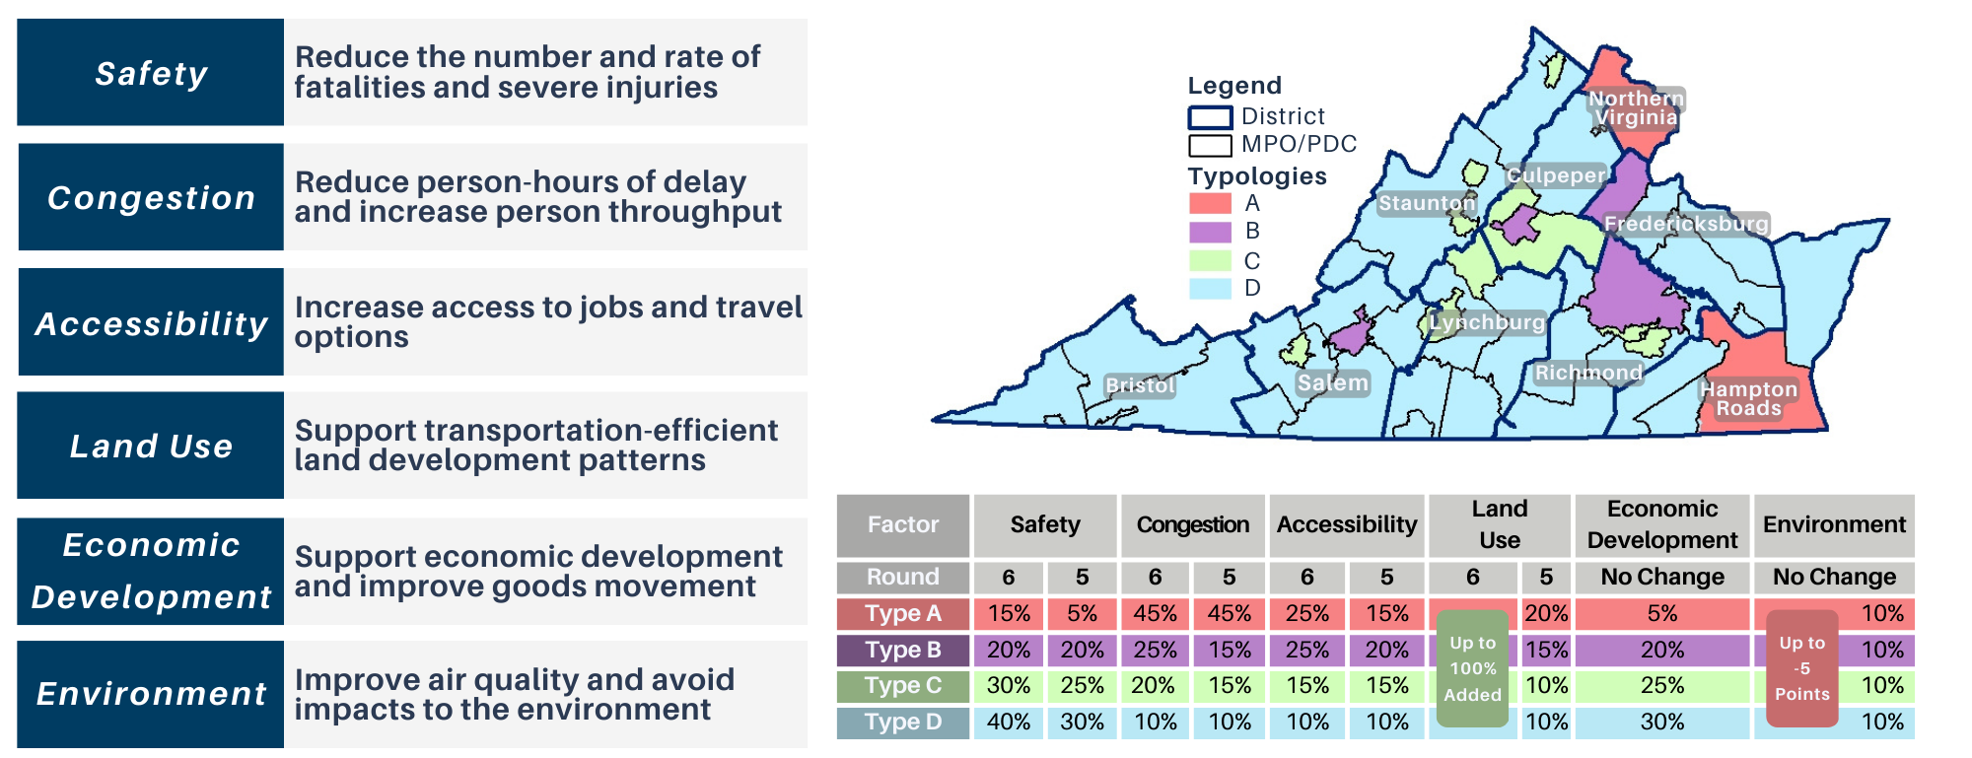
Implemented Improvements from 2023 SMART SCALE Review
Evaluation Factors and Weighting
PROCESS OVERVIEW

Slide 9
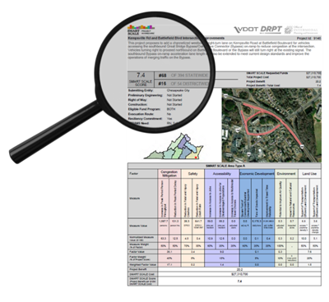
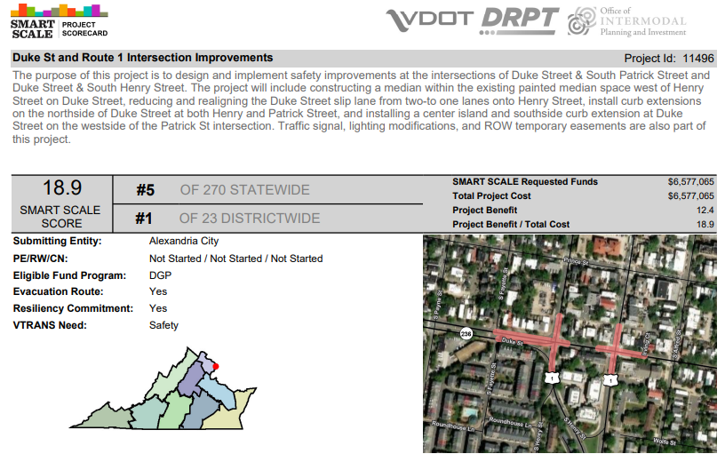
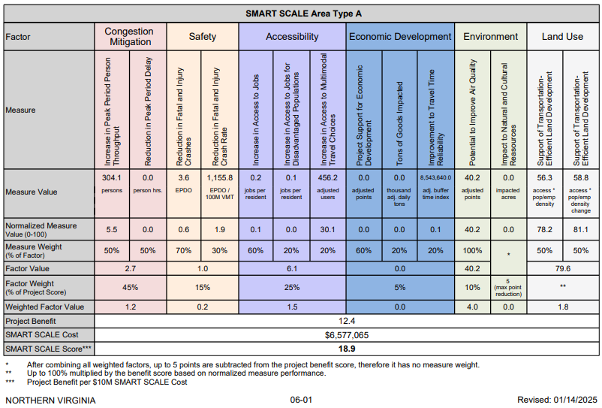
Scorecard Example
PROCESS OVERVIEW

Slide 10
Project Selection Process
PROCESS OVERVIEW
Step 1 – Fund top-scoring projects within each district eligible for Highway Construction District Grant Program (DGP) funds using DGP funds until the remaining funds are insufficient to fund the next highest-scoring project.
  DGP eligibility pertains only to localities addressing a VTrans need
Step 2 – Fund remaining top-scoring projects statewide that are eligible for Highway High-Priority Projects Program (HPP) funds using HPP funds until the remaining funds are insufficient to fund the next highest-scoring project.
  HPP eligibility pertains to localities, transit agencies, and regional entities addressing a VTrans need on either a Corridor of Statewide Significance (CoSS) or a Regional Network (RN), and refined policy definitions

Slide 11
Summary of Full Application Request By District
FY 2026 REQUESTS AND FUNDING DISTRIBUTION
District | Number of Applications | Request (Millions) | Total Cost (Millions)
Bristol | 20 | $290 | $290
Culpeper | 24 | $795 | $795
Fredericksburg | 34 | $1,005 | $1,090
Hampton Roads | 31 | $650 | $720
Lynchburg | 12 | $295 | $295
Northern Virginia | 23 | $1,330 | $1,865
Richmond | 65 | $2,190 | $2,575
Salem | 34 | $1,240 | $1,265
Staunton | 27 | $375 | $415
Grand Total | 270 | $8,170 | $9,310

Slide 12
Funding Available in millions for FY 2026 (Round 6)
FY 2026 REQUESTS AND FUNDING DISTRIBUTION
District | DGP Available | Previous DGP Cost Increases | HPP Available
Bristol | $37.0
Culpeper | $68.0 | -$6.6
Fredericksburg | $76.2
Hampton Roads | $121.6
Lynchburg | $85.9
Northern Virginia* | $97.4
Richmond | $104.9
Salem | $64.3
Staunton | $39.4 | -$6.0
Statewide HPP |  |  | $384.7
Total | $694.6 |  | $384.7
A total of $1.08 billion is available for Round 6
Background information for the FY2026 – 2031 planning period
  VDOT CFO Presentation (pdf)
  VDOT CFO Presentation (YouTube)
Budget is still in flux depending on remaining needs through May
*Note: Supplemental DGP from additional gas tax in localities is not captured in NOVA District

Slide 13
Staff Recommended Funding Scenario Summary - $ in millions
FY 2026 REQUESTS AND FUNDING DISTRIBUTION
Step 1
Step 2
District | Number of Applications | DGP Available | Previous DGP Cost Increases | HPP Available | DGP Allocated | DGP Remaining | HPP Allocated | HPP Remaining | Funded in Staff Scenario | Total Allocated
Bristol | 20 | $37.0 |  |  | $27.2 | $9.8 | $0.0 |  | 3 | $27.2
Culpeper | 24 | $68.0 | -$6.6 |  | $57.0 | $4.3 | $36.4 |  | 4 | $93.5
Fredericksburg | 34 | $76.2 |  |  | $73.5 | $2.7 | $16.8 |  | 4 | $90.3
Hampton Roads | 31 | $121.6 |  |  | $111.9 | $9.7 | $27.3 |  | 11 | $139.2
Lynchburg | 12 | $85.9 |  |  | $82.4 | $3.5 | $0.0 |  | 4 | $82.4
Northern Virginia | 23 | $97.4 |  |  | $88.7 | $8.8 | $0.0 |  | 4 | $88.7
Richmond | 65 | $104.9 |  |  | $82.6 | $22.2 | $255.8 |  | 14 | $338.5
Salem | 34 | $64.3 |  |  | $53.9 | $10.3 | $0.0 |  | 3 | $53.9
Staunton | 27 | $39.4 | -$6.0 |  | $25.3 | $8.1 | $44.7 |  | 6 | $69.9
Statewide HPP |  |  |  | $384.7
Total | 270 | $694.6 |  | $384.7 | $602.5 | $79.5 | $381.0 | $3.6 | 53 | $983.6
Starting Total | $1,079.3
Remaining Total | $83.1

Slide 14
Summary of Principal Improvement Type - $ in millions
FY 2026 REQUESTS AND FUNDING DISTRIBUTION
Principal Improvement Type | Applications Scored | Request | Percent of Request | Funded in Staff Scenario | Funding Allocated | Percent of Funded
Highway | 219 | $7,216.5 | 88.3% | 43 | $855.2 | 87.0%
Bike/Pedestrian | 47 | $805.8 | 9.9% | 8 | $94.3 | 9.6%
Bus Transit | 3 | $133.5 | 1.6% | 2 | $34.0 | 3.5%
TDM | 1 | $13.7 | 0.2% | 0 | $0.0 | 0.0%
Rail Transit | 0 | $0.0 | 0.0% | 0 | $0.0 | 0.0%
Rail Freight | 0 | $0.0 | 0.0% | 0 | $0.0 | 0.0%
Grand Total | 270 | $8,169.6 |  | 53 | $983.6

Slide 15
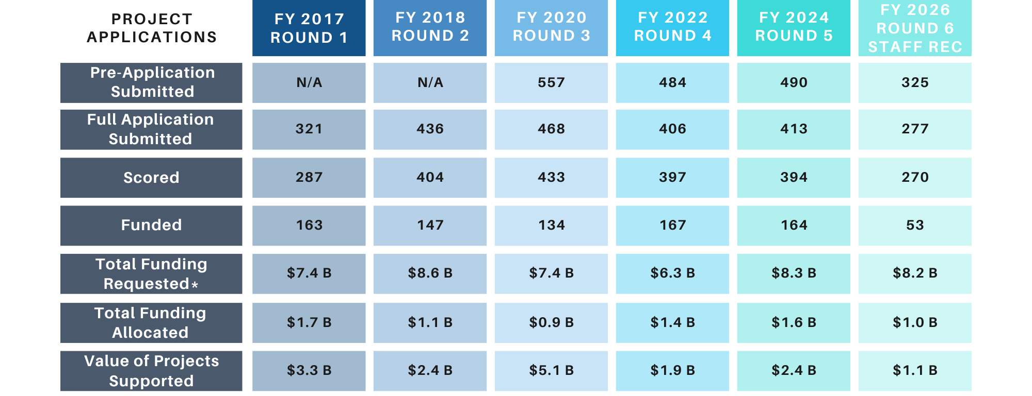
SMART SCALE FY 2026 (Round 6)
Summary and Comparison to Prior Rounds
FY 2026 REQUESTS AND FUNDING DISTRIBUTION
*Total of scored applications funding requested

Slide 16
Summary of Funding Requests
FY 2026 REQUESTS AND FUNDING DISTRIBUTION
Round | Funding Requested (billions) | Funding Leveraged (billions) | Average Request (millions) | Average HPP Request (millions) | Average DGP Request (millions)
FY 2017 | $7.4 | $6.0 | $25.7 | $32.6 | $19.5
FY 2018 | $8.6 | $2.3 | $21.2 | $25.9 | $19.3
FY 2020 | $7.4 | $4.9 | $17.0 | $24.1 | $12.9
FY 2022 | $6.3 | $1.1 | $15.7 | $17.3 | $15.7
FY 2024 | $8.3 | $1.5 | $21.1 | $24.4 | $21.6
FY 2026 | $8.2 | $1.1 | $30.3 | $55.2 | $17.4

Slide 17
Staff Recommended Scenario – Northern Virginia
FY 2026 REQUESTS AND FUNDING DISTRIBUTION
App ID | Organization | Application Name | Area Type | Benefit | Total Cost | Total Requested | SMART SCALE Score | FUND | (1) DGP | (2) HPP
11496 | Alexandria City | Duke St and Route 1 Intersection Improvements | A | 12.43 | $ 6,577,065 | $ 6,577,065 | 18.90 | DGP | $ 6,577,065
11577 | Arlington County | US 50 at VA 27 Interchange Access Improvements | A | 24.46 | $ 32,348,376 | $ 32,348,376 | 7.56 | BOTH | $ 32,348,376
11475 | Prince William County | US 29 (Lee Highway) Corridor Improvements | A | 18.63 | $ 40,463,612 | $ 40,463,612 | 4.60 | BOTH | $ 40,463,612
11469 | Loudoun County | Cascades Pkwy Bike &Ped (Church Rd. to Victoria Station Dr) | A | 3.66 | $ 13,932,841 | $ 9,296,841 | 3.94 | DGP | $ 9,296,841
11466 | Loudoun County | Route 15 at Braddock Road Roundabout | A | 5.70 | $ 46,914,469 | $ 14,538,179 | 3.92 | DGP
11703 | Prince William County | Route 294 (Prince William Parkway) Corridor Improvements | A | 9.48 | $ 26,742,423 | $ 26,742,423 | 3.54 | BOTH
11481 | NVTA | I395 Shirlington Rotary &S Glebe Rd Interchange Improvements | A | 10.47 | $ 31,462,633 | $ 31,462,633 | 3.33 | HPP
11485 | Loudoun County | North Berlin Turnpike Shared Use Path | A | 0.80 | $ 5,887,528 | $ 2,762,528 | 2.88 | DGP
11709 | Fairfax County | Braddock Road Phase II | A | 20.03 | $ 97,778,658 | $ 70,479,658 | 2.84 | BOTH
11581 | Arlington County | Glebe Rd Safety Improvements (I-66 to Columbia Pike) | A | 12.94 | $ 46,125,836 | $ 46,125,836 | 2.81 | BOTH
11453 | Prince William County | Route 123 and Old Bridge Rd Intersection Improvements | A | 33.22 | $ 159,160,334 | $ 118,674,082 | 2.80 | BOTH
11490 | Alexandria City | King St -Bradlee Safety and Mobility Enhancements | A | 6.04 | $ 26,367,419 | $ 23,350,267 | 2.59 | BOTH
11729 | Alexandria City | Eisenhower Avenue and Van Dorn Street Improvements | A | 6.07 | $ 26,078,581 | $ 26,078,581 | 2.33 | BOTH
11484 | Loudoun County | East Broad Way Sidewalk | A | 0.11 | $ 704,279 | $ 470,042 | 2.29 | DGP
11465 | Loudoun County | Route 7 Improvements - Route 9 to Dulles Greenway | A | 11.33 | $ 195,134,112 | $ 49,631,037 | 2.28 | BOTH
11524 | Loudoun County | Old Ox Road Widening - Shaw Road to Fairfax County Line | A | 10.13 | $ 104,490,636 | $ 52,114,636 | 1.94 | BOTH
11793 | Prince William County | Dale Boulevard/Rippon Boulevard Corridor Improvements | A | 9.64 | $ 51,767,817 | $ 51,767,817 | 1.86 | BOTH
11557 | Loudoun County | Route 7/Route 601 Intersection Improvements | D | 0.76 | $ 5,186,091 | $ 4,636,091 | 1.64 | DGP
11630 | Leesburg Town | Town of Leesburg, Catoctin Circle turn lane and sidewalk | A | 0.58 | $ 6,368,444 | $ 3,722,554 | 1.55 | DGP
11468 | Loudoun County | Cascades Pkwy Bike&Ped (Nokes Boulevard to Woodshire Drive) | A | 3.01 | $ 26,378,740 | $ 20,285,740 | 1.48 | DGP
11530 | Fairfax County | Frontier Drive Extension | A | 5.60 | $ 267,227,772 | $ 71,503,584 | 0.78 | BOTH
11527 | Fairfax County | Town Center Parkway Underpass | A | 12.51 | $ 419,530,736 | $ 407,530,736 | 0.31 | BOTH
11685 | Prince William County | Van Buren Road Improvements: Route 234 to Cardinal Dr | A | 5.02 | $ 228,675,095 | $ 218,675,095 | 0.23 | BOTH

Slide 18
Project Benefit and SS Request determine SS Score
RESULTS OBSERVATIONS
DGP funds are competed for within the district
HPP funds are competed for statewide
Of funded HPP projects statewide
  Highest SS Score was 17.68
  Lowest SS Score was 3.96
  Average funded Project Benefit was 17.9 and the average SS Score was 6.9
  Average requested amount was $27.2 million and the average value supported was $30.4 million
HPP Requests in the NOVA District
  Average Project Benefit was 13.0 and the average SS Score was 2.7
  Average requested amount was $84.5 million and the average value supported was $116.9 million

Slide 19
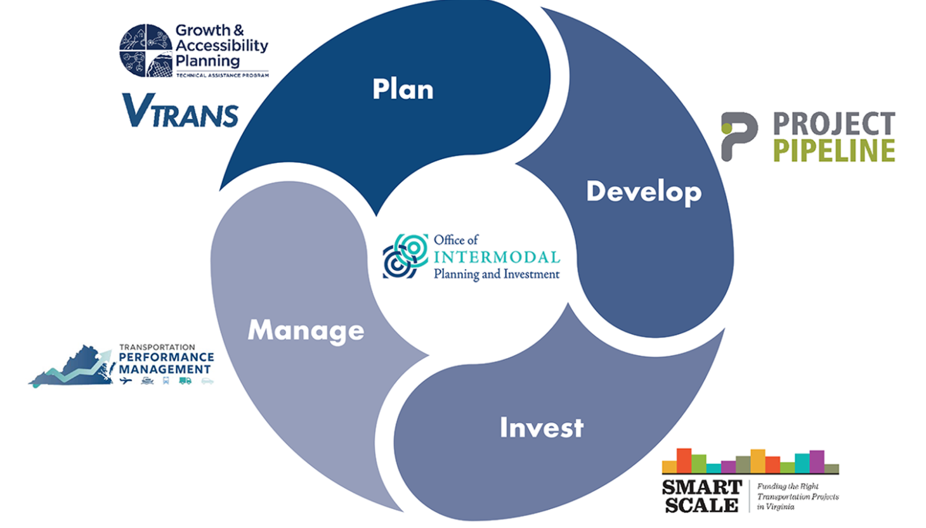
VTrans Priority Needs
RESULTS OBSERVATIONS
The locations with greatest needs are identified in VTrans
VTrans Priority Needs are categorized by Statewide Priority or Construction District Priority
  Statewide Priority Locations focused on Corridors of Statewide Significance
  Construction District Priority Locations focused on all other roads (RN, Safety, UDA)
  For Round 6
    65% of the HPP eligible projects were located on a Statewide Priority Need Location
    70% of the HPP projects that were funded were located on a Statewide Priority Need Location
    Of NOVA’s HPP eligible projects, only 5 out of 15 were located on a Statewide Priority Need Location

Slide 20
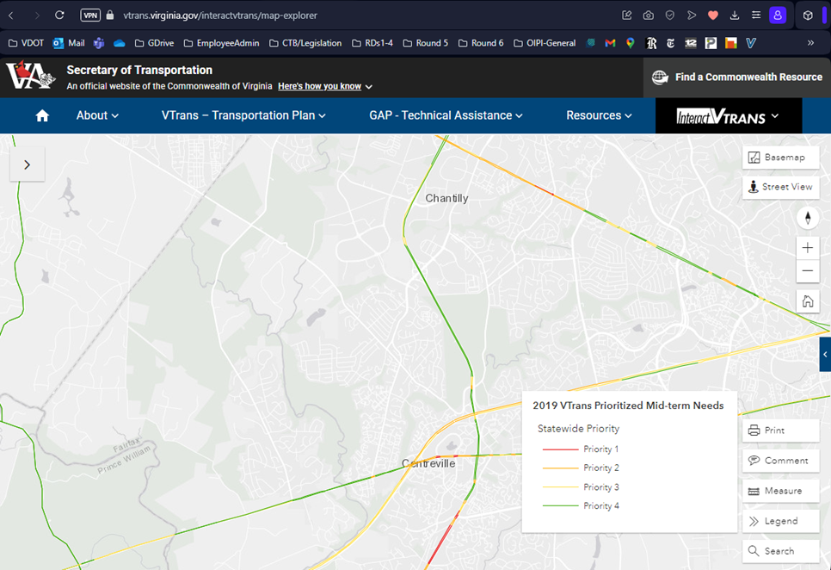
VTrans Priority Needs
RESULTS OBSERVATIONS
https://vtrans.virginia.gov/interactvtrans/map-explorer

Slide 21
Next Steps
February to April – Board to consider potential revisions to staff recommended funding scenario
April to May – Public hearings (Spring SYIP Meetings) on staff recommended scenario and any potential revisions
May CTB meeting – Consensus funding scenario developed
June CTB meeting – Adoption of Six-Year Improvement Program and SC Round 6 projects

Slide 22
FY 2026 SMART SCALE Results
RESOURCES
Reminder website is now - https://smartscale.virginia.gov
Apply/Resources
  Round 6 Funding Scenario
    Round 6 Screening Decisions (Excel, 17KB)
    Staff recommended funding scenario (Excel, 50KB)
    Project scorecards (PDF, 77.6MB)
    Project scores (Excel, 106KB)
    Project scoring calculations (Excel, 307KB)
    January 2025 CTB Presentation (PPT, 1.4MB)
2023 Review Implemented for Round 6

Slide 23
Contact Us
RESOURCES
Brooke Jackson, P.E. – SMART SCALE Program Manager
  Brooke.Jackson@oipi.virginia.gov
Email - SmartPortal@CTB.Virginia.gov
Contact Form

Slide 24
Thank you.

