Slide 1
SMART SCALE Round 6 Update
Brooke Jackson, P.E.

Slide 2
Agenda/Contents
SMART SCALE FY 2026 Round 6 Overview
Process Overview and Support
Performance-Based Planning
Scoring Questions

Slide 3
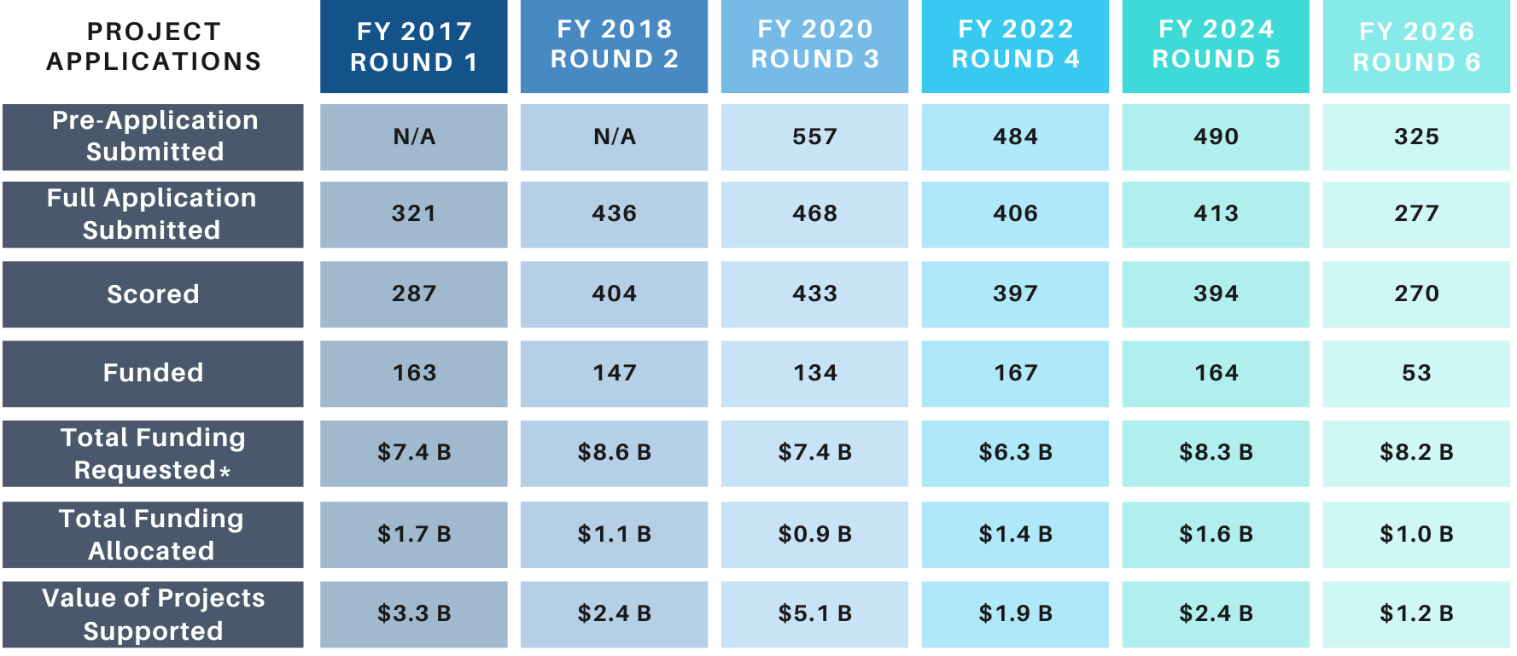
SMART SCALE FY 2026 (Round 6) Summary and Comparison to Prior Rounds
SMART SCALE FY 2026 (Round 6) Overview
*Total of scored applications funding requested

Slide 4
Funding Available in millions for FY 2026 (Round 6)
SMART SCALE FY 2026 (Round 6) Overview
District | DGP Available | Previous DGP Cost Increases | HPP Available
Bristol | $37.0
Culpeper | $68.0 | -$6.6
Fredericksburg | $76.2
Hampton Roads | $121.6
Lynchburg | $85.9
Northern Virginia* | $97.4
Richmond | $104.9
Salem | $64.3
Staunton | $39.4 | -$6.0
Statewide HPP |  |  | $384.7
Total | $694.6 |  | $384.7
A total of $1.08 billion is available for Round 6
Background information for the FY2026 – 2031 planning period
VDOT CFO Presentation (pdf)
VDOT CFO Presentation (YouTube)
Budget is still in flux depending on remaining needs through May
*Note: Supplemental DGP from additional gas tax in localities is not captured in NOVA District

Slide 5
Final FY2026 Funding Scenario Summary - $ in millions
SMART SCALE FY 2026 (Round 6) Overview
District | Step 1 |  | Step 2 |  | Consensus |  | Total
 | # | Amount DGP | # | Amount HPP | # | Amount DGP | DGP | HPP | # | Amount
Bristol | 1 | $ 5.3 | 0 | $ - | 1 | $ 28.5 | $ 33.8 | $ - | 2 | $ 33.8
Culpeper | 3 | $ 57.0 | 1 | $ 36.4 | 0 | $ - | $ 57 | $ 36.4 | 4 | $ 93.5
Fredericksburg | 3 | $ 73.5 | 1 | $ 16.8 | 0 | $ - | $ 73.5 | $ 16.8 | 4 | $ 90.3
Hampton Roads | 9 | $ 106.5 | 1 | $ 27.3 | 1 | $ 6.8 | $ 113.3 | $ 27.3 | 11 | $ 140.6
Lynchburg | 4 | $ 82.4 | 0 | $ - | 0 | $ - | $ 82.4 | $ - | 4 | $ 82.4
Northern Virginia | 2 | $ 72.8 | 0 | $ - | 1 | $ 14.5 | $ 87.3 | $ - | 3 | $ 87.4
Richmond | 7 | $ 100.8 | 8 | $ 255.8 | 1 | $ 3.6 | $ 104.5 | $ 255.8 | 16 | $ 360.3
Salem | 3 | $ 53.9 | 0 | $ - | 0 | $ - | $ 53.9 | $ - | 3 | $ 53.9
Staunton | 2 | $ 22.6 | 3 | $ 44.7 | 1 | $ 8.0 | $ 30.6 | $ 44.7 | 6 | $ 75.3
Total | 34 | $ 574.9 | 14 | $ 381.0 | 5 | $ 61.5 | $ 636.5 | $ 381.0 | 53 | $ 1,017.5

Slide 6
Consensus Scenario – Salem District
SMART SCALE FY 2026 (Round 6) Overview
Display ID | Organization | Name | Area Type | Benefit | Total Cost | SMART SCALE Request | SMART SCALE Score | Fund Eligible | (1) DGP | (2) HPP | Consensus (DGP)
11538 | Carroll County | Carrollton Pike (Rt 58) at Coulson Church Rd (Rt 620) RCUT | D | 4.62 | $ 10,531,849 | $ 10,531,849 | 4.39 | DGP | $ 10,531,849
11728 | Henry County | Roundabout at Dillons Fork Rd (609) and The Great Rd (683) | D | 5.46 | $ 17,978,683 | $ 17,978,683 | 3.04 | DGP | $ 17,978,683
11451 | Roanoke Valley TPO | Route 11/460 at Dow Hollow Rd Intersection Improvements | B | 13.32 | $ 56,697,003 | $ 52,697,003 | 2.53 | HPP
11539 | Carroll County | Intersection Improvements at Route 100 and Route 221 | D | 4.78 | $ 25,397,984 | $ 25,397,984 | 1.88 | DGP | $ 25,397,984
11511 | Roanoke County | Starkey Road/Ogden Road Streetscape Improvements | B | 2.62 | $ 17,574,820 | $ 17,574,820 | 1.49 | DGP
11697 | Rocky Mount Town | Rt 40 at Floyd Avenue Intersection Improvement | D | 2.29 | $ 15,759,282 | $ 15,759,282 | 1.45 | DGP
11563 | Montgomery County | Transit Center and Campus Mobility Improvements | C | 5.50 | $ 39,054,533 | $ 39,054,533 | 1.41 | DGP
11750 | Roanoke City | Peters Creek Rd at Valleypointe Pkwy Improvements | B | 3.73 | $ 27,601,325 | $ 27,601,325 | 1.35 | DGP
11710 | Roanoke County | Peters Creek Road Multimodal Safety Improvements | B | 4.83 | $ 38,131,297 | $ 38,131,297 | 1.27 | DGP
11478 | Franklin County | Intersection Improvements Brooks Mill & Scruggs Rtes 834/616 | D | 2.71 | $ 21,851,852 | $ 21,851,852 | 1.24 | DGP
11602 | Montgomery County | Peppers Ferry Road (Rt 114) Improvements | C | 7.27 | $ 60,740,470 | $ 60,740,470 | 1.20 | DGP
11636 | Franklin County | Route 220 NB at Henry Rd. (Rte. 605) Realignment Project | D | 5.73 | $ 49,883,071 | $ 49,883,071 | 1.15 | DGP
11526 | Rocky Mount Town | Route 40 - Tanyard Rd/Old Franklin Tpke Improvements | D | 2.24 | $ 19,563,211 | $ 19,563,211 | 1.15 | DGP
11570 | Pulaski County | Lee Highway (Route 11) Improvements at Hatcher Road | D | 2.42 | $ 30,391,909 | $ 21,986,891 | 1.10 | BOTH
11585 | Montgomery County | Merrimac Rd (657) & Prices Fork Rd (685) Intersection | C | 1.74 | $ 17,359,125 | $ 17,359,125 | 1.00 | DGP
11482 | Christiansburg Town | Peppers Ferry Road to Cambria Street Connector Route | C | 4.51 | $ 45,005,723 | $ 45,005,723 | 1.00 | BOTH
11449 | Roanoke Valley TPO | Peters Creek Rd and Williamson Rd Corridor Improvements | B | 14.12 | $ 148,466,414 | $ 148,466,414 | 0.95 | HPP
11784 | Henry County | Barrows Mill Road Improvement | D | 5.11 | $ 54,026,206 | $ 54,026,206 | 0.95 | DGP
11734 | Botetourt County | US 220/Commons Parkway Thru-Cut and Pedestrian Accommodation | B | 1.85 | $ 19,672,763 | $ 19,672,763 | 0.94 | DGP
11647 | New River Valley MPO | Roanoke Street (Route 11/460 Business) Improvements | C | 4.27 | $ 48,361,663 | $ 48,361,663 | 0.88 | HPP
11629 | Bedford Town | Roundabout at Longwood Ave, Forest Rd, and Independence Blvd | C | 3.85 | $ 43,849,446 | $ 43,849,446 | 0.88 | DGP
11698 | Roanoke County | Peters Creek Rd/Williamson Rd Multimodal Safety Improvements | B | 4.65 | $ 61,161,520 | $ 57,561,520 | 0.81 | DGP
11632 | Franklin County | Intersection Improvements Rte 40 & Rte 640 | D | 1.26 | $ 15,999,917 | $ 15,999,917 | 0.79 | DGP
11580 | Salem City | Route 419 at Texas St and Lynchburg Trpk Int. Improvements | B | 1.10 | $ 15,364,740 | $ 15,364,740 | 0.72 | DGP
11726 | Henry County | Signalized Continuous Green T at the Int. of Routes 220 & 87 | D | 2.51 | $ 36,596,261 | $ 36,596,261 | 0.69 | DGP
11593 | Botetourt County | Route 220 Superstreet | B | 1.12 | $ 23,555,395 | $ 17,631,395 | 0.63 | DGP
11786 | Blacksburg Town | Prices Fork and US Route 460 Bypass Pedestrian Improvements | C | 2.59 | $ 44,554,319 | $ 44,554,319 | 0.58 | DGP
11790 | Botetourt County | US 220 Pedestrian Crossing and Sidewalks at Daleville | B | 1.26 | $ 22,729,679 | $ 22,729,679 | 0.55 | DGP
11497 | Vinton Town | Washington Avenue and Bypass Road Roundabout | B | 1.91 | $ 40,032,075 | $ 40,032,075 | 0.48 | DGP
11579 | Salem City | E. Main St. (Rt. 460) Multimodal Improvements - Phase II | B | 1.38 | $ 34,535,305 | $ 34,535,305 | 0.40 | DGP
11510 | Galax City | Galax E. Stuart Drive Sidewalk Phase III | D | 1.00 | $ 25,258,619 | $ 25,258,619 | 0.40 | DGP
11631 | Franklin County | Intersection Improvements Harmony School Rte 634 & Rte 122 | D | 1.01 | $ 30,592,413 | $ 30,592,413 | 0.33 | DGP
11489 | Bedford County | Route 122 Corridor Improvements | C | 2.70 | $ 97,400,136 | $ 97,400,136 | 0.28 | DGP
11514 | Roanoke County | Carson Road Safety Improvements | B | 0.13 | $ 8,030,993 | $ 8,030,993 | 0.16 | DGP

Slide 7
SMART SCALE FY 2026 (Round 6) Overview
Statewide Comparison Benefit and Cost
Round 6 Applications
Round 6 Funded Applications
District | # | Ave Req | Ave Cost | Cong | Saf | Acc | Env | EcD | LUM | Ave Benefit
Bristol | 20 | $ 14.5 | $ 14.5 | 0.01 | 1.33 | 0.04 | 0.18 | 0.70 | 1.16 | 2.70
Culpeper | 24 | $ 33.0 | $ 33.0 | 0.20 | 4.40 | 1.17 | 1.17 | 0.51 | 1.35 | 10.55
Fredericksburg | 34 | $ 29.5 | $ 32.1 | 0.82 | 2.33 | 0.87 | 0.18 | 0.87 | 1.10 | 5.55
Hampton Roads | 31 | $ 20.9 | $ 23.3 | 1.24 | 2.09 | 1.48 | 0.37 | 0.34 | 1.21 | 6.55
Lynchburg | 12 | $ 24.6 | $ 24.6 | 0.21 | 2.11 | 0.11 | 0.23 | 1.19 | 1.09 | 4.08
Northern Virginia | 23 | $ 57.8 | $ 81.1 | 1.86 | 1.30 | 2.62 | 1.24 | 0.05 | 1.36 | 9.68
Richmond | 65 | $ 33.7 | $ 39.6 | 1.17 | 3.10 | 2.34 | 0.86 | 1.67 | 1.27 | 11.66
Salem | 34 | $ 36.5 | $ 37.2 | 0.08 | 2.17 | 0.36 | 0.25 | 0.33 | 1.20 | 3.69
Staunton | 27 | $ 14.0 | $ 15.3 | 0.21 | 1.33 | 0.31 | 0.46 | 1.09 | 1.33 | 4.60
Grand Total | 270 | $ 30.3 | $ 34.5 | 0.75 | 2.38 | 1.25 | 0.58 | 0.85 | 1.24 | 7.33
District | # | Ave Req | Ave Cost | Cong | Saf | Acc | Env | EcD | LUM | Ave Benefit
Bristol | 3 | $ 9.1 | $ 9.1 | 0.02 | 3.68 | 0.04 | 0.25 | 1.79 | 1.19 | 6.48
Culpeper | 4 | $ 23.4 | $ 23.4 | 0.23 | 5.39 | 0.64 | 2.68 | 1.13 | 1.53 | 15.74
Fredericksburg | 4 | $ 22.6 | $ 25.4 | 3.56 | 7.63 | 2.61 | 0.72 | 2.45 | 1.06 | 18.02
Hampton Roads | 11 | $ 12.7 | $ 12.8 | 2.81 | 3.13 | 2.92 | 0.58 | 0.25 | 1.25 | 11.53
Lynchburg | 4 | $ 20.6 | $ 20.6 | 0.17 | 4.93 | 0.30 | 0.34 | 0.04 | 1.06 | 6.20
Northern Virginia | 4 | $ 22.2 | $ 23.3 | 2.59 | 0.84 | 3.05 | 3.15 | 0.07 | 1.55 | 14.79
Richmond | 14 | $ 24.2 | $ 28.7 | 1.44 | 4.63 | 4.59 | 1.15 | 3.74 | 1.31 | 19.76
Salem | 3 | $ 18.0 | $ 18.0 | 0.00 | 4.55 | 0.00 | 0.00 | 0.00 | 1.10 | 4.95
Staunton | 6 | $ 11.7 | $ 12.7 | 0.70 | 1.29 | 1.00 | 1.30 | 2.88 | 1.43 | 10.31
Grand Total | 53 | $ 18.6 | $ 20.2 | 1.54 | 3.90 | 2.43 | 1.11 | 1.75 | 1.29 | 13.56
Salem district is requesting near the highest amount per project, second only to Northern Virginia, and has near the lowest benefit in the state, second only to Bristol.

Slide 8
Statewide Comparison Benefit and Cost - HPP
SMART SCALE FY 2026 (Round 6) Overview
HPP Eligible Applications
HPP Funded Applications
District | # | Ave Req | Ave Cost | Cong | Saf | Acc | Env | EcD | LUM | Ave Benefit
Bristol | 3 | $ 28.6 | $ 28.6 | 0.02 | 0.89 | 0.09 | 0.66 | 0.95 | 1.29 | 4.01
Culpeper | 5 | $ 74.7 | $ 74.7 | 0.41 | 4.25 | 3.29 | 2.29 | 0.84 | 1.76 | 19.69
Fredericksburg | 12 | $ 59.4 | $ 65.5 | 2.22 | 2.44 | 2.11 | 0.23 | 1.76 | 1.13 | 9.83
Hampton Roads | 13 | $ 26.8 | $ 32.0 | 2.25 | 1.36 | 2.55 | 0.68 | 0.49 | 1.18 | 8.42
Lynchburg | 3 | $ 51.3 | $ 51.3 | 0.61 | 1.17 | 0.04 | 0.34 | 4.35 | 1.05 | 6.65
Northern Virginia | 15 | $ 84.5 | $ 116.9 | 2.59 | 1.69 | 3.74 | 1.43 | 0.08 | 1.41 | 13.04
Richmond | 28 | $ 57.9 | $ 67.2 | 2.33 | 2.73 | 4.56 | 1.26 | 2.90 | 1.27 | 17.01
Salem | 5 | $ 63.3 | $ 65.8 | 0.16 | 4.77 | 0.94 | 0.39 | 0.66 | 1.13 | 7.73
Staunton | 8 | $ 24.5 | $ 28.1 | 0.66 | 1.51 | 0.85 | 1.04 | 2.47 | 1.36 | 8.83
Grand Total | 92 | $ 55.2 | $ 65.3 | 1.85 | 2.30 | 2.94 | 1.01 | 1.66 | 1.28 | 12.38
 |  |  |  | 45% | 15% | 25% | 10% | 5%
District | # | Ave Req | Ave Cost | Cong | Saf | Acc | Env | EcD | LUM | Ave Benefit
Culpeper | 1 | $ 36.4 | $ 36.4 | 0.26 | 2.94 | 0.99 | 4.80 | 4.08 | 1.87 | 24.39
Fredericksburg | 1 | $ 16.8 | $ 16.8 | 1.44 | 2.55 | 3.57 | 1.75 | 0.38 | 1.11 | 10.81
Hampton Roads | 1 | $ 27.3 | $ 27.3 | 2.99 | 0.07 | 6.59 | 0.70 | 0.00 | 1.04 | 10.81
Richmond | 8 | $ 32.0 | $ 37.0 | 1.12 | 4.32 | 5.23 | 1.39 | 4.12 | 1.33 | 20.59
Staunton | 3 | $ 14.9 | $ 16.1 | 1.08 | 1.70 | 1.55 | 2.50 | 2.87 | 1.34 | 13.41
Grand Total | 14 | $ 27.2 | $ 30.4 | 1.21 | 3.23 | 4.12 | 1.85 | 3.29 | 1.34 | 17.93

Slide 9
Virginia Code§ 33.2-214.1
Process Overview and Support
Benefit-Cost Relationship
Six Factor Areas Required (SCALE) – safety, congestion mitigation, accessibility, land use*, economic development, and environmental quality
Multi-Modal Project Evaluation – must consider highway, transit, rail, roadway, technology operational improvements, and transportation demand management strategies
Meet a VTrans Need
Projects must be fully funded when added to the SYIP
*Note: Land Use is required in populations over 200,000 defined in the 6th enactment clause

Slide 10
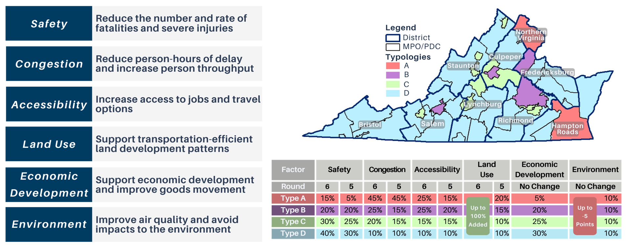
Process Overview and Support
Benefit Consider Area Type Weighting

Slide 11
Project Selection Process
Process Overview and Support
Step 1 – Fund top-scoring projects within each district eligible for Highway Construction District Grant Program (DGP) funds using DGP funds until the remaining funds are insufficient to fund the next highest-scoring project.
DGP eligibility pertains only to localities addressing a VTrans need
Step 2 – Fund remaining top-scoring projects statewide that are eligible for Highway High-Priority Projects Program (HPP) funds using HPP funds until the remaining funds are insufficient to fund the next highest-scoring project.
HPP eligibility pertains to localities, transit agencies, and regional entities addressing a VTrans need on either a Corridor of Statewide Significance (CoSS) or a Regional Network (RN), and refined policy definitions

Slide 12
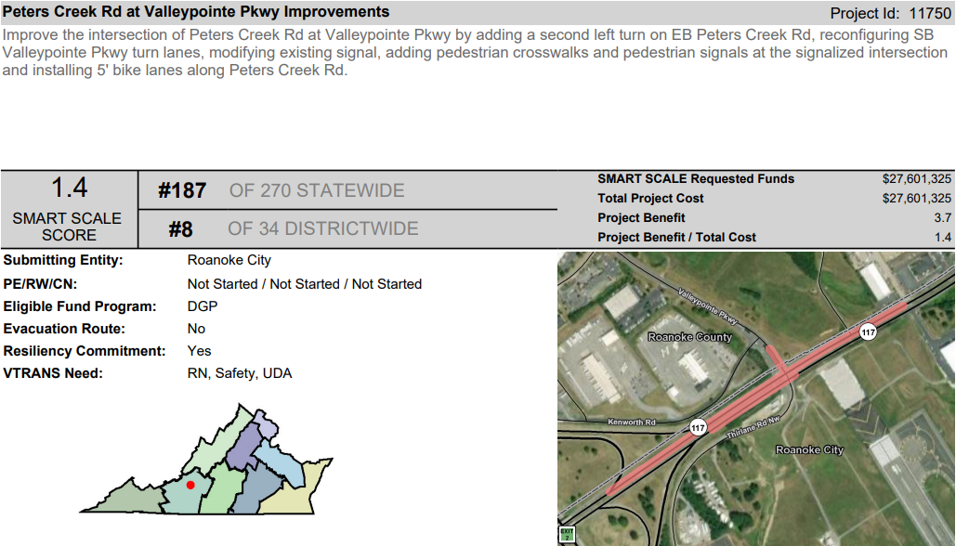
Scorecard Example – Route 100/221 Intersection Improvements
Process Overview and Support

Slide 13
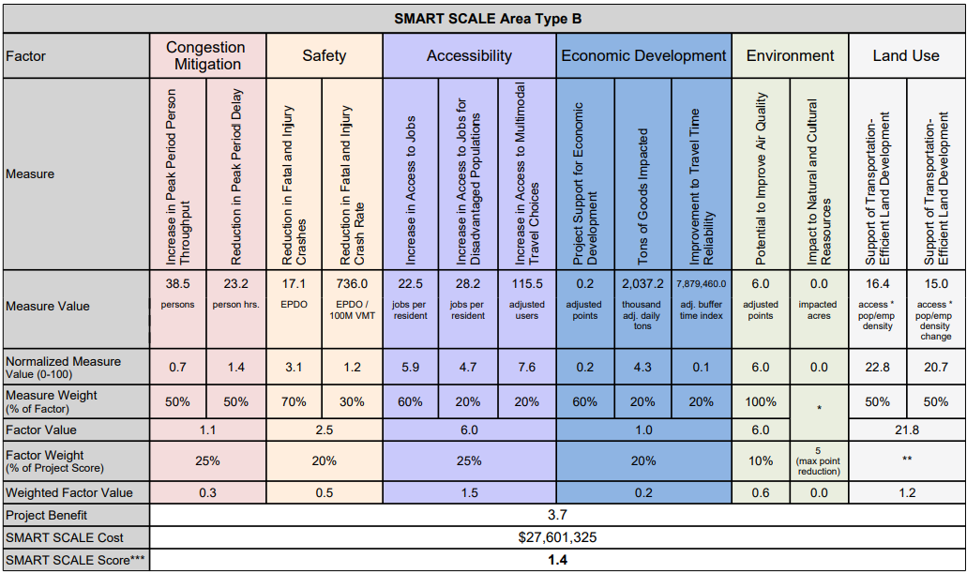
Scorecard Example – Route 100/221 Intersection Improvements
Process Overview and Support

Slide 14
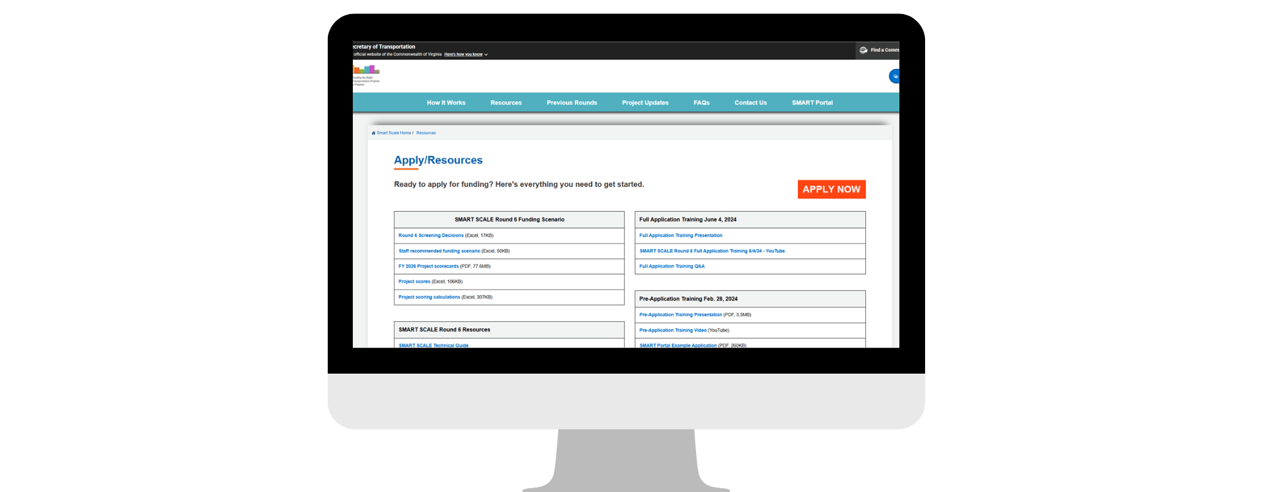
Support Available
Process Overview and Support
https://smartscale.virginia.gov/resources/
VDOT District Staff
Previous Staff, Scorers, Consultants
SMART SCALE Website
Resources
Previous Round Data
Technical Guide
SMARTPortal – Public Visibility
Scorecards
Town Halls, CTB Meetings
Trainings at Round Open
Quarterly MPO Meetings

Slide 15
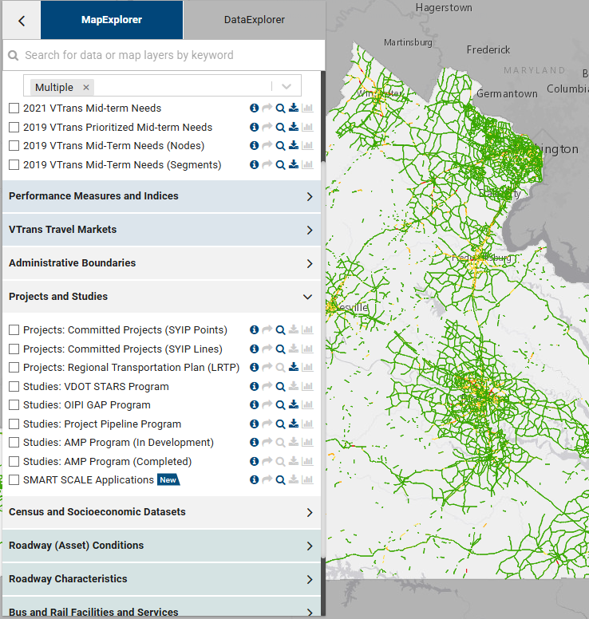
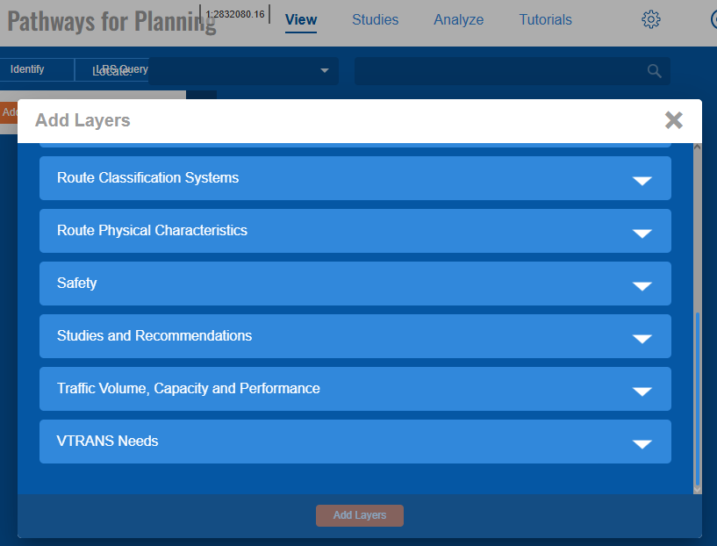
Process Overview and Support
Publicly Available Data Sources
Interact VTrans - vtrans.virginia.gov/
P4P - vdotp4p.com
VDOT TMPD-Managed Data repository site
Virginia Roads for Crash Data - virginiaroads.org
U.S. Census On the Map
Population Density, Points of Interest (HERE)
ArcGIS Online Map Population Density
Open Street Map Data
Economic Development – VEDP Sites
VDOT Tools Homepage - vdot.virginia.gov/doing-business/tools/
VDOT Junction Screening Tool – VJuST
VDOT Online Forms
Virginia Open Data Portal - https://data.virginia.gov/
Applicant-Provided Data - Regional Travel Demand Models, Traffic and Planning Studies – Volumes and Growth

Slide 16
Process Overview and Support
Regional Organizations Adopting SMART SCALE Like Processes
Central Virginia Transportation Authority (CVTA) - Regional Project Selection and Allocation Framework Page 9/PDF Page 11
Staunton-Augusta-Waynesboro Metropolitan Planning Organization (SAWMPO) - Chapter 6: Performance-Based Programming and Project Evaluation
In Round 6, Staunton and Richmond District captured 11 of 14 HPP Projects.

Slide 17
Performance-Based Planning
Performance-Based Planning
VTrans Prioritized Needs - Benefit score is project's impact to needs/problems
Identify the Right Solutions to Needs – Value Engineering
Cost Effectiveness

Slide 18
VTrans Prioritized Needs
Performance-Based Planning
ANY Mid-Term Need is acceptable for SMART SCALE
Locations with the greatest needs are VTrans Prioritized Needs
Priority 1 and 2 locations established in VTrans become eligible for study funding under the Project Pipeline program
Priority Needs are ranked 1 - worst 1%, 2 – worst 5%, 3 – worst 15%, 4 - remaining

Slide 19
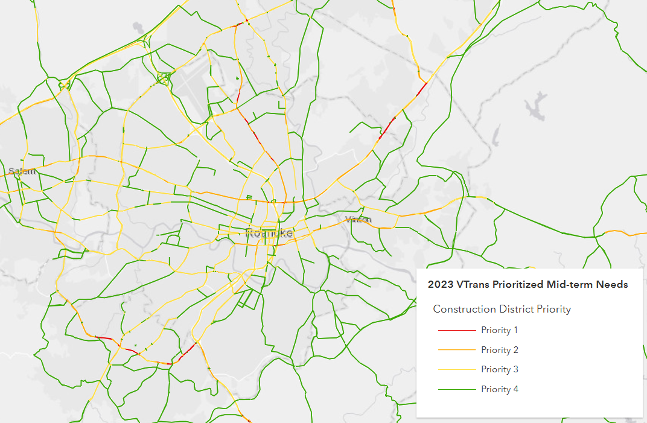
VTrans Prioritized Needs Construction District Priority
Performance-Based Planning
Priority 1 is highest need (red)
43 out of 53 (80%) of all Funded Statewide were located on a Priority 1 or 2 Construction District Priority Need
14 out of 14 (100%) of HPP Projects Funded Statewide were located on a Priority 1 or 2 Construction District Priority Need
https://vtrans.virginia.gov/interactvtrans/map-explorer

Slide 20
VTrans Prioritized Needs Construction District Priority
Performance-Based Planning
Funding Comparison by District
 |  | Priority 1 |  |  | Priority 2 |  |  | All Other Locations
District | Total Apps | Total | Funded | Not Funded | Total | Funded | Not Funded | Total | Funded | Not Funded
Bristol | 20 | 3 | 1 | 2 | 4 | 0 | 4 | 13 | 2 | 11
Culpeper | 24 | 6 | 2 | 4 | 12 | 2 | 10 | 6 | 0 | 6
Fredericksburg | 34 | 6 | 2 | 4 | 14 | 1 | 13 | 14 | 1 | 13
Hampton Roads | 31 | 11 | 6 | 5 | 8 | 3 | 5 | 12 | 2 | 10
Lynchburg | 12 | 1 | 1 | 0 | 4 | 2 | 2 | 7 | 1 | 6
Northern Virginia | 23 | 8 | 3 | 5 | 6 | 1 | 5 | 9 | 0 | 9
Richmond | 65 | 18 | 6 | 12 | 22 | 6 | 16 | 25 | 2 | 23
Salem | 34 | 5 | 0 | 5 | 15 | 1 | 14 | 14 | 2 | 12
Staunton | 27 | 12 | 4 | 8 | 8 | 2 | 6 | 7 | 0 | 7
 | 270 | 70 | 25 | 45 | 93 | 18 | 75 | 107 | 10 | 97
Salem Average SS Request for Priority 1 = $65M
Richmond, HR, and Staunton Average SS Request for Priority 1 = $25M
35% Success Rate
19% Success Rate
10% Success Rate

Slide 21
Performance-Based Planning
Identify the Right Solutions to Needs – Value Engineering
Planning Studies to determine the Preferred Alternative
Incorporate STARS and Pipeline program methodologies
Several HPP Eligibility Questions, reminder 1. HPP Eligible features, outlined in Table 2.5 (page 17) of the Technical Guide, OR 2. Or the preferred alternative of an approved study defined in the same section. Note that some studies are small; there are STARS and Pipeline Studies dedicated to single intersections
Consider the most cost-effective solution in the preferred alternative selection
Right-size the application scope (corridor size) to the worst performance locations
Frequently, the solution has already been determined, and value engineering has not been considered

Slide 22
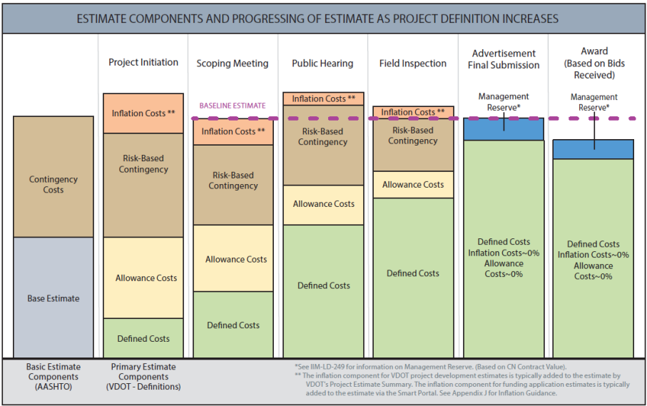
Performance-Based Planning
Cost Effectiveness
Cost Estimates
Work with VDOT District early and often
Reduce risk and contingency
If possible, apply when ready for the last dollars

Slide 23
Performance-Based Planning
Cost Effectiveness
Applicants are not “buying down” the requested amount with leverage
Average Funded Project Request Round 6 – $18.6M (all) and $27.2M HPP

Slide 24
Key Takeaways
Performance-Based Planning
Focus on Priority 1 & 2 locations
Value Engineer Solutions
Partnership in cost estimate preparation
Not what percent you leverage; it is what amount is requested [request vs benefit]
Acknowledge reasons why performance-based planning is overlooked
Local board members expect an application in their district
Pressure to apply for maximum application limit cap
Complaints received in an area that is perceived issue, but doesn’t have supporting historical data
Solution has already been determined; value engineering not considered

Slide 25
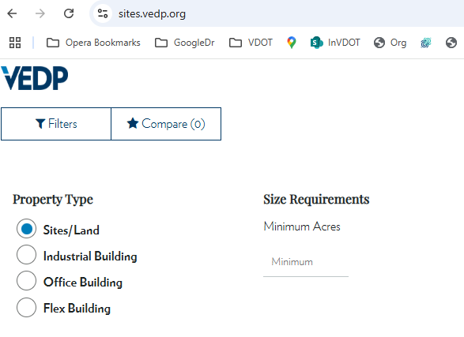
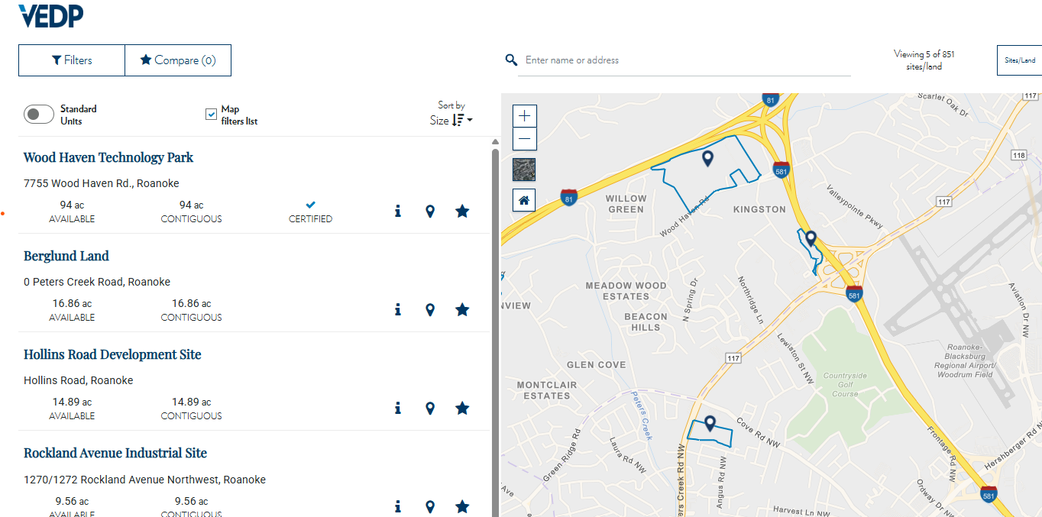


Scoring Questions
Project Support for Economic Development ED.1
Indicates VBRSP Tiered Site
Contact - Michelle Mende (MMende@vedp.org) if you need support or don’t see your site.

Slide 26
Scoring Questions
Project Support for Economic Development ED.1
Refer to SMART SCALE Technical Guide, Appendix E: Economic Development Measures
Determine Search Radius by Features of the Project (up to a 3-mile search)
Calculate Economic Impact Points using Historical Model
Jobs Creation normalize to 40 pts
CapEx normalize to 25 pts
Funding Points (Y/N) – 15 pts Grant Tracking Dashboard
Project Site Visits in Coordination with VEDP – normalized to 10pts by # of visits
Highest VBRSP Tier Site – 0 - 10pts Grant Tracking Dashboard
Calculate Final Measure

Slide 27
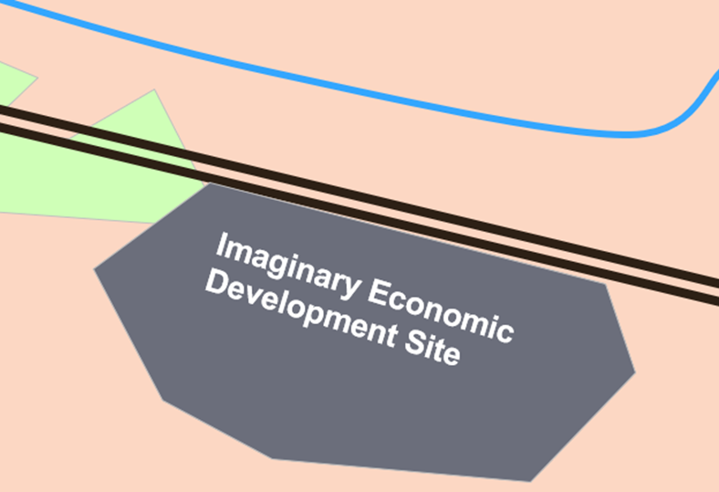
Scoring Questions
Project Support for Economic Development ED.1
The Historical Projects Model (HPM) is a tool to provide bulk estimates for the announced jobs and capital expenditure (CapEx) a property could generate if it were to receive an economic development project. These estimations are created by a linear regression model, which considers the size of the property and its geographic location. These figures represent the jobs and CapEx that have typically been associated with similar properties in the past.
Property Size (~ 60% of score)
Geographic Location (~40% of score)
~15% surrounding terrain - Developed/Forest/Swamp/)
Remaining ~20-25%
Industry Sector (Knowledge Work/Logistics/Manufacturing)
Wages for each industry sector w/in 45-minute drive
Potential Employees (workforce w/ in a 45-minute drive)
Educational pipeline – Student population and Research Universities within 20 miles
Metropolitan Statistical Areas (MSA) Classification
Access to Infrastructure – ports/airports within 30 miles
Utilize - https://onthemap.ces.census.gov

Slide 28
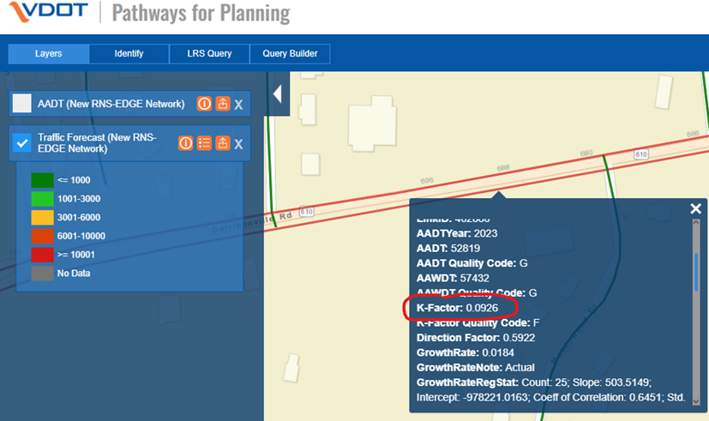
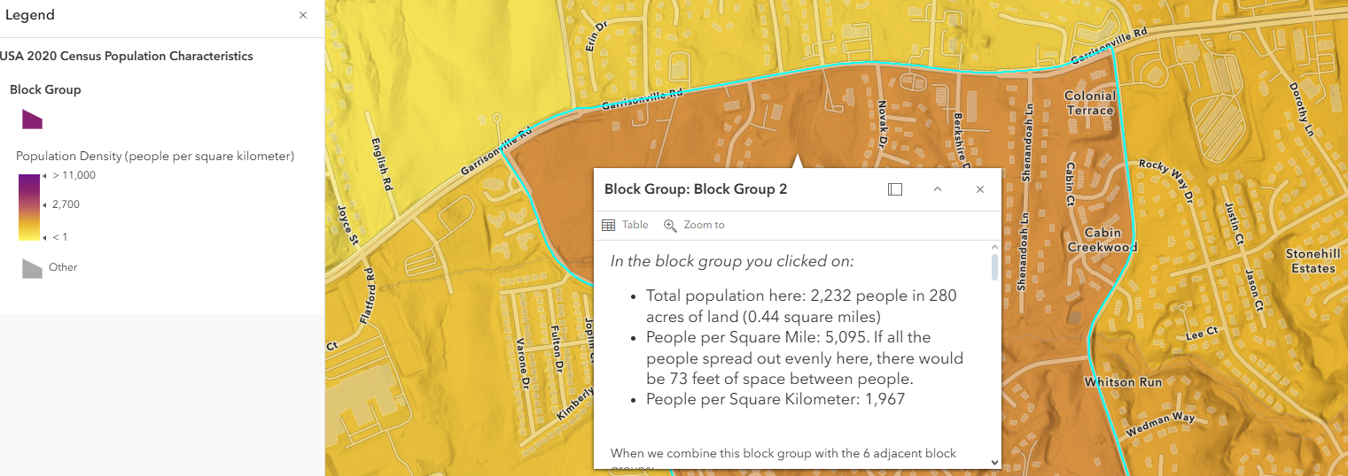
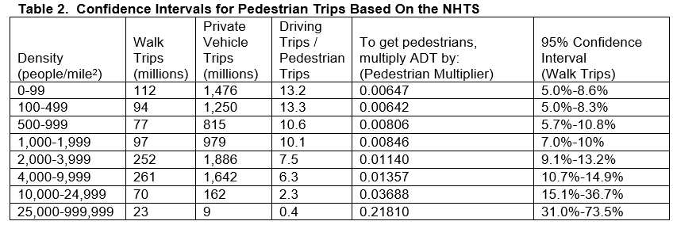
Scoring Questions
Pedestrian Scoring
Congestion Person Throughput C.1 – Non-SOV
Pedestrian - (AADT*k-factor) on the roadway directly adjacent and multiplying the result by a pedestrian multiplier
ArcGIS Online Map Population Density
Pedestrian Multiplier Table 5,095 people per square mile = Ped Multiplier of 0.01357
Traffic Forecast P4P
New Ped Users = 57,500*0.0926 *0.0137 = 73 person

